Slide 2
The Bible and Prophecy
Prophets were spokespeople for God.
Sometimes, their messages were about events that had not yet taken place.
God wanted His people to have confidence in His word (Deut. 18:21-22)
Prophesy confirms the truth of God’s Word!

Slide 3
Ezekiel’s Prophecy Against Tyre
Ezekiel started prophesying in 593BC among the exiles in Babylon.
Chapters 25-32 are prophecies about other nations, including Tyre (chs. 26-28)

Slide 4
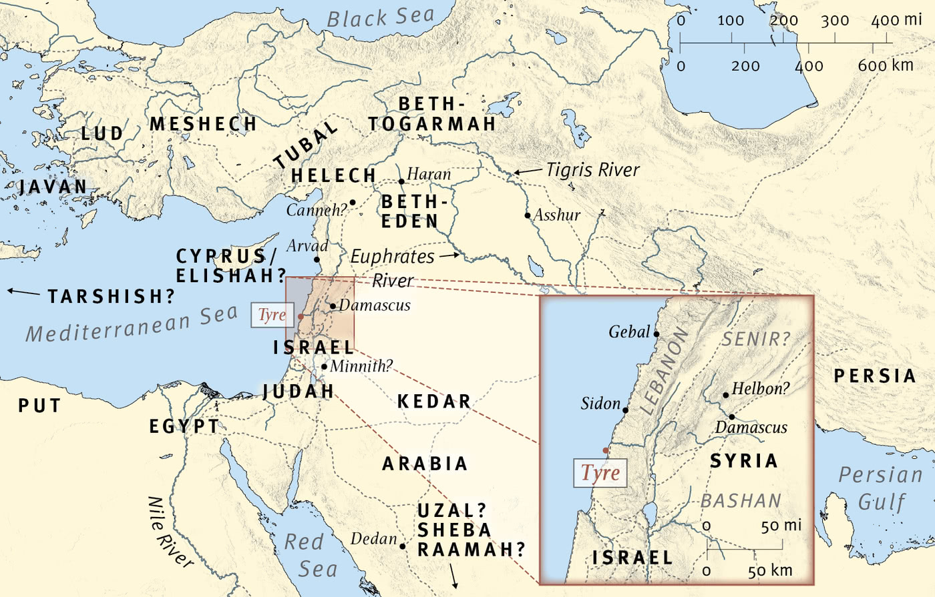
ESV.org

Slide 5
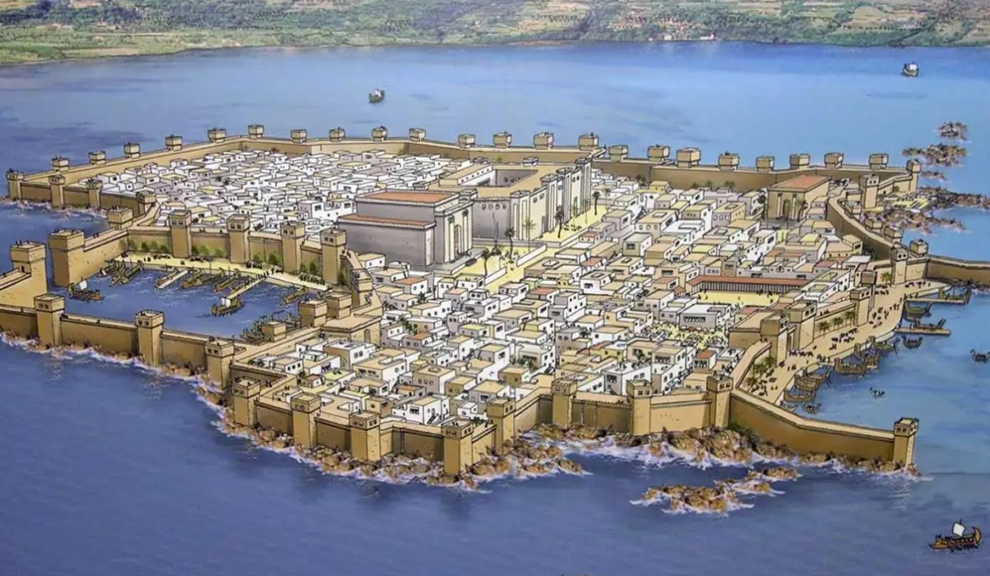
thecollector.com

Slide 6
The Pride of Tyre
Tyre was boastful about its military strength and economic prosperity (Ezk. 27:3; 28:2, 6-10).
God also took note of its attitude toward Jerusalem (Ezk. 26:2)

Slide 7
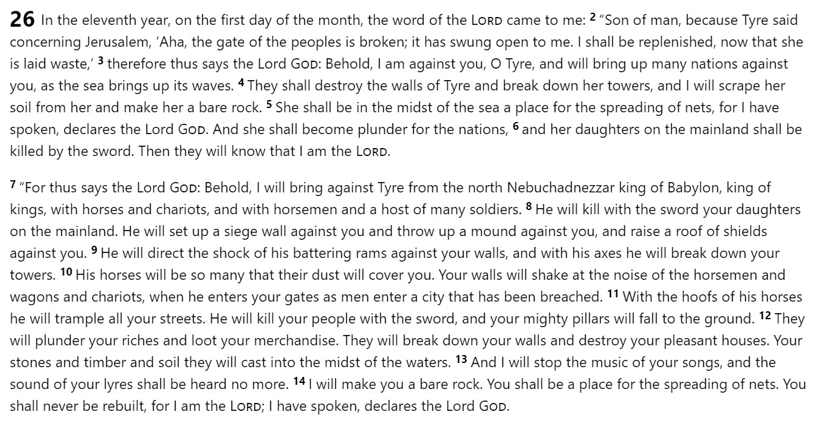
biblegateway.com

Slide 8
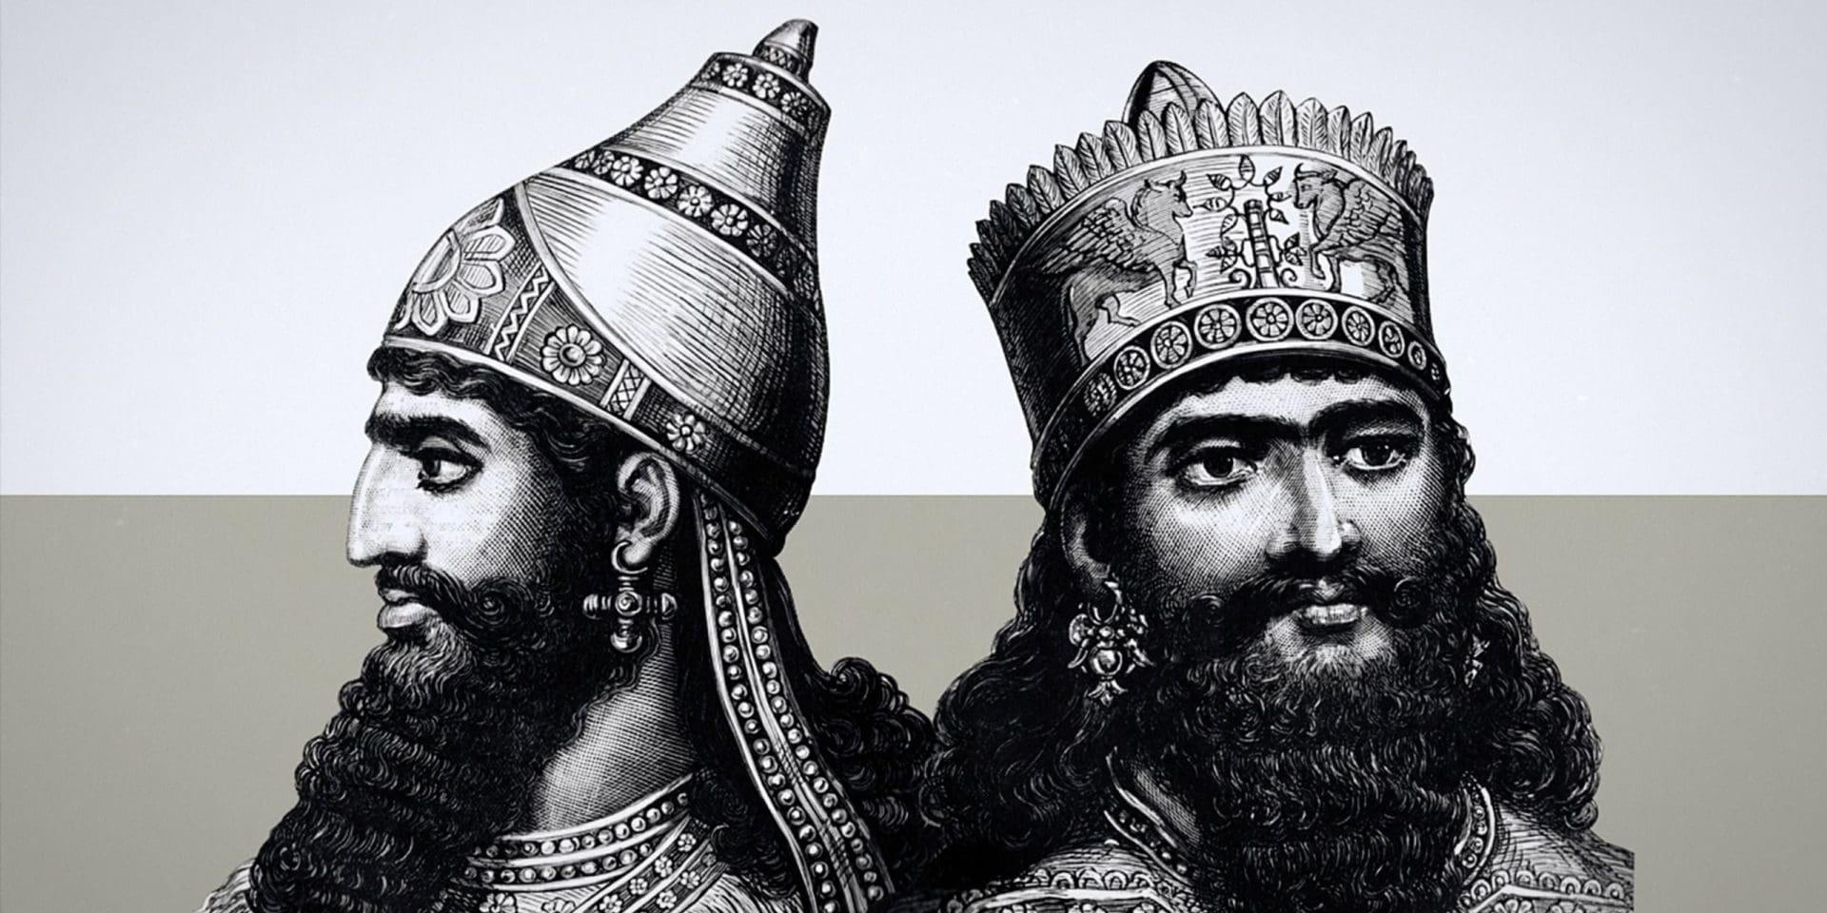
Ezekiel 29:17-18 – ¹⁷ In the twenty-seventh year, in the first month, on the first day of the month, the word of the Lord came to me: ¹⁸ “Son of man, Nebuchadnezzar king of Babylon made his army labor hard against Tyre. Every head was made bald, and every shoulder was rubbed bare, yet neither he nor his army got anything from Tyre to pay for the labor that he had performed against her.
https://biblediscoverytv.com/history/2023/nebuchadnezzar-ii/

Slide 9
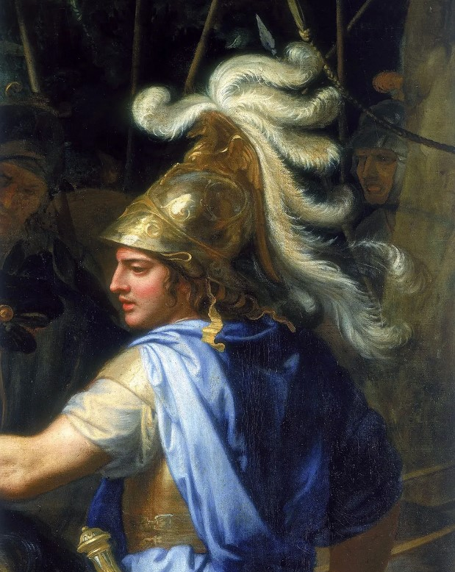
Detail from Alexander and Porus by Charles Le Brun
© Heritage Images—Hulton Fine Art Collection/Getty Images

Slide 10
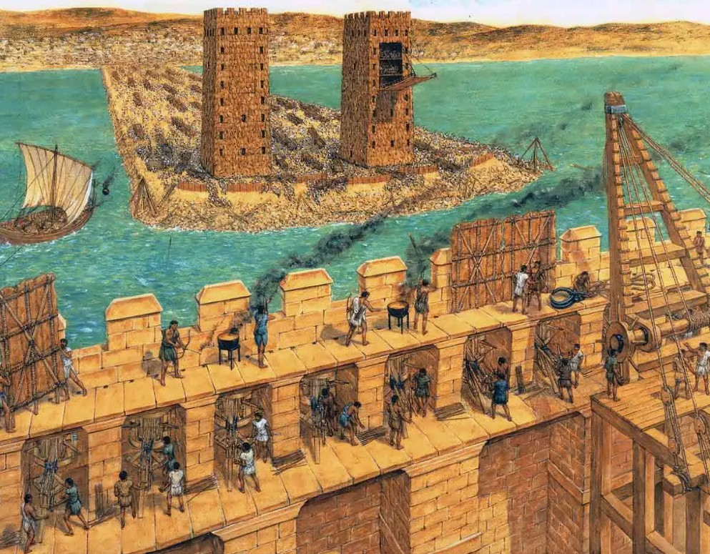
The Siege of Tyre by Duncan B. Campbell
Source: thecollector.com

Slide 11
"Alexander did far more against Tyre than Shalmaneser or Nebuchadnezzar had done. Not content with crushing her, he took care that she never should revive; for he founded Alexandria as her substitute, and changed forever the track of the commerce of the world." (Edward Creasy, Fifteen Decisive Battles of the World, ch. 4)

Slide 12
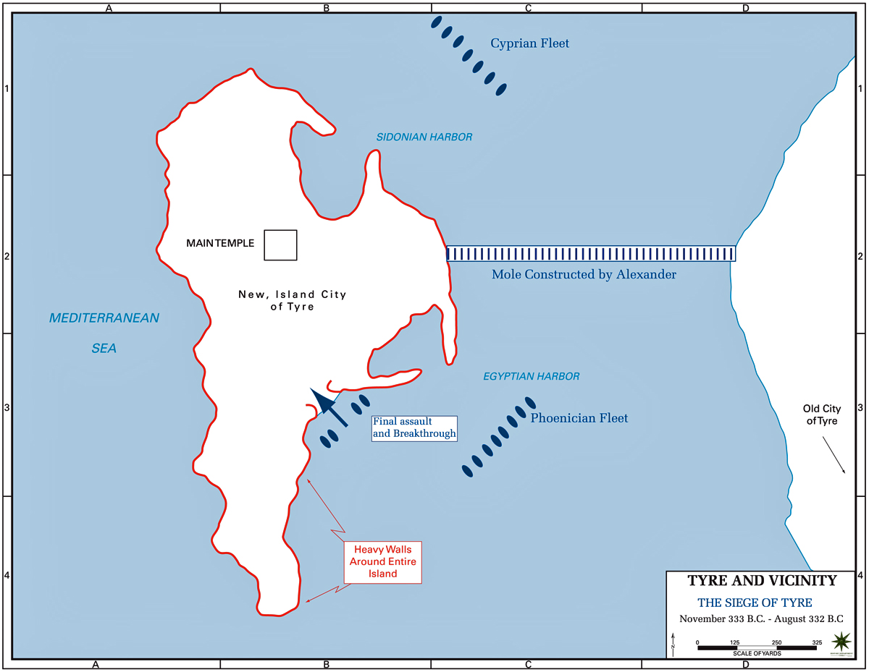
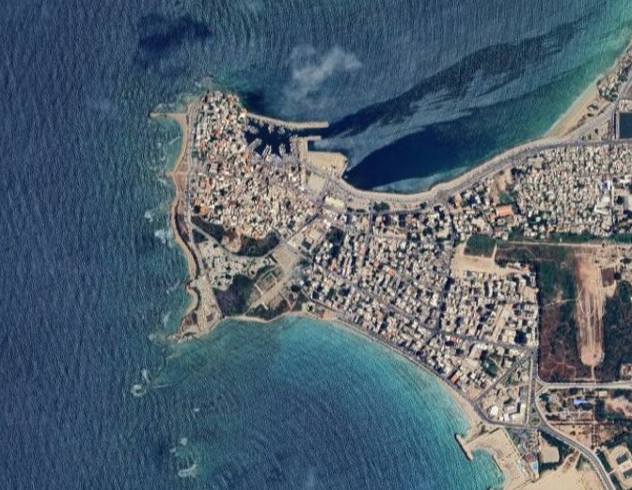
US Military Department of History
Google Earth

Slide 13
God’s Word Can be Trusted!
2 Peter 1:19-21 - ¹⁹ And we have the prophetic word more fully confirmed, to which you will do well to pay attention as to a lamp shining in a dark place, until the day dawns and the morning star rises in your hearts, ²⁰ knowing this first of all, that no prophecy of Scripture comes from someone's own interpretation. ²¹ For no prophecy was ever produced by the will of man, but men spoke from God as they were carried along by the Holy Spirit.

