Slide 1
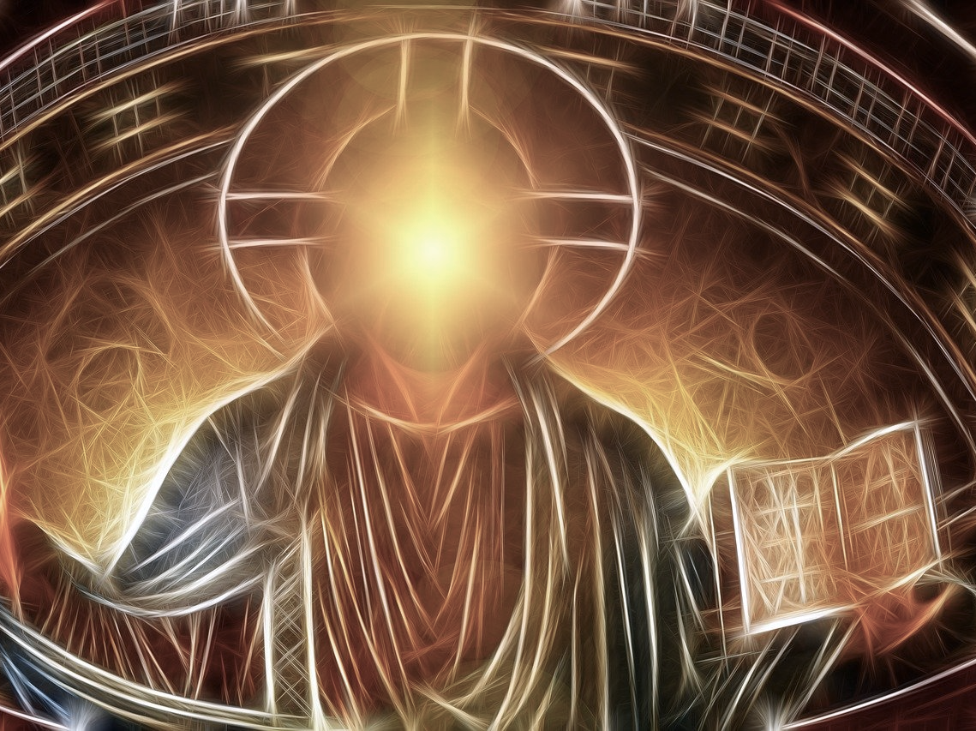
Partakers of The Divine Nature
2 Peter

Slide 2
2 Peter 1:3-4
“seeing that His divine power has granted to us everything pertaining to life and godliness, through the true knowledge of Him who called us by His own glory and excellence. For by these He has granted to us His precious and magnificent promises, so that by them you may become partakers of the divine nature, having escaped the corruption that is in the world by lust.” (2 Peter 1:3-4)
When we know Him, we will have the right attitude toward growth!
Think of that! We can...
Become partakers of the divine nature!
Escape the corruption in the world

Slide 3
2 Peter 1:5
“Now for this very reason also, applying all diligence, in your faith supply moral excellence, and in your moral excellence, knowledge,” (2 Peter 1:5)
Apply all diligence!
The word “supply” / “add” is an interesting one.
It was used to describe a patron of the arts who would provide for the chorus.
“We do not automatically become more virtuous as if God infused virtue into us intravenously; we need to make plans and expend effort.” - Peter H. Davids.

Slide 4
2 Peter 1:5
“Now for this very reason also, applying all diligence, in your faith supply moral excellence, and in your moral excellence, knowledge,” (2 Peter 1:5)
“In your faith...”
It is no accident that this list begins with faith and ends with love!
Faith in this context indicates trust in the promises of God.
“Moral excellence” is used of God.
1 Peter 2:9
2 Peter 1:3
We need aspire to this same moral excellence.

