Slide 1
Knowing God In Times Of Trouble
Nahum 1:1-8

Slide 2
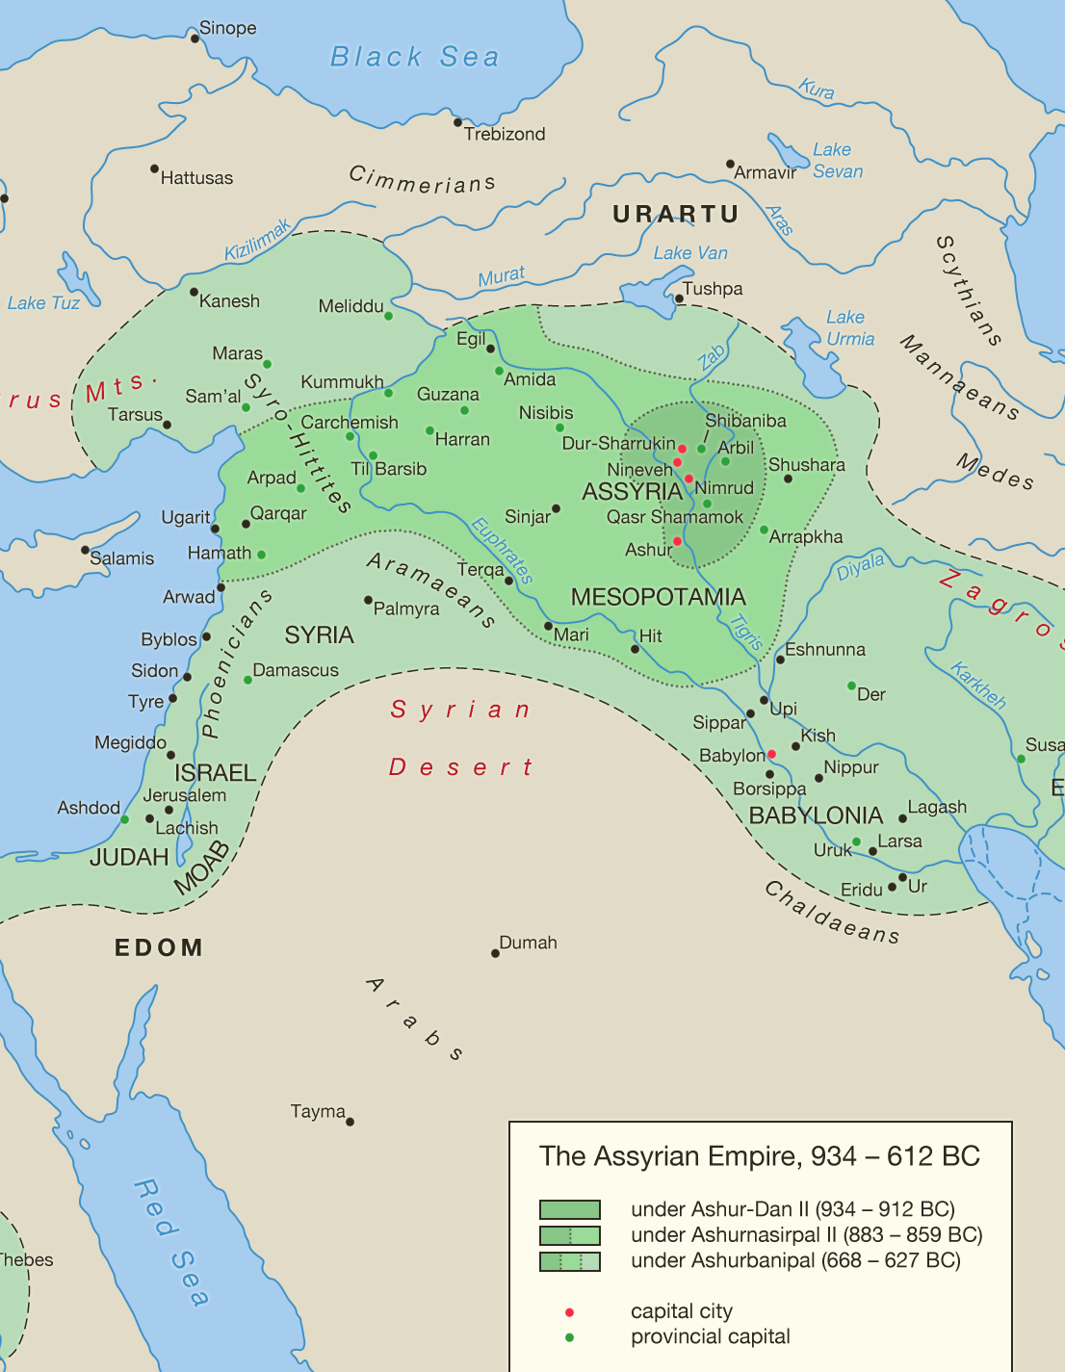
Background of Nahum
Assyria had afflicted Judah on and off for some time.
Hezekiah - 704 BC (2 Kings 18:13ff)
Manasseh ~ 650 BC (2 Chron. 33:11-13)
Nahum pronounced judgment on Assyria. It was written to give comfort to Judah.
Nahum 1:15
Nahum 2:2

Slide 3
“A jealous and avenging God is the LORD; The LORD is avenging and wrathful. The LORD takes vengeance on His adversaries, And He reserves wrath for His enemies. The LORD is slow to anger and great in power, And the LORD will by no means leave the guilty unpunished...”
REMEMBER WHO GOD IS!
NAHUM 1:2-3a
Compare Exodus 34:6-7; Numbers 14:17-19; Deuteronomy 5:9-10; Nehemiah 9:17; Psalm 86:15; 103:8-13; Jeremiah 32:17-18; Joel 2:13; Jonah 4:2; Micah 7:18; Daniel 9:4

Slide 4
“...In whirlwind and storm is His way, And clouds are the dust beneath His feet. He rebukes the sea and makes it dry; He dries up all the rivers. Bashan and Carmel wither; The blossoms of Lebanon wither. Mountains quake because of Him And the hills dissolve; Indeed the earth is upheaved by His presence, The world and all the inhabitants in it.”
REMEMBER WHAT GOD HAS DONE!
NAHUM 1:3b-6

Slide 5
“The LORD is good, A stronghold in the day of trouble, And He knows those who take refuge in Him. But with an overflowing flood He will make a complete end of its site, And will pursue His enemies into darkness.”
REMEMBER WHAT GOD WILL DO!
NAHUM 1:7-8

