Slide 2
Acts 17:22-31
Page in the pew Bible
Notes:
Hubble Ultra Deep Field Image shows the amount of sky that you would see if you were looking through a straw. This photo alone captured around 10,000 galaxies.

Slide 3
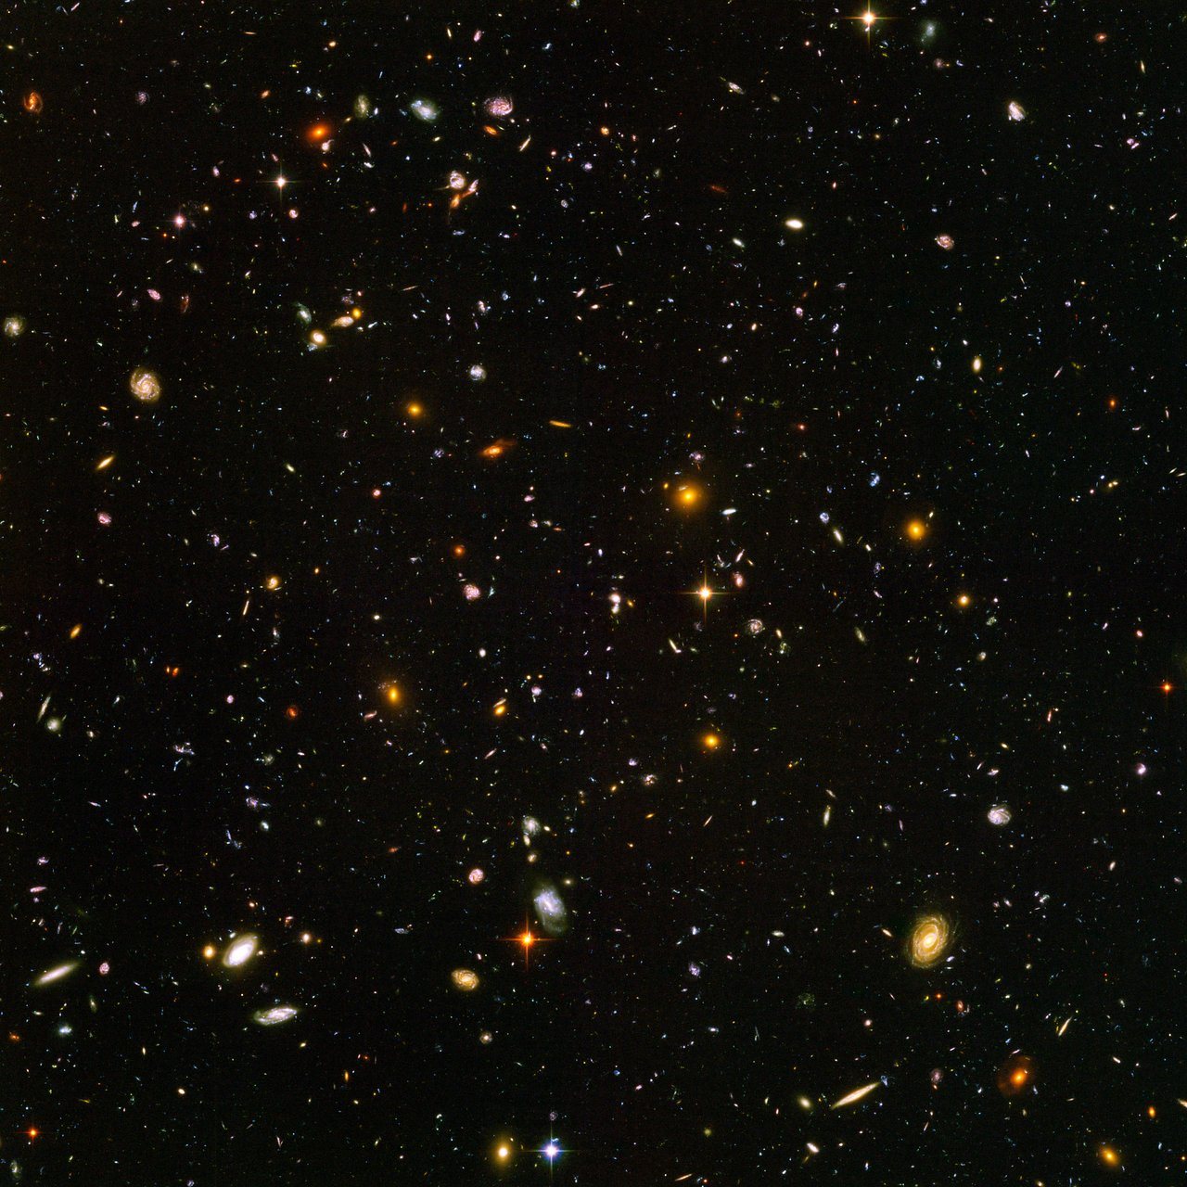
NASA, ESA, S. Beckwith (STScI), the HUDF Team
Notes:
Hubble Ultra Deep Field Image shows the amount of sky that you would see if you were looking through a straw. This photo alone captured around 10,000 galaxies.

Slide 4
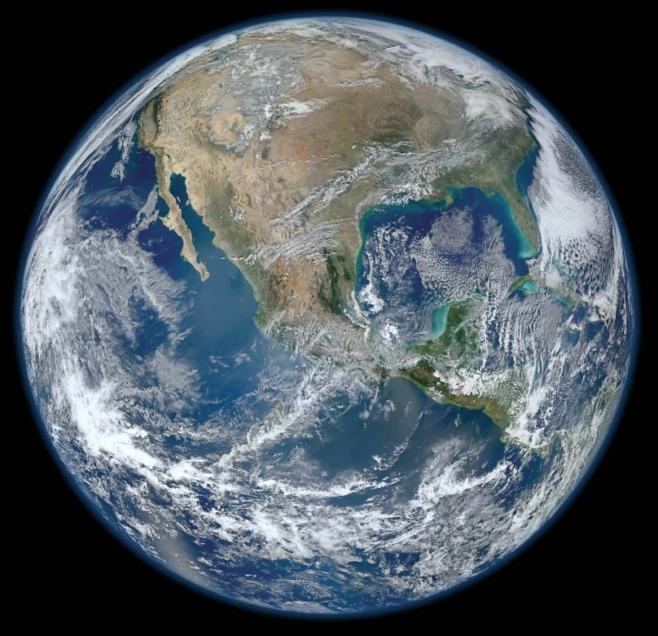
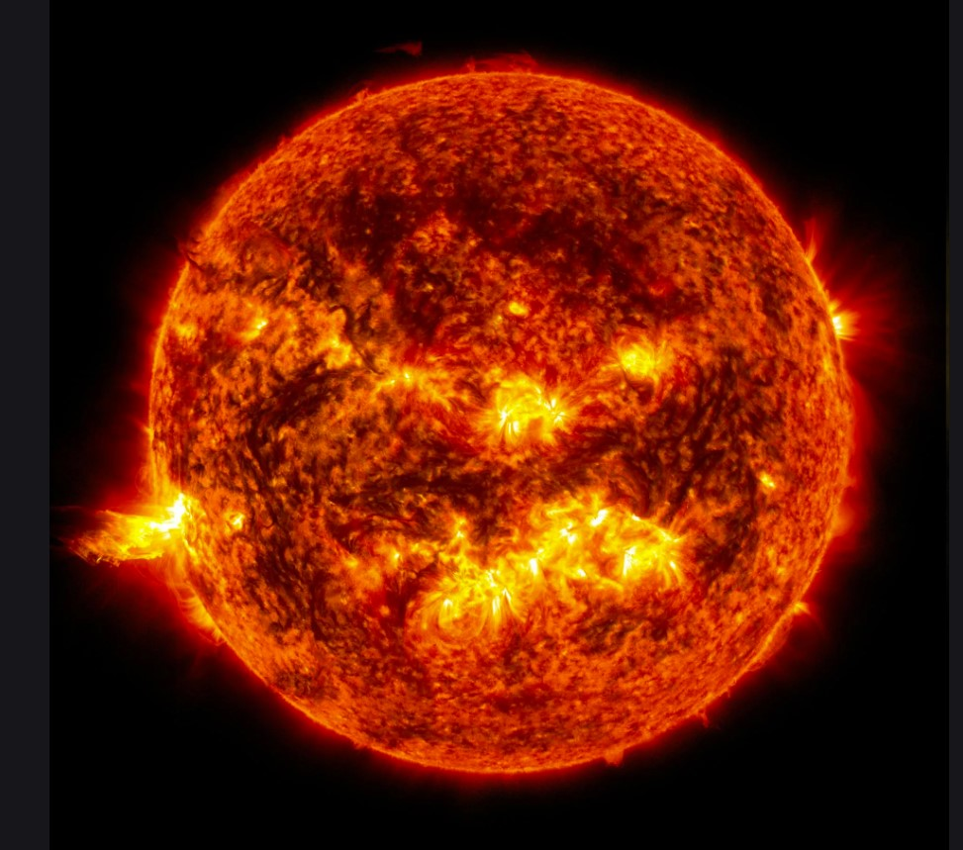
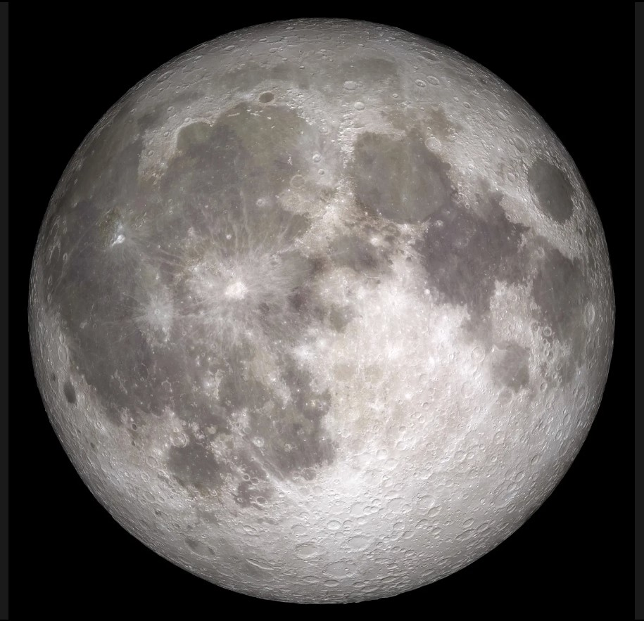
Photo Credits: NASA

Slide 5
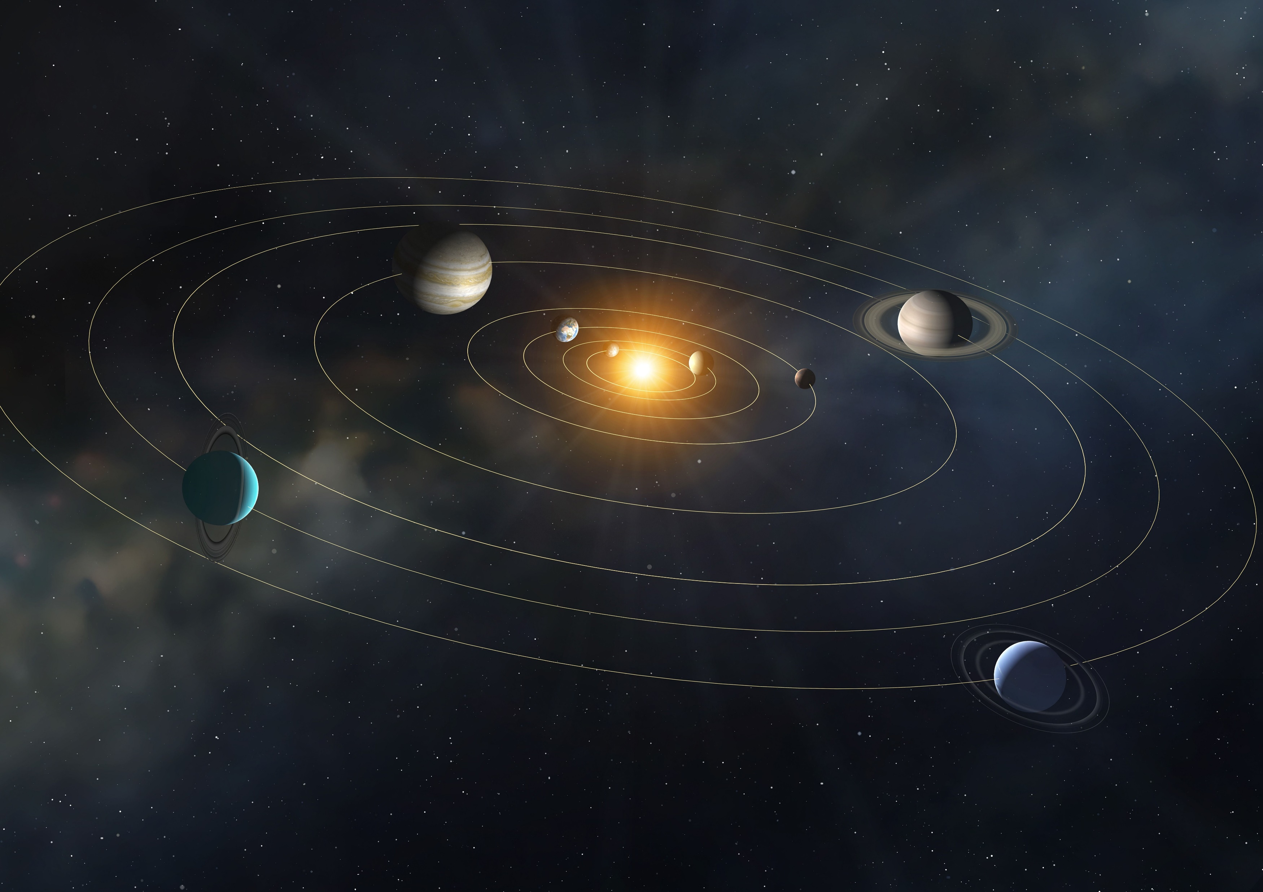
“This most beautiful system of the sun, planets, and comets, could only proceed from the counsel and dominion of an intelligent and powerful Being...”
-Isaac Newton,
Principia Mathematica
Mark Garlick / Science photo library // Getty Images

Slide 6
Credit: LEGO and brothers-brick.com

Slide 8
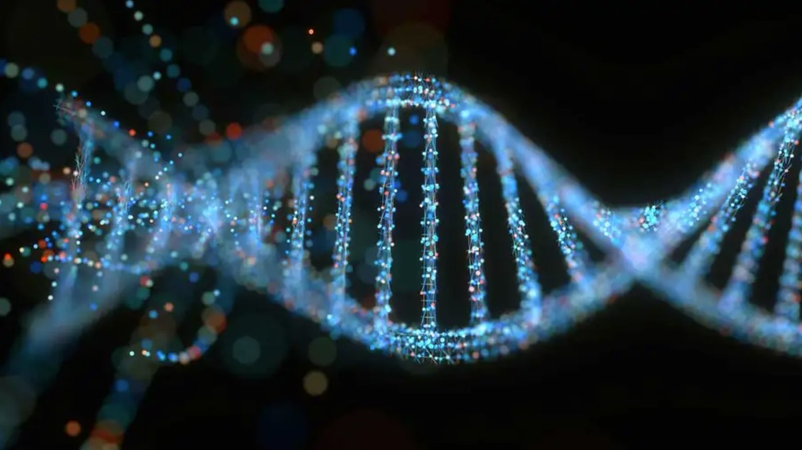
KTSDESIGN/SCIENCE PHOTO LIBRARY/Getty

Slide 9
census.gov

