Slide 1
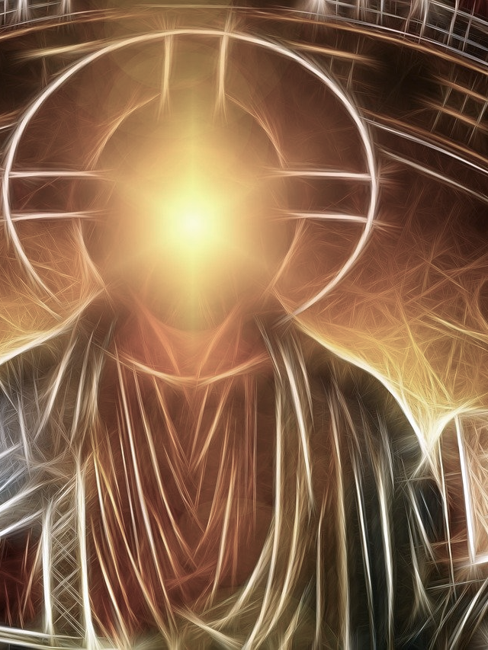
Partakers of The Divine Nature
2 Peter

Slide 2
Conformed To His Image
“until we all attain to the unity of the faith, and of the knowledge of the Son of God, to a mature man, to the measure of the stature which belongs to the fullness of Christ.” (Ephesians 4:13)
“For those whom He foreknew, He also predestined to become conformed to the image of His Son, so that He would be the firstborn among many brothers and sisters;” (Romans 8:29)
“I have been crucified with Christ; and it is no longer I who live, but Christ lives in me; and the life which I now live in the flesh I live by faith in the Son of God, who loved me and gave Himself up for me.” (Galatians 2:20)
“My children, with whom I am again in labor until Christ is formed in you—” (Galatians 4:19)
“Be imitators of me, just as I also am of Christ.” (1 Corinthians 11:1)

Slide 3
Introduction to 2 Peter
Authorship: Simon Peter, a bond-servant and apostle of Jesus Christ, To those who have received a faith of the same kind as ours, by the righteousness of our God and Savior, Jesus Christ:” (2 Peter 1:1)
Audience: “This is now, beloved, the second letter I am writing to you in which I am stirring up your sincere mind by way of reminder,” (2 Peter 3:1; cf. 1 Peter 1:1)
Date: “I consider it right, as long as I am in this earthly dwelling, to stir you up by way of reminder, knowing that the laying aside of my earthly dwelling is imminent, as also our Lord Jesus Christ has made clear to me.” (2 Peter 1:13-14)

Slide 4
Introduction to 2 Peter
Theme: “For by these He has granted to us His precious and magnificent promises, so that by them you may become partakers of the divine nature, having escaped the corruption that is in the world by lust.” (2 Peter 1:4)
“Since all these things are to be destroyed in this way, what sort of people ought you to be in holy conduct and godliness,” (2 Peter 3:11)
“Therefore, beloved, since you look for these things, be diligent to be found by Him in peace, spotless and blameless…” (2 Peter 3:14)
“...but grow in the grace and knowledge of our Lord and Savior Jesus Christ. To Him be the glory, both now and to the day of eternity. Amen.” (2 Peter 3:18)

Slide 5
2 Peter 1:1-2
“Simon Peter, a bond-servant and apostle of Jesus Christ, To those who have received a faith of the same kind as ours, by the righteousness of our God and Savior, Jesus Christ: Grace and peace be multiplied to you in the knowledge of God and of Jesus our Lord,”

Slide 6
2 Peter 1:3-4
“for His divine power has granted to us everything pertaining to life and godliness, through the true knowledge of Him who called us by His own glory and excellence. Through these He has granted to us His precious and magnificent promises, so that by them you may become partakers of the divine nature, having escaped the corruption that is in the world on account of lust.” (2 Peter 1:3-4)

