Slide 1
1-7-24 Elder address
* Elder initiative (Troy)
* Where are we going (Sid)
* New Year Resolutions (Brent)

Slide 2
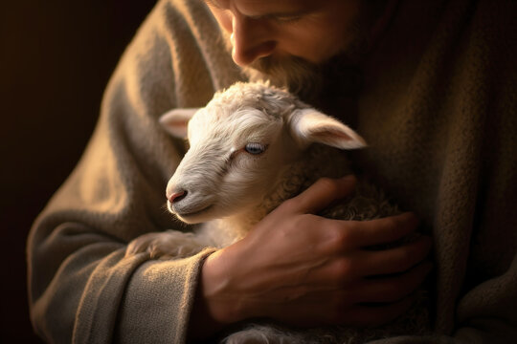
Psa 23:1-2
Jer 23:1-4
Jn 10:14-15
1 Pet 5:1-3

Slide 3
What’s Ahead?

Slide 4
Edification / Evangelism
Our Meetings:
2024:
Spring: Wes Brown, June 9-14
Fall: Marshall McDaniel, Sept. 29– Oct. 4
2025:
Evangelism: Rennie Frazier, Feb 28– March 2
Spring: The McDaniel’s, June 22-27
Fall: Stephen Russell, Sept. 28 – Oct. 3

Slide 5
Our Goals:
More: 2 Peter 1:8-10
More Evangelistic: Acts 8:4
More Spiritual:
John 4:24
Romans 8:14
John 14:26
More spiritual means more biblical!
More Connected / Involved - Brent

Slide 6
New Year’s Resolutions:
Prov 21:5 Heb 5:12-6:3 2Pet 1:5-7

Slide 7
New Year’s Resolution for Each of Us : Being Assembled & Being Involved

Slide 8
Let’s resolve to spiritually mature in …
1.) assembling with saints (Heb 10:25) AND
2.) being knit (connected / involved – in work) together (Col 2:2; Eph 4:16)
1. Not attending services at all; not connected to brethren (or the work)
4. Attending all services regularly; connected to brethren (seeing benefit to my brethren) & the work
We can typically fall in
1 of 5 categories in terms
of where we are on the spectrum
of assembling & being engaged..
2. Attending services from time to time (for my own benefit?); not connected to brethren (or the work)
5. Attending all services regularly; connected to brethren & the work & encouraging others to attend & be connected!
3. Attending services on a more regular basis (maybe still seeing only benefit for me); very little connectivity to brethren or the work

Slide 9
Spiritual Maturity Growth Ladder for …
1.) assembling with saints (Heb 10:25) AND
2.) being knit (connected / involved – in work) together (Col 2:2; Eph 4:16)
Attending all services regularly; connected to brethren & the work & encouraging others to attend & be connected!
Attending all services regularly; connected to brethren (seeing benefit to my brethren) & the work
Attending services on a more regular basis (maybe still seeing only benefit for me); very little connectivity to brethren or the work
Attending services from time to time (for my own benefit?); not connected to brethren (or the work)
Two Qs for each of our members :
(1) Where am I and my family
on this ‘attendance’ and ‘being
Knitted together’ spiritual maturity
Ladder?
(2) Where do I NEED to be?
Not attending services at all; not connected to brethren (or the work)

