Slide 1
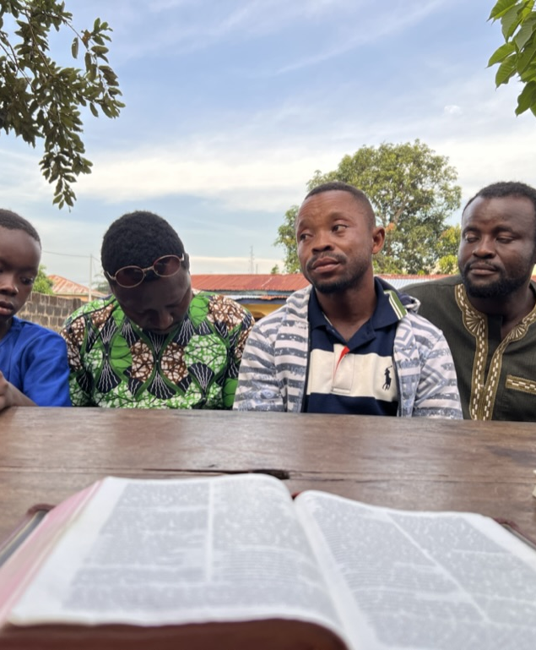
Sierra Leone 2023
“When they had arrived and gathered the church together, they began to report all things that God had done with them and how He had opened a door of faith to the Gentiles.” (Acts 14:27)

Slide 2
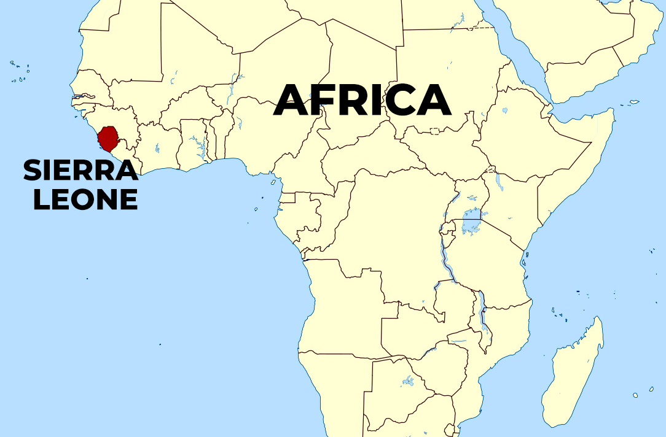
Population: 8.9 Million

Slide 3
“...my brother and fellow worker and fellow soldier...” (Philippians 2:25)

Slide 4
The Work in Kailahun
Population: 30,411
Capital of the Kailahun district.
We spent the first two weeks here.

Slide 5
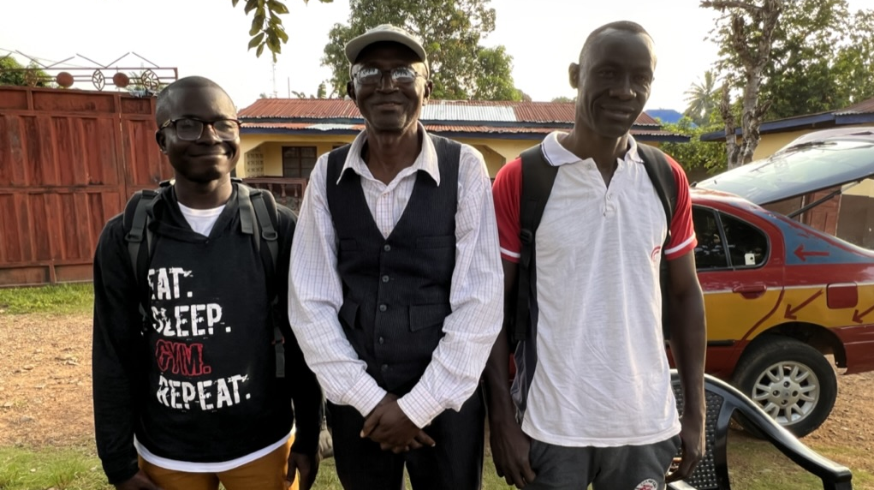
The Work in Kailahun: Evangelism

Slide 6
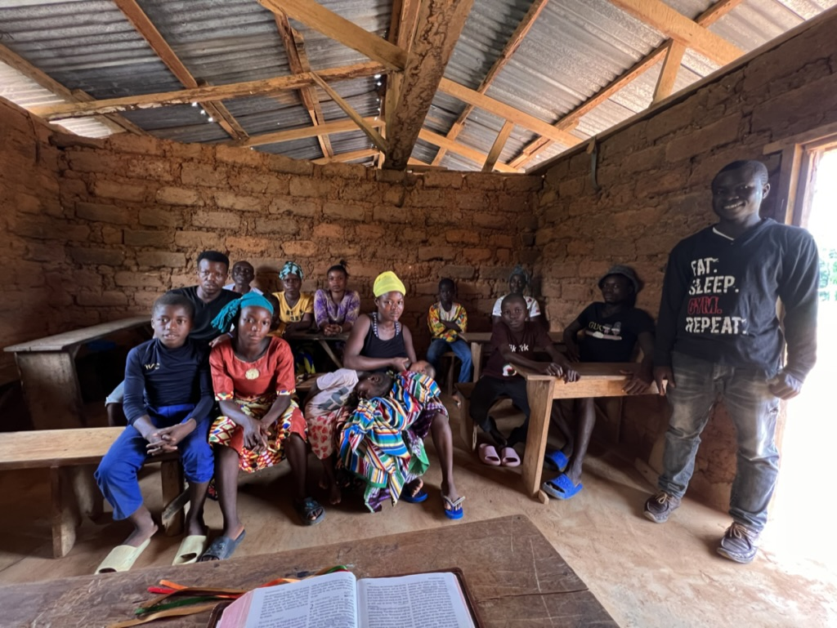
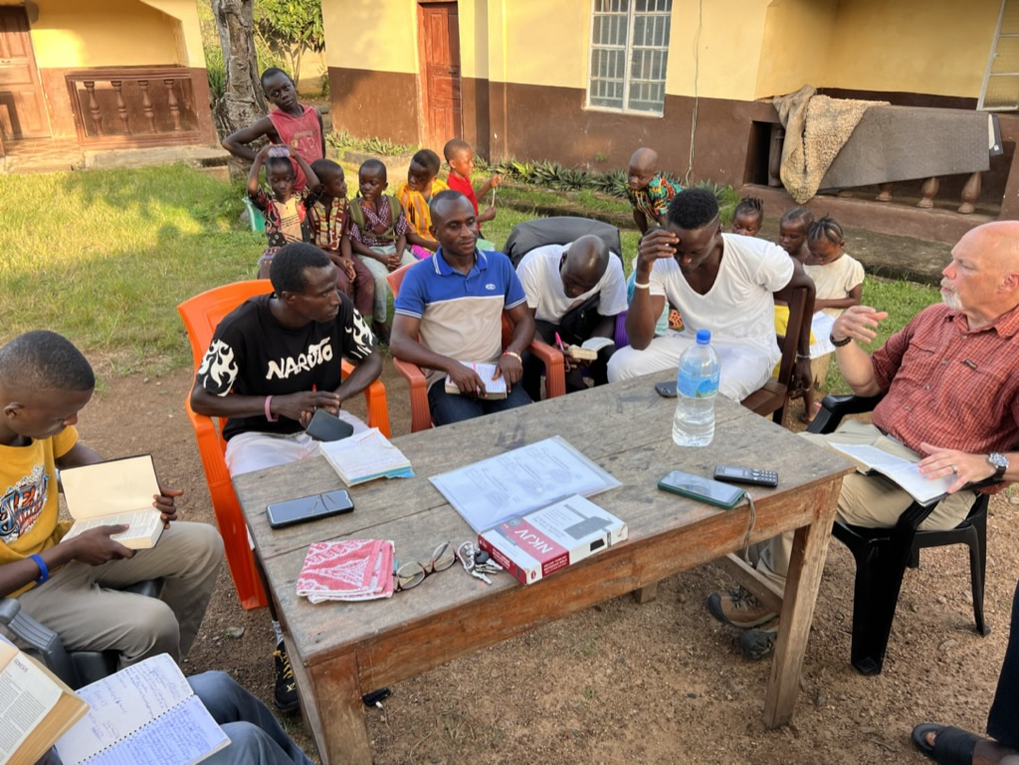
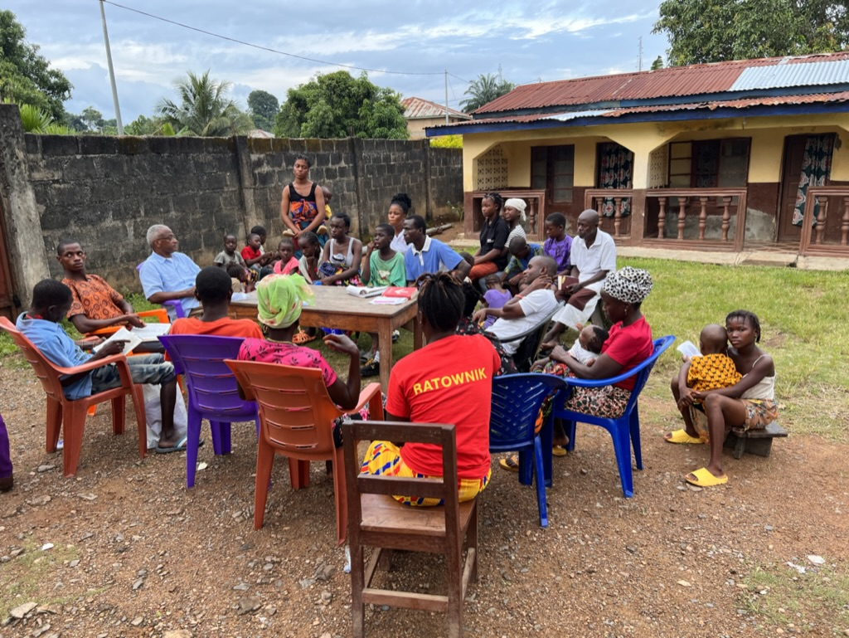
The Work in Kailahun: Evangelism
“So then neither the one who plants nor the one who waters is anything, but God who causes the growth.” (1 Corinthians 3:7)

Slide 7
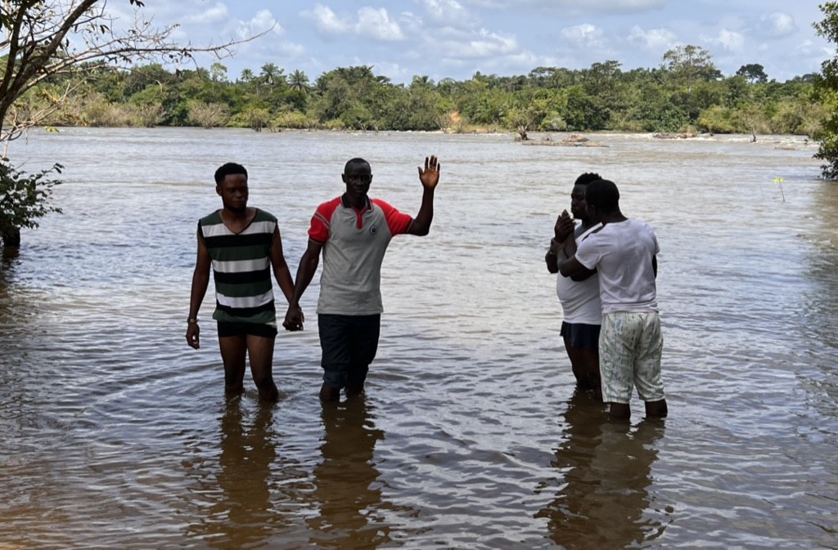
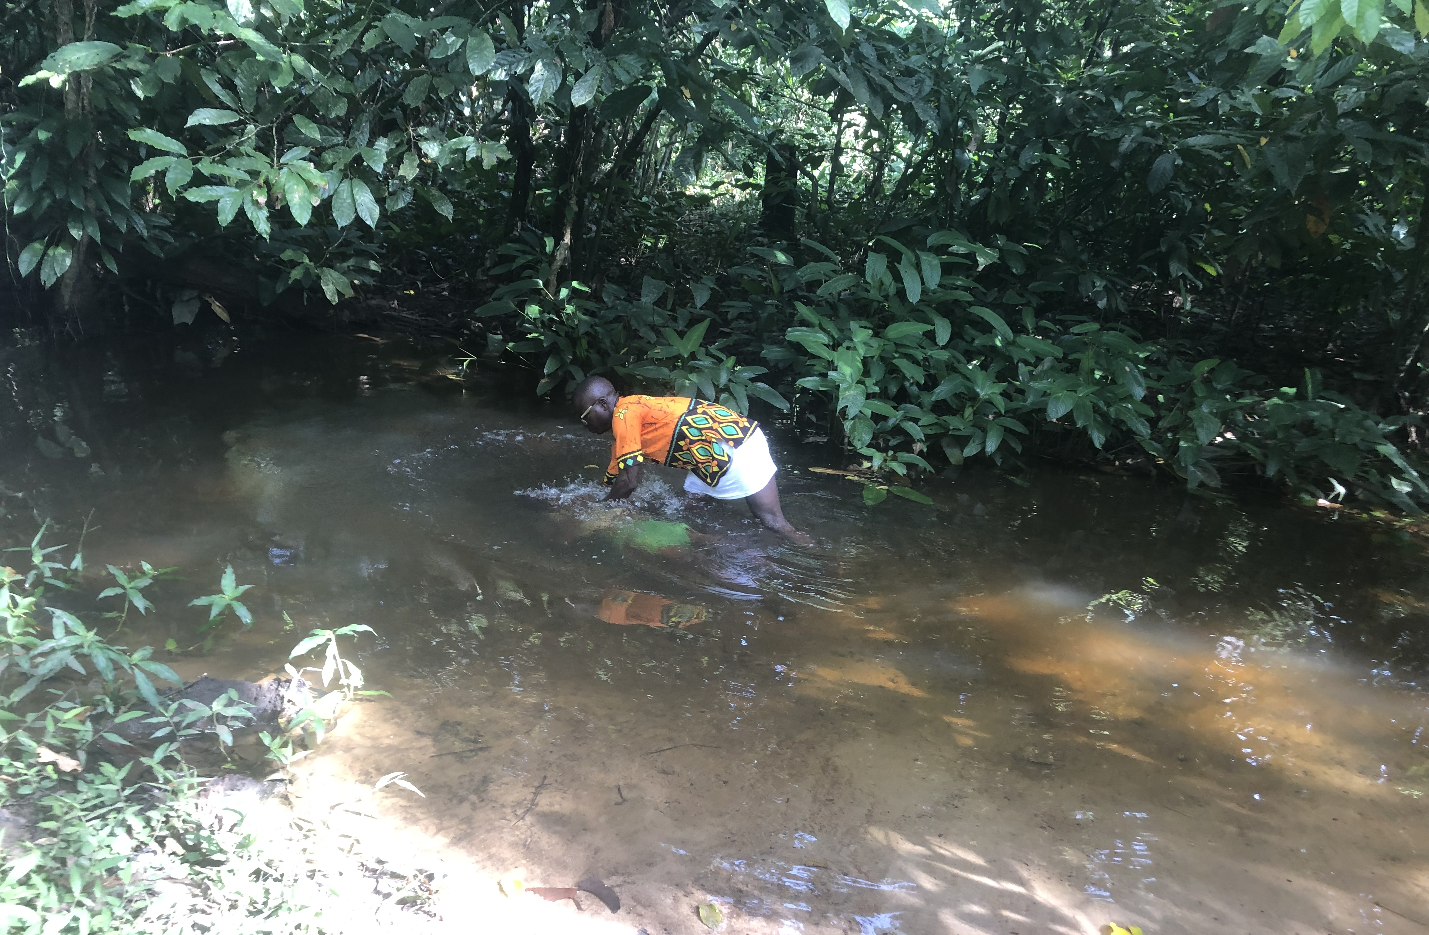
The Work in Kailahun: Evangelism

Slide 8
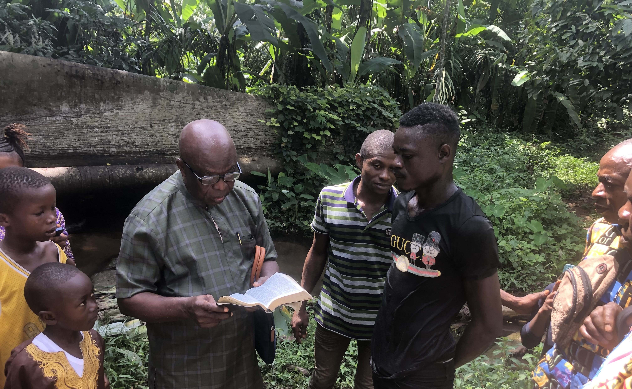
The Work in Kailahun: Evangelism

Slide 9
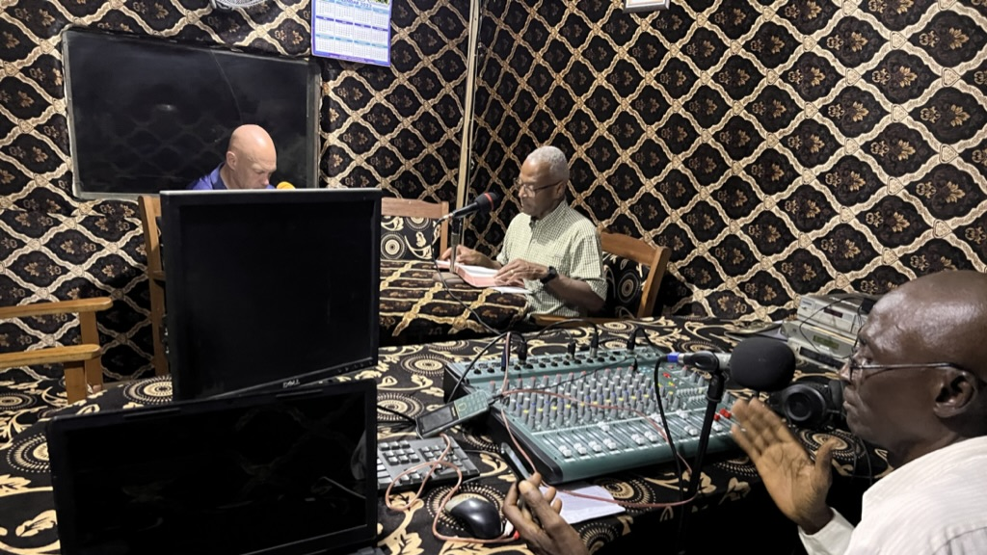
The Work in Kailahun: Radio

Slide 10
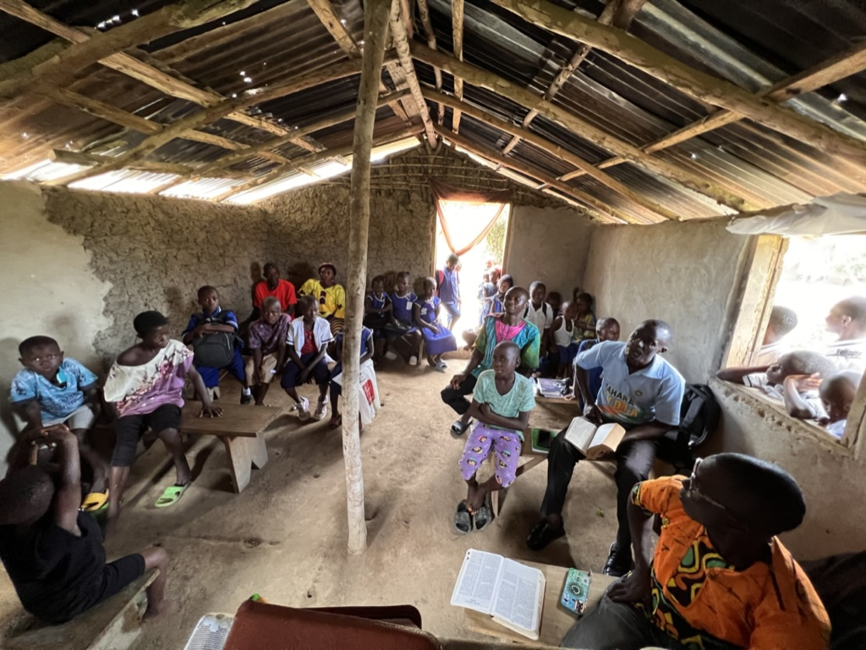
The Work in Kailahun: Edification

Slide 11
The Work in Bo
Population: 233,684
Second largest city in Sierra Leone
There are two American families living here

Slide 12
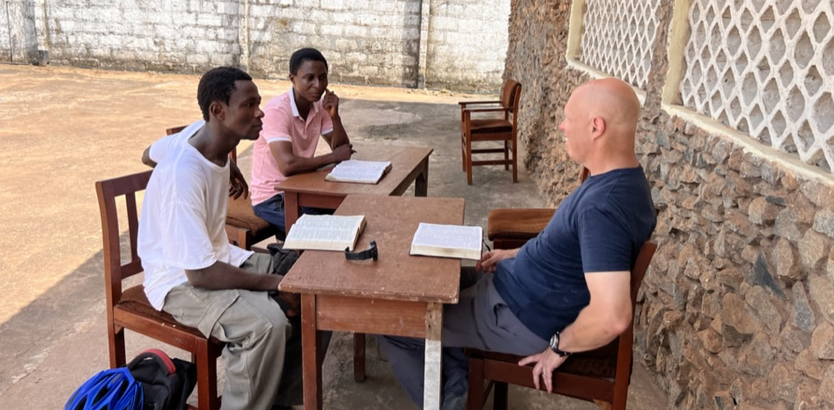
The Work in Bo: Edification

Slide 13
The Work in Njala
Village Northwest of Bo.
Home of Njala University
Home of Abraham Charles

Slide 14
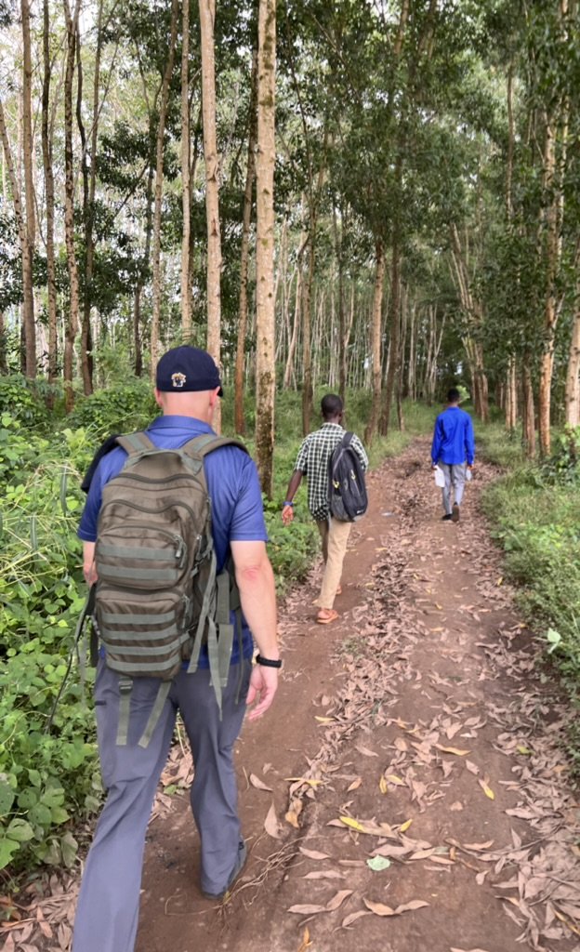
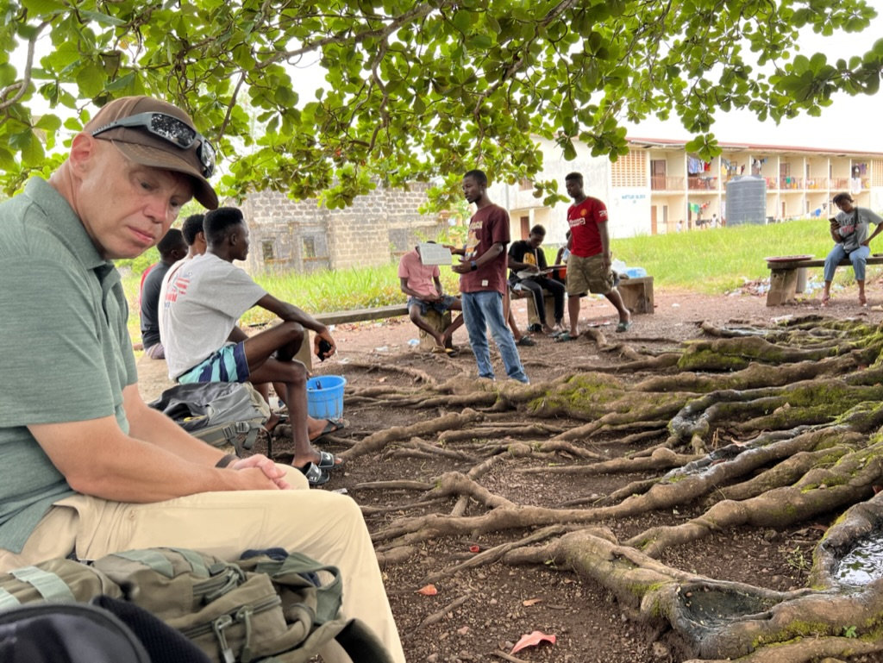
The Work in Njala

Slide 15
