Slide 1
Your Word I Have Treasured In My Heart!
A Call To Read God’s Word

Slide 2
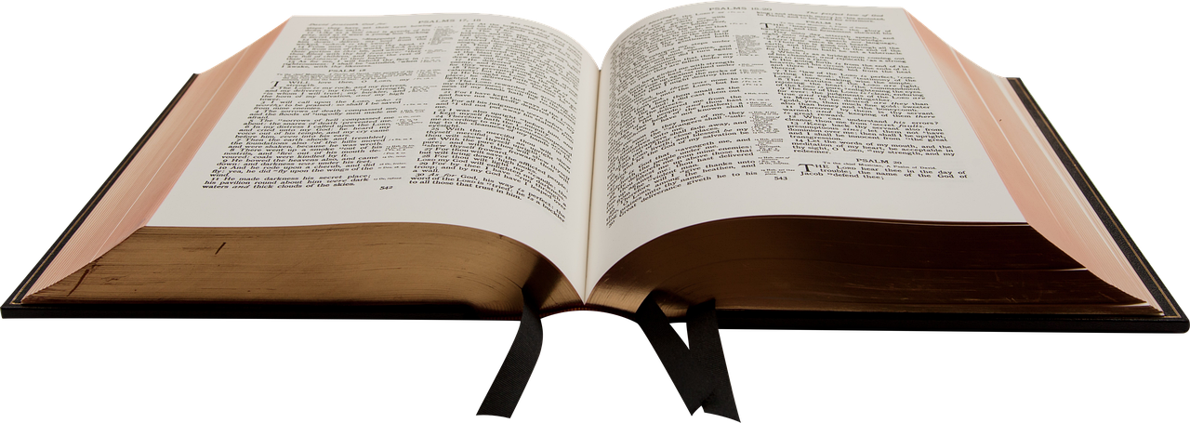
God’s Tool To Transform
Be transformed by the renewing of your mind. (Romans 12:2)
What is the means of this transformation?
Nehemiah 8:1-3, 9; 9:2-3
Romans 1:16; 1 Peter 1:23; James 1:18

Slide 3
God’s Tool To Transform
Be transformed by the renewing of your mind. (Romans 12:2)
What is the means of this transformation?
Nehemiah 8:1-3, 9; 9:2-3
Romans 1:16; 1 Peter 1:23; James 1:18
What is the purpose of this transformation?
We become a source of blessing!
We become leaders. (Matthew 5:13-16)

Slide 4
Leaders Are Readers!
This was true in Israel.
Joshua 1:7-8
Deuteronomy 17:18-20
Ezra 7:10

Slide 5
Leaders Are Readers!
This was true in Israel.
Joshua 1:7-8
Deuteronomy 17:18-20
Ezra 7:10
It is true in the church.
1 Timothy 4:13; 2 Timothy 2:2, 15
1 Timothy 3:2; Titus 1:9

Slide 6
The Bible Reading Schedules
One Year Bible Reading Schedule
Who is this for? – It is for those who need to develop the discipline of daily Bible reading.
There are 3 “make up” days.
It will take about 1% of your day!

Slide 7
The Bible Reading Schedules
One Year Bible Reading Schedule
Who is this for? – It is for those who need to develop the discipline of daily Bible reading.
There are 3 “make up” days.
It will take about 1% of your day!
Twice In One Year Bible Reading Schedule
Who is this for? – It is for those who want to dig deeper.
There are 6 “make up” days.
This will take 2-3% of your day.

