Slide 1
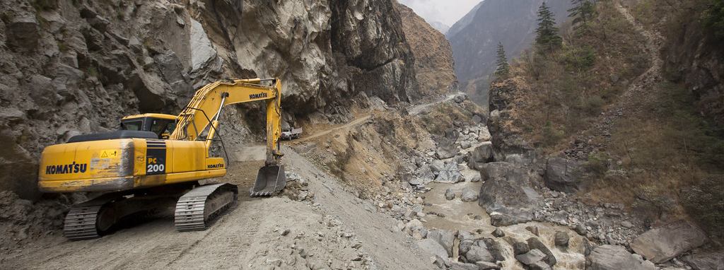
God’s Highway
Isaiah 40:3-5
East End – 19 November 2023
This Photo by Unknown Author is licensed under CC BY-SA-NC

Slide 2
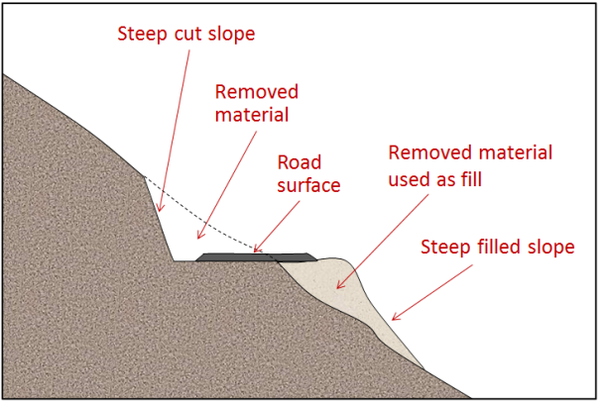
God has Built a Highway
Starting with a straight barren path
Low parts of the road are filled in with soil, rock, etc
High parts are cut down
A smooth road is made by straightening out the crooked path
This Photo by Unknown Author is licensed under CC BY

Slide 3
Characteristics of the Highway
ISAIAH 35:8-10
Way of Holiness – 1 Peter 2:9
Unclean Shall Not Pass Over It
Matthew 7:13-14, Rom 6:12-14

Slide 4
Characteristics of the Highway
ISAIAH 35:8-10
For the Wayfaring Man – 1 Peter 2:24-25
Fools shall not Err Therein
James 1:5-6

Slide 5
Characteristics of the Highway
ISAIAH 35:8-10
No Lion or Ravenous Beast
1 Peter 3:12-13, 2 Peter 5:8-9, Matthew 7:15
Acts 20:29

Slide 6
Characteristics of the Highway
ISAIAH 35:8-10
Redeemed Shall Walk There
Ransomed of the Lord Shall Walk There
1 Peter 1:18-19

Slide 7
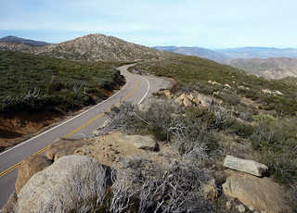
The Church is Called the Way Acts 9:2
GET IN THE WAY
HEAR – Rom 1:16-17
BELIEVE – John 3:16
REPENT – Acts 4:
BE BAPTIZED – Acts 2:38
WALK IN THE WAY – Matt 6:13-14
This Photo by Unknown Author is licensed under CC BY-NC

