Slide 1
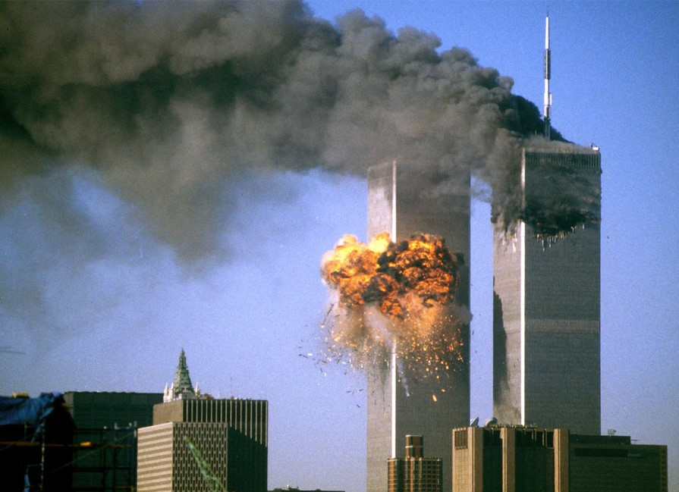
Reuters/Sean Adair
Tunnel to Towers Foundation

Slide 3
Philippians 2:1-8
Page 980 in pew Bible

Slide 4
Jesus came as God (v. 6)
He is the form of God
He is the whole fullness of Deity (Col. 2:9)
He is the Creator and Sustainer (Col. 1:15-17)
Jesus is the Word “who was God” (Jn. 1:1-14)

Slide 5
Jesus came as God (v. 6)
Willingly left heaven’s privileges (v. 6)
Walked away from perfection to enter an imperfect world.
God came to dwell among a broken and lost humanity!
He is “God with us” (Matt. 1:23)

Slide 6
Jesus came to Serve (v. 7)
Jesus didn’t set aside His deity, but added humanity
He has walked in our shoes! (Heb. 4:15)
Came to serve, not to be served (Matt. 20:28)
Seen by His miracles, teaching, giving of time, etc… (Matt. 5-7; Mark 5; 10:46-52)

Slide 7
Jesus came to Serve (v. 7)
We are to have the same attitude of service as Jesus (Jn. 13:14-15)
Among all people (Gal. 6:10)

Slide 8
Jesus came to Sacrifice (v. 8)
The ultimate act of service
Heaven’s plan from the beginning (1 Pet. 1:20-21)
The fulfillment of the sacrificial system (Heb. 9:11-14)
Animal sacrifices foreshadowed the final sacrifice of Jesus

Slide 9
Jesus came to Save (v. 8)
The meaning of the cross
God sacrificed for you!
His life was the payment for our sins (Matt. 20:28)
He gave us spiritual life!
Something we could not give ourselves (Eph. 2:8-9)

Slide 10
How do I respond to Jesus?
Acts 2:37-39
³⁷ Now when they heard this they were cut to the heart, and said to Peter and the rest of the apostles, “Brothers, what shall we do?” ³⁸ And Peter said to them, “Repent and be baptized every one of you in the name of Jesus Christ for the forgiveness of your sins, and you will receive the gift of the Holy Spirit. ³⁹ For the promise is for you and for your children and for all who are far off, everyone whom the Lord our God calls to himself.”

