Slide 2
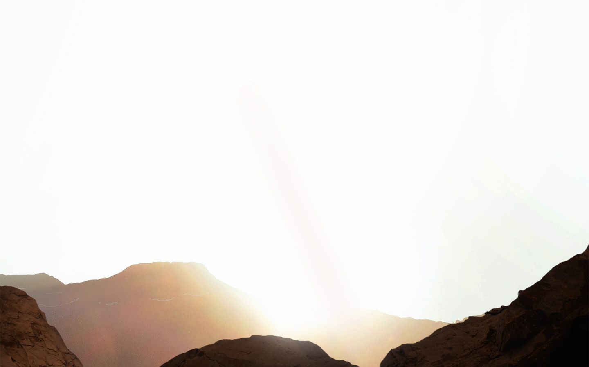
Psalm 146
Page 525 in the pew Bible

Slide 3
An Introduction to Psalm 146
Background and author are unknown
Located in Book Five of the Psalms (Ps. 107-150)
Contains Davidic Psalms (108-110, 138-145), psalms of ascent (120-134) and the Hallelujah psalms (146-150)

Slide 4
An Introduction to Psalm 146
The first of the “Hallelujah Psalms” (Psalms 146-150)
Hallelujah = Praise Yah (Praise the Lord)
Each of these psalms begin and end with “Praise the Lord!”

Slide 5
A Determination to Praise (1-2)
Opening stanza sets the tone for the Psalm
“Praise” is mentioned four times
Each time the praise is directed toward God
General invitation to collective praise (1a)
Similar to Ps. 33:1-3
Determination that the psalmist will praise (1b-2)

Slide 6
A Determination to Praise (1-2)
Opening stanza sets the tone for the Psalm
“Praise” is mentioned four times
General invitation to collective praise (1a)
Similar to Ps. 33:1-3
Determination that the psalmist will praise (1b-2)
Praise with his entire being!

Slide 7
A Determination to Praise (1-2)
Our purpose is to praise God! (Ps. 86:12; Eph. 1:11-14)
True praise manifests in our actions and at all times.
Shadrach, Meshach, and Abednego (Dan. 3)
Stephen (Acts 7)
Paul and Silas (Acts 16)

Slide 8
Trust Not in Mortal Man (3-4)
It’s easy to place our trust in princes (people of influence)
teachers, elders, innovators, influencers, politicians, etc…
Man is prone to disappoint
Man is destined to die (Heb. 9:27)

Slide 9
Trust in the Immortal God! (5-9)
God is our help and our hope (5)
Psalms often highlight the psalmist’s hope in God despite their difficult circumstances.
Four reasons God is our help and hope:
The God of creation (6a)
The God of faithfulness (6b)
The God of justice (7a)
The God of provision (7b)

Slide 10
The Lord sets the prisoners free;
⁸ the Lord opens the eyes of the blind.
The Lord lifts up those who are bowed down;
the Lord loves the righteous.
⁹ The Lord watches over the sojourners;
he upholds the widow and the fatherless,
but the way of the wicked he brings to ruin.

Slide 11
God’s Graces (7b-9)
The Lord restores those in spiritual need!
Jesus is “The Lord” of vv. 7b-9 (Matt. 11:4; Is. 61:1-3)
See also Matt. 9:27-30; 13:43; 20:34; 21:12; 25:46; Lk. 7:12-15; 13:11-13; 18:35-43; Jn. 9:1-7, etc…

Slide 12
Concluding Confidence (10)
We can be confident that, unlike mortal men, our God IS and will ALWAYS be.
God is worthy to be praised!

