Slide 1
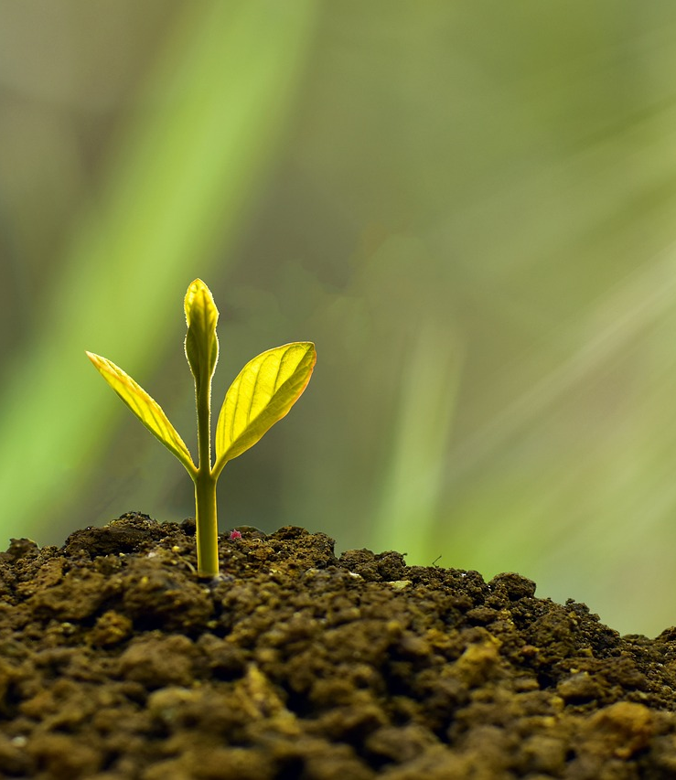
Grow
2 Peter 3:18

Slide 2
Growth is grace and freedom.
Growing in Christ is a gift!
Repentance is a gift. (Acts 5:31; Acts 11:18)
Obedience is a gift. (Ephesians 3:8; 1 Peter 4:10)
Growing in Christ means being set free to become the people we were created to be.
Romans 8:21
Romans 8:29-30
1 Peter 2:16

Slide 3
There is no “good enough.”
Jesus emphasized this in the sermon on the mount.
Matthew 5:20
Matthew 5:48; Ephesians 5:1ff
Paul expressed the same idea.
1 Thessalonians 4:1
1 Thessalonians 4:9-10
This should not discourage us. It should fill us with hope!

Slide 4
Struggle is good!
“And not only this, but we also exult in our tribulations, knowing that tribulation brings about perseverance...” (Romans 5:3-5)
Paul didn’t just talk about this; it was his practice.
Philippians 1:12
Philippians 3:8, 10
2 Corinthians 12:9
We need to learn to do the same!

