Slide 2
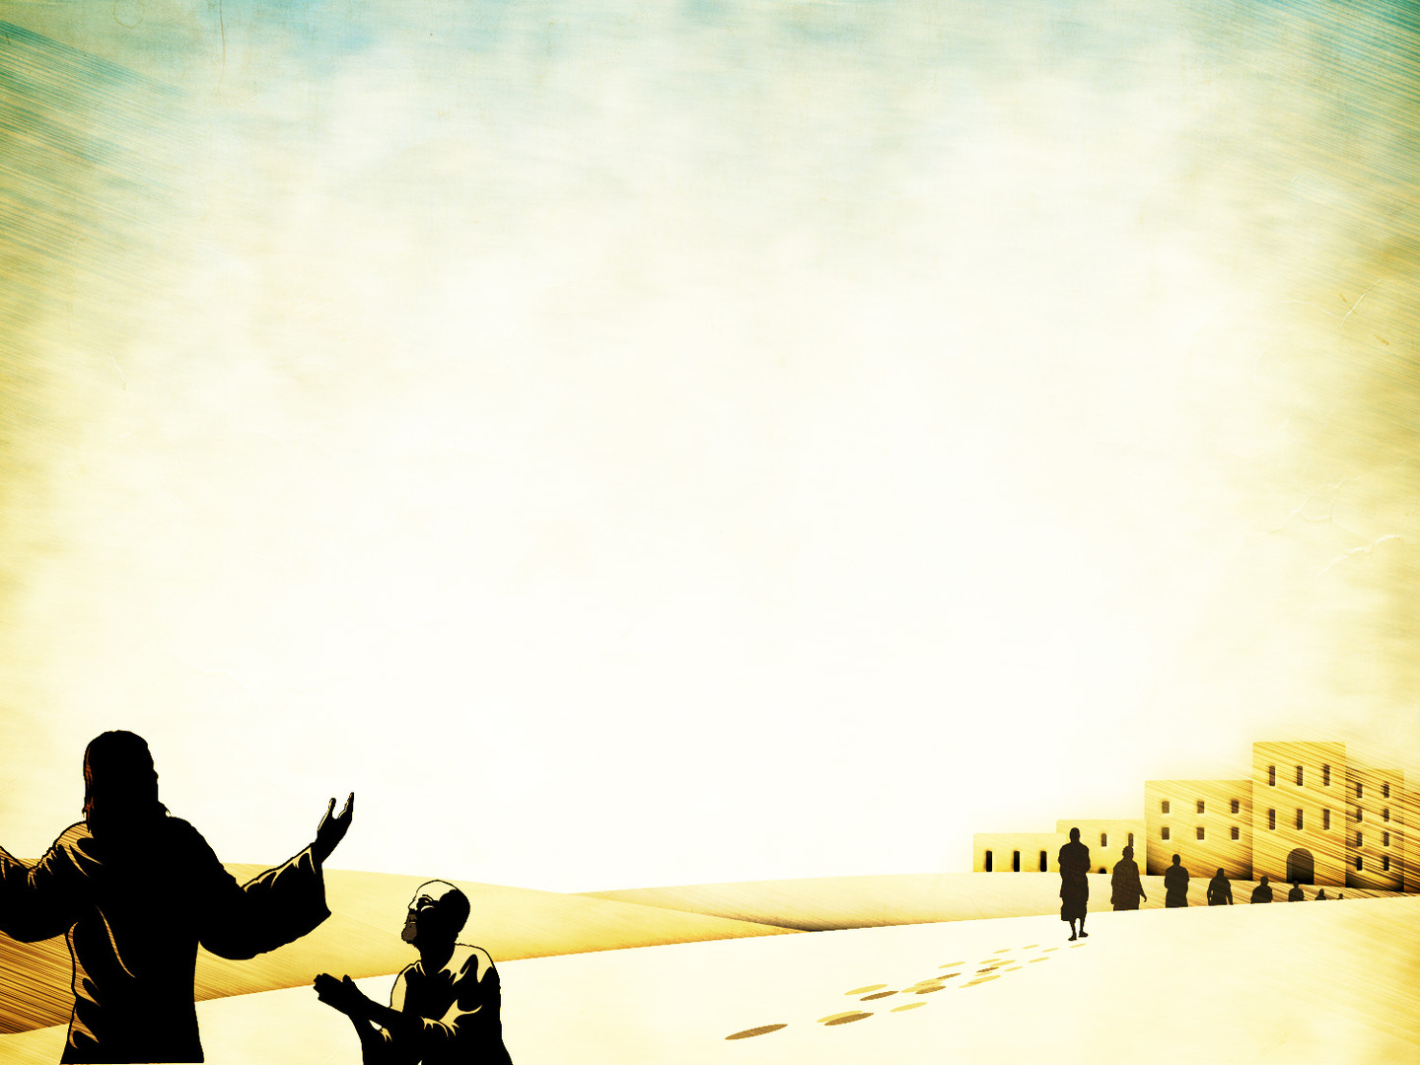
Luke 17:11-13
¹¹ On the way to Jerusalem he was passing along between Samaria and Galilee. ¹² And as he entered a village, he was met by ten lepers, who stood at a distance ¹³ and lifted up their voices, saying, “Jesus, Master, have mercy on us.”

Slide 3
Leviticus 13:45-46
The leprous person who has the disease shall wear torn clothes and let the hair of his head hang loose, and he shall cover his upper lip and cry out, ‘Unclean, unclean.’ 46 He shall remain unclean as long as he has the disease. He is unclean. He shall live alone. His dwelling shall be outside the camp.

Slide 4
Luke 17:11-13
¹¹ On the way to Jerusalem he was passing along between Samaria and Galilee. ¹² And as he entered a village, he was met by ten lepers, who stood at a distance ¹³ and lifted up their voices, saying, “Jesus, Master, have mercy on us.”

Slide 5
Luke 17:14
¹⁴ When he saw them he said to them, “Go and show yourselves to the priests.”

Slide 6
Jesus sees us in
our times of need.

Slide 7
Luke 17:14
¹⁴ When he saw them he said to them, “Go and show yourselves to the priests.”

Slide 8
Do we call Him “Master” and
faithfully do what He says?

Slide 9
Luke 17:14
¹⁴ When he saw them he said to them, “Go and show yourselves to the priests.” And as they went they were cleansed.

Slide 10
No distance is greater than the power of Jesus’ forgiveness.

Slide 11
Luke 17:15-19
¹⁵ Then one of them, when he saw that he was healed, turned back, praising God with a loud voice; ¹⁶ and he fell on his face at Jesus' feet, giving him thanks. Now he was a Samaritan. ¹⁷ Then Jesus answered, “Were not ten cleansed? Where are the nine? ¹⁸ Was no one found to return and give praise to God except this foreigner?” ¹⁹ And he said to him, “Rise and go your way; your faith has made you well.”

Slide 12
Are our eyes open to God’s blessings? Are we thanking Him for them?

Slide 13
Access to God is found at the feet of Jesus.

