Slide 1
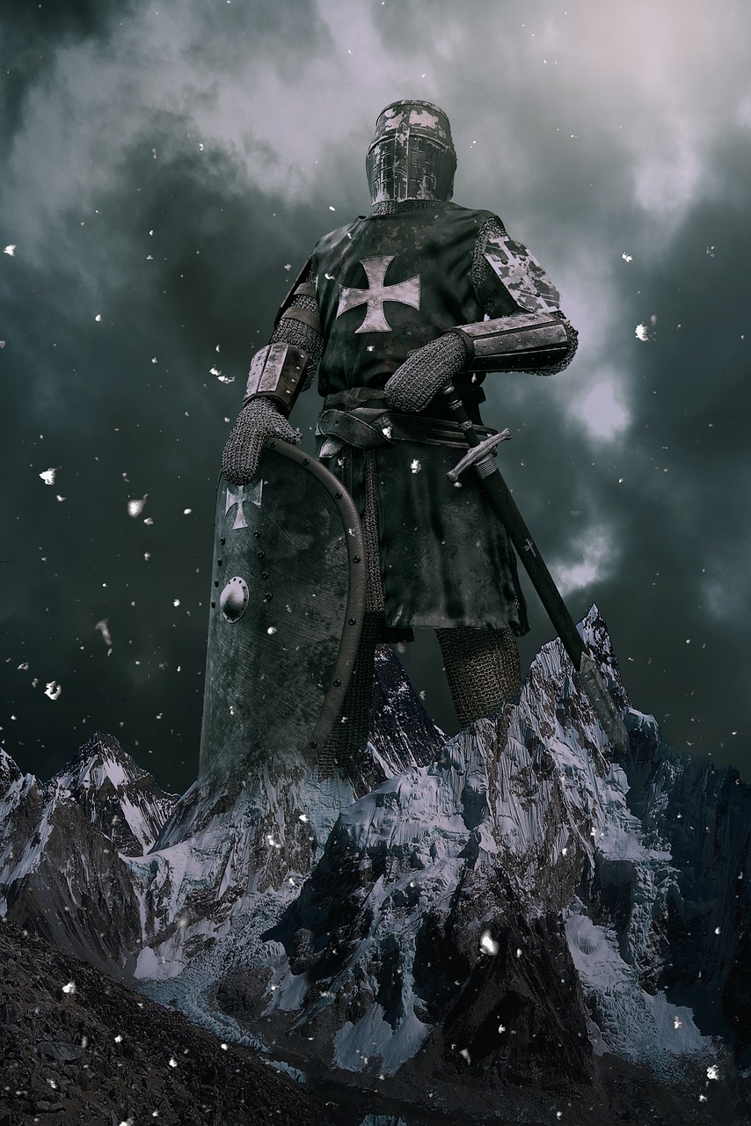
Biblical Masculinity
1 Corinthians 16:13-14

Slide 2
Stand Firm In The Faith!
You are not the problem, and you are not a victim!
Many in the world say that men are oppressors.
Titus 2:6-8
1 Timothy 4:12
Many men respond by saying that they are victims.
Ecclesiastes 3:16-17; 8:14
Guard your heart and remember why you are here! (Ecclesiastes 12:13-14)

Slide 3
Act Like Men!
Consider this statement in context...
1 Corinthians 3:1; 14:20
Paul’s point is that we need to grow up!
Don’t settle for pretending to be a man!
Don’t settle for a pretend life.
Don’t settle for pretend relationships.

Slide 4
Be Strong!
Humility- Be strong enough to see your own shortcomings and grow. (1 Peter 5:5)
Matthew 7:3-4
Proverbs 8:33
Honesty- Be strong enough to live and speak the truth.
Ephesians 4:25
James 1:22
Hard Work- Be strong enough to do what needs to be done.
1 Corinthians 9:26-27
2 Timothy 2:22

