Slide 1
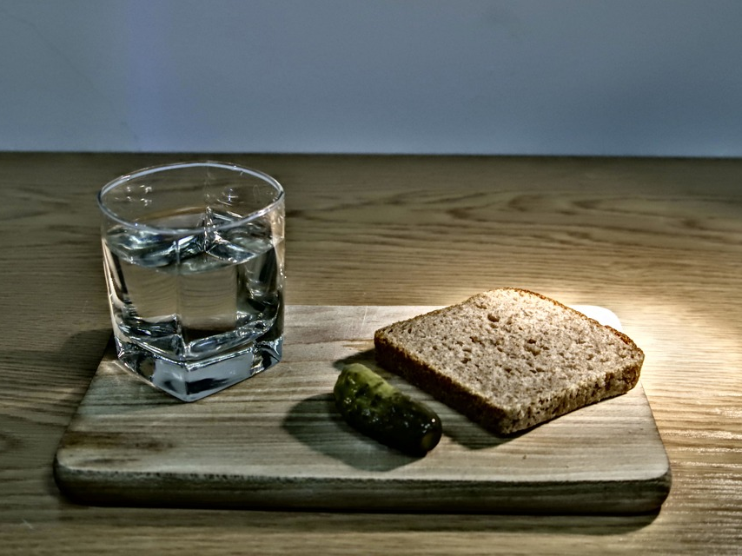
Blessed are those who hunger and thirst for righteousness...

Slide 2
Jesus was hungry and thirsty...
Jesus greatest hunger...
Matthew 4:2
Matthew 4:4
Jesus was sustained by God’s purpose!
John 4:32
John 4:34
Jesus’ life became a demonstration of God’s righteousness. (Romans 1:17)

Slide 3
We need to hunger and thirst.
Be careful what you want!
Righteousness in Matthew...
Matthew 3:15
Matthew 5:10
Matthew 5:20; 6:1
Matthew 6:33

Slide 4
They will be satisfied.
This promise goes from beginning to end.
Matthew 5:6
Matthew 7:7-8
There are two things implicit in the promise!
We do not have what we long for.
God will provide. (Romans 4:5; 6:16)

