Slide 2
Exodus 1:7
the people of Israel were fruitful and increased greatly; they multiplied and grew exceedingly strong so that the land was filled with them
Compare to Gen. 12:2; 17:6; 18:18 and the theme of being fruitful in Gen. 1:28; 9:1.

Slide 3
Exodus 1:8-11
And [Pharoah] said to his people, “Behold, the people of Israel are too many and too mighty for us. Come, let us deal shrewdly with them, lest they multiply, and, if war breaks out, they join our enemies and fight against us and escape from the land.” Therefore they set taskmasters over them to afflict them with heavy burdens.

Slide 4
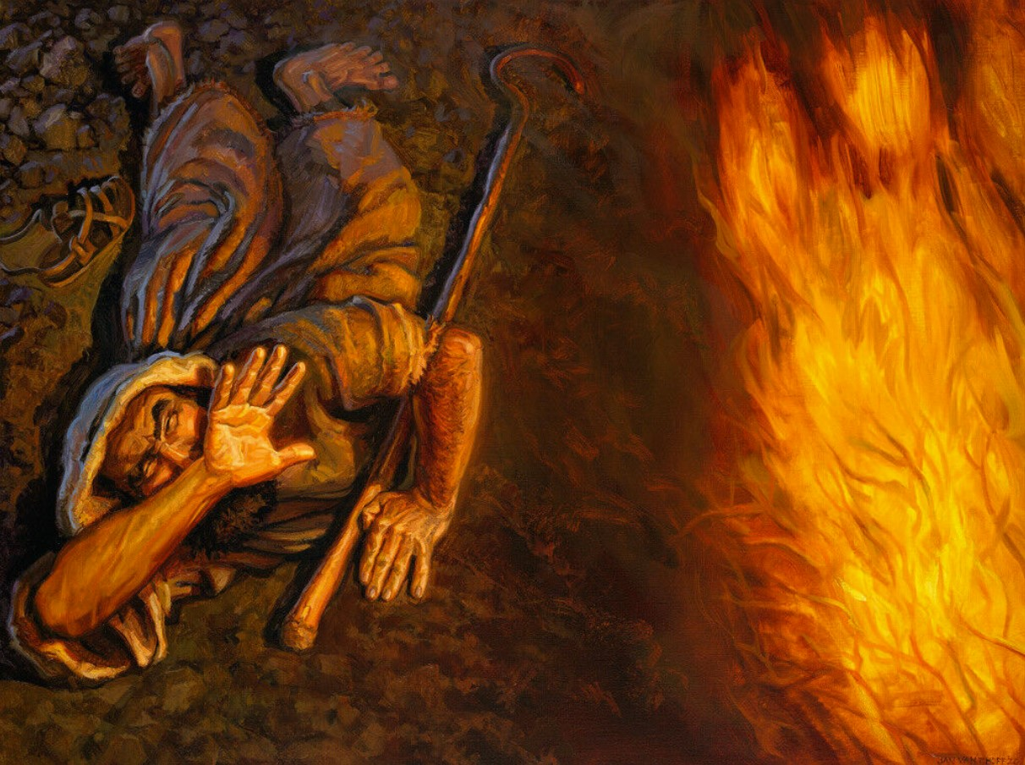
freebibleimages.com

Slide 5
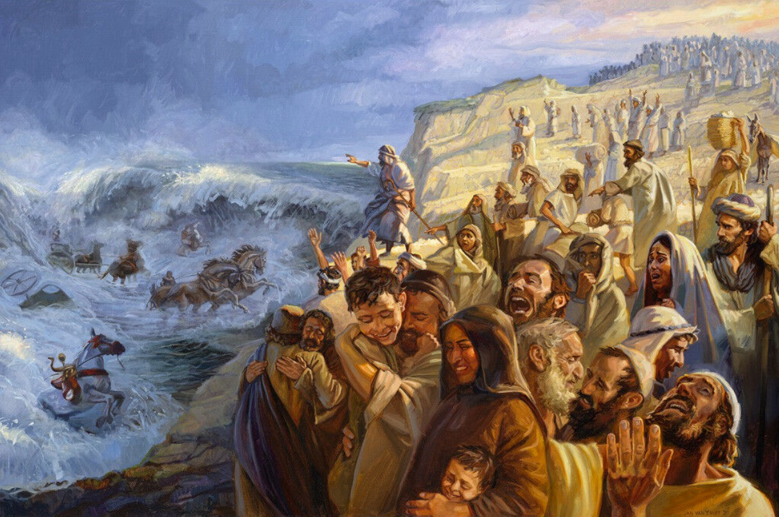
freebibleimages.com

Slide 6
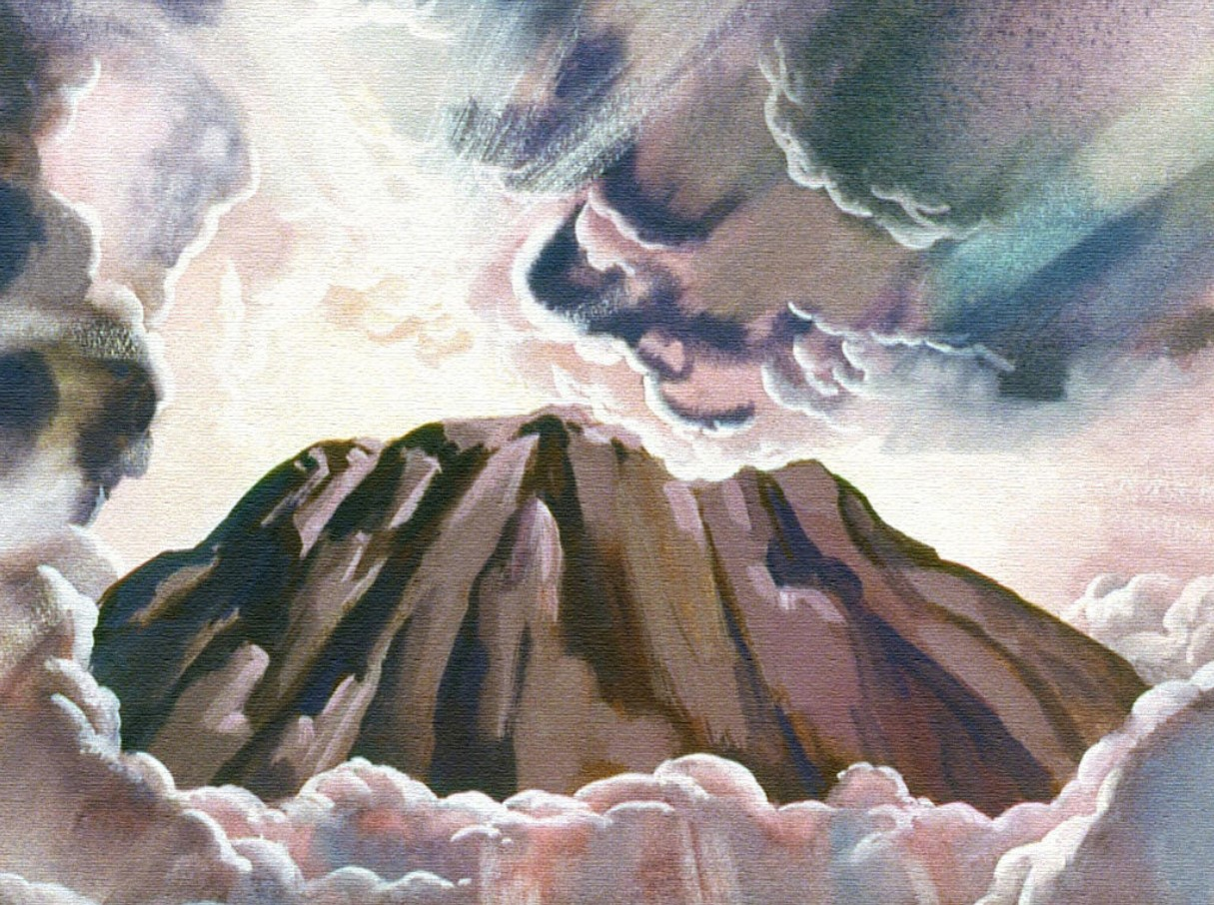
freebibleimages.com

Slide 7
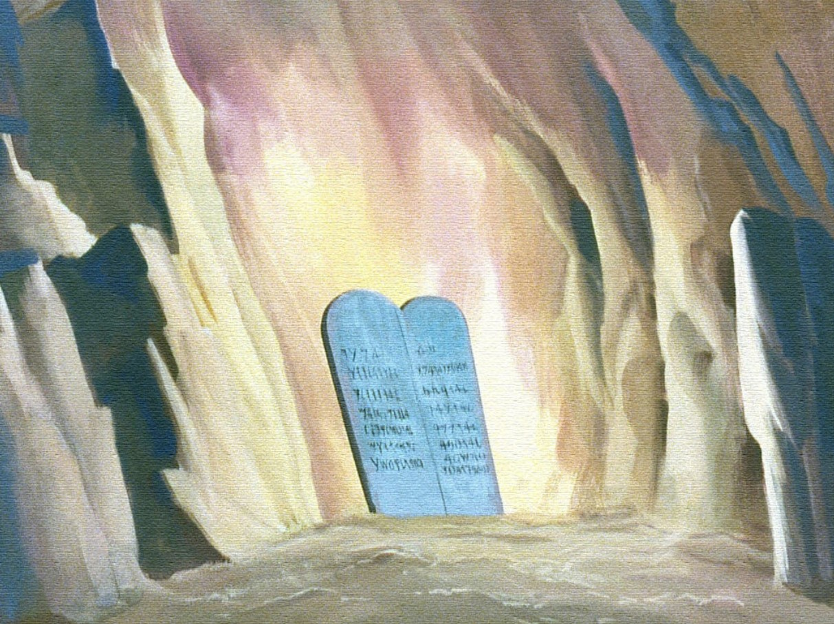
freebibleimages.com

Slide 8
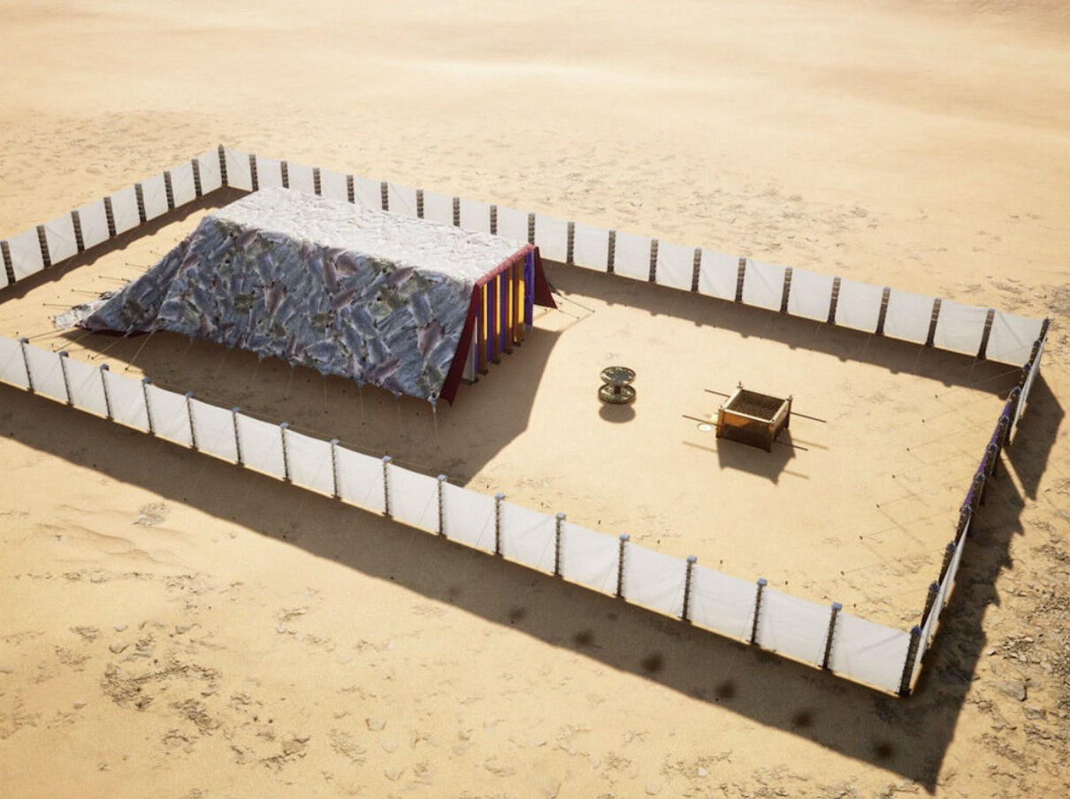
freebibleimages.com

Slide 9
“There I will meet with you, and from above the mercy seat, from between the two cherubim that are on the ark of the testimony, I will speak with you about all that I will give you in commandment for the people of Israel.”
- Exodus 25:22
freebibleimages.com

Slide 10
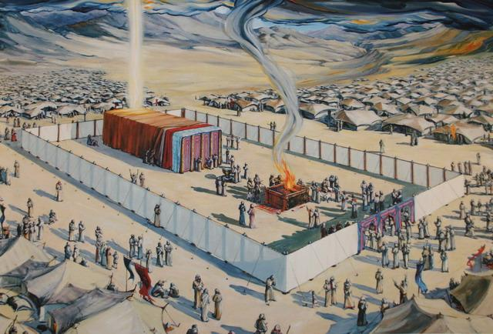
Biblestudentsdaily.com

Slide 11
Jesus came to Rescue His People
1 Timothy 1:15; Titus 2:11
Jesus came to Rule His People
Matthew 21:4-5; Hebrews 1:8
Jesus came to Reside with His People
John 1:14; Matthew 28:20

