Slide 2
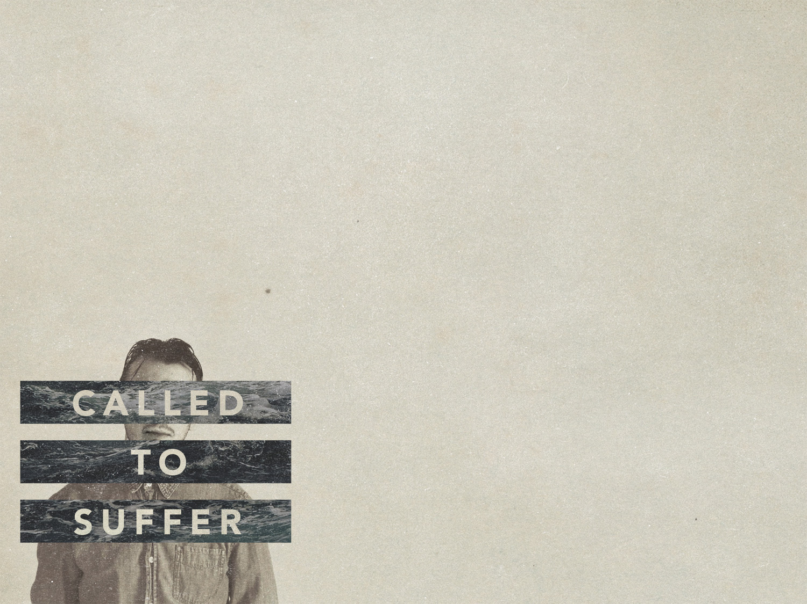
1 Peter 3:18-4:2
Page 1016 in pew Bible

Slide 3
Christ suffered to bring RESTORATION
The righteous suffered once for the unrighteous (Heb. 4:15; 9:26; 1 Jn. 3:5)
Christ’s suffering made reconciliation with God possible!

Slide 4
Christ suffered to bring PROCLAMATION
Keep vv. 19-20 in context!
3:13-4:2 – the victory that comes through suffering
Christ’s death brought victory
Christ’s proclamation to the spirits after His death seems to be one of victory!

Slide 5
Christ suffered to bring PROCLAMATION
The flood and baptism
An example of anti-type and type
Baptism’s power isn’t found in the water, but in God! (Acts 2:38; 22:16 Gal. 3:26-27)
Because Christs rose, so too can we (Rom. 6:3-4)

Slide 6
Christ suffered to bring TRANSFORMATION
We should be ready to suffer (Lk. 9:23)
We cease from sin by no longer being characterized by the ways of the world (Eph. 2:1-2)
When we consider what Christ suffered for us, we will be changed (Rom. 12:1-2)

