Slide 2
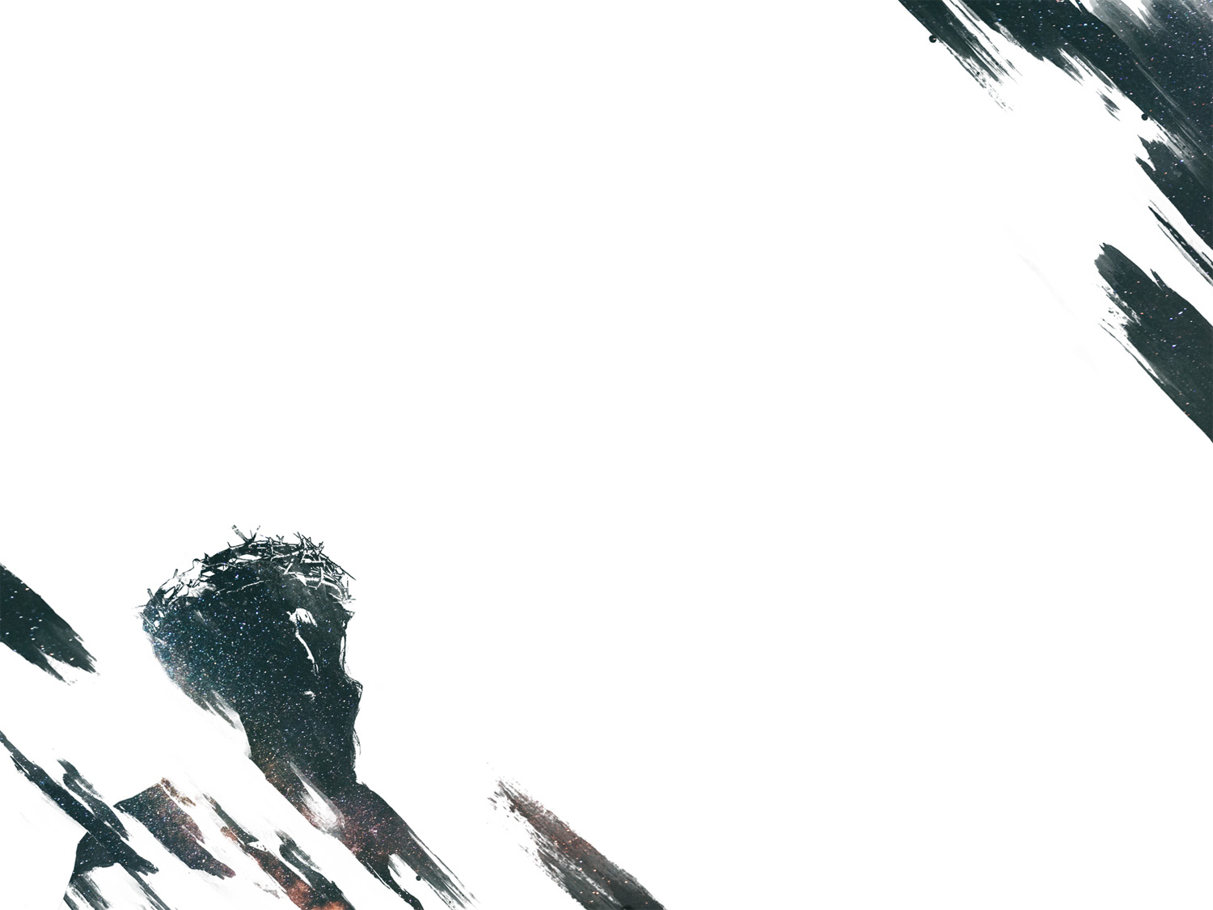
Hebrews 1:1-4
Page 1001 in pew Bible

Slide 3
Hebrews 5:1-11
Page 1004 in pew Bible

Slide 4
The Role of High Priest
Chosen from among men (1a)
Could sympathize with the nation he represented (see v. 2)
Acted on behalf of the people in relation to God (1b)
Through instruction of the law (Lev. 10:11; Deut. 24:8; 33:10; Hos. 4:1-6; Mal. 2:7)
Through gifts and sacrifices for sins (Lev. 1-5; 16-17)

Slide 5
The Role of High Priest
Called by God (v. 4)
First high priest, Aaron, was selected by God (Ex. 28; Num. 16)
God ordained that every other high priest would come from the line of Aaron.

Slide 6
Limitations of the High Priest and Sacrificial System
Priests came and went
Heb. 7:23
Death was a reminder of human frailty and the consequences of sin.
Priests were imperfect people
Offered sacrifices on behalf of their own sins as well as the nation’s (Heb. 5:2-3; 9:7)

Slide 7
Limitations of the High Priest and Sacrificial System
Sacrificed never offered a permanent solution to sin
The blood of animals isn’t the solution to sin (Heb. 10:11)
Had to be repeated regularly (Heb. 7:27; 10:11)

Slide 8
The limitations of the high priest and sacrificial system were intentionally ordained by God.

Slide 9
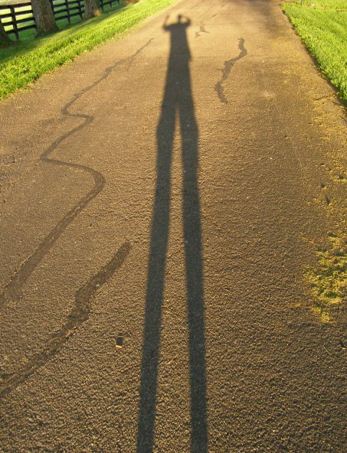

Slide 10
Jesus is our Great High Priest
Appointed by God (vv. 5-6)
After the order of Melchizedek = Jesus’ priesthood is better (see ch. 7)
Our sympathizing High Priest (vv. 7-8)
Jesus understands the human experience
Consider Gethsemane
The perfect sacrifice that brings salvation (v. 9)
Heb. 9:13-14
Intercedes on our behalf (Heb. 7:25; 9:24)

Slide 11
We cannot enter into the presence of God without the priestly work of Christ!

Slide 13
JESUS THE
KING

