Slide 2
Hebrews 1:1-4
Page 1001 in pew Bible

Slide 3
The Prophesied King
2 Samuel 7:12-16
¹² When your days are fulfilled and you lie down with your fathers, I will raise up your offspring after you, who shall come from your body, and I will establish his kingdom. ¹³ He shall build a house for my name, and I will establish the throne of his kingdom forever. ¹⁴ I will be to him a father, and he shall be to me a son. When he commits iniquity, I will discipline him with the rod of men, with the stripes of the sons of men, ¹⁵ but my steadfast love will not depart from him, as I took it from Saul, whom I put away from before you. ¹⁶ And your house and your kingdom shall be made sure forever before me. Your throne shall be established forever.’”

Slide 4
The Prophesied King
Isaiah 9:6-7
⁶ For to us a child is born, to us a son is given; and the government shall be upon his shoulder, and his name shall be called Wonderful Counselor, Mighty God, Everlasting Father, Prince of Peace. ⁷ Of the increase of his government and of peace there will be no end, on the throne of David and over his kingdom, to establish it and to uphold it with justice and with righteousness from this time forth and forevermore. The zeal of the Lord of hosts will do this.

Slide 5
The Prophesied King
Luke 1:28-35
²⁸ And he came to her and said, “Greetings, O favored one, the Lord is with you!” ²⁹ But she was greatly troubled at the saying, and tried to discern what sort of greeting this might be. ³⁰ And the angel said to her, “Do not be afraid, Mary, for you have found favor with God. ³¹ And behold, you will conceive in your womb and bear a son, and you shall call his name Jesus. ³² He will be great and will be called the Son of the Most High. And the Lord God will give to him the throne of his father David, ³³ and he will reign over the house of Jacob forever, and of his kingdom there will be no end.” ³⁴ And Mary said to the angel, “How will this be, since I am a virgin?” ³⁵ And the angel answered her, “The Holy Spirit will come upon you, and the power of the Most High will overshadow you; therefore the child to be born will be called holy—the Son of God.

Slide 6
A Humble Birth
Luke 2:6-7
⁶ And while they were [in Bethlehem], the time came for her to give birth. ⁷ And she gave birth to her firstborn son and wrapped him in swaddling cloths and laid him in a manger, because there was no place for them in the inn.

Slide 7
A Humble Birth
Unexpected Lk. 2:6-7
Divinely Foreknown 1 Pet. 1:20; Micah 5:2
A foreshadowing of the type of King Jesus is

Slide 8
A Humble King
A King of Servitude Matt. 9:36; 14:14; Jn. 13
A King of Simplicity Matt. 8:19-20; 21:1-7

Slide 9
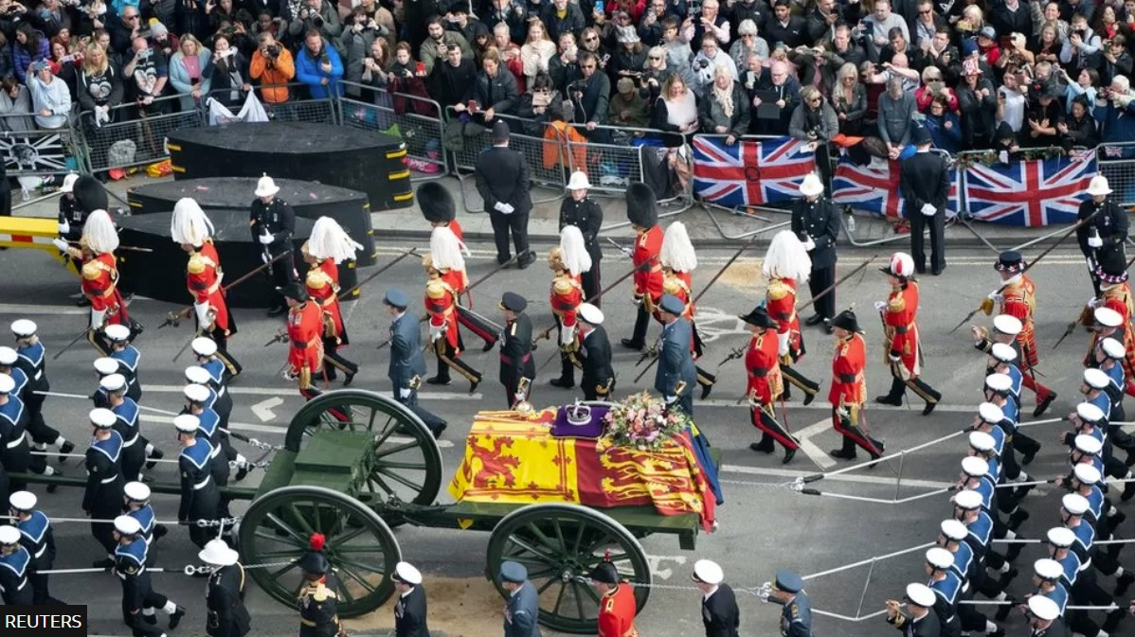

Slide 10
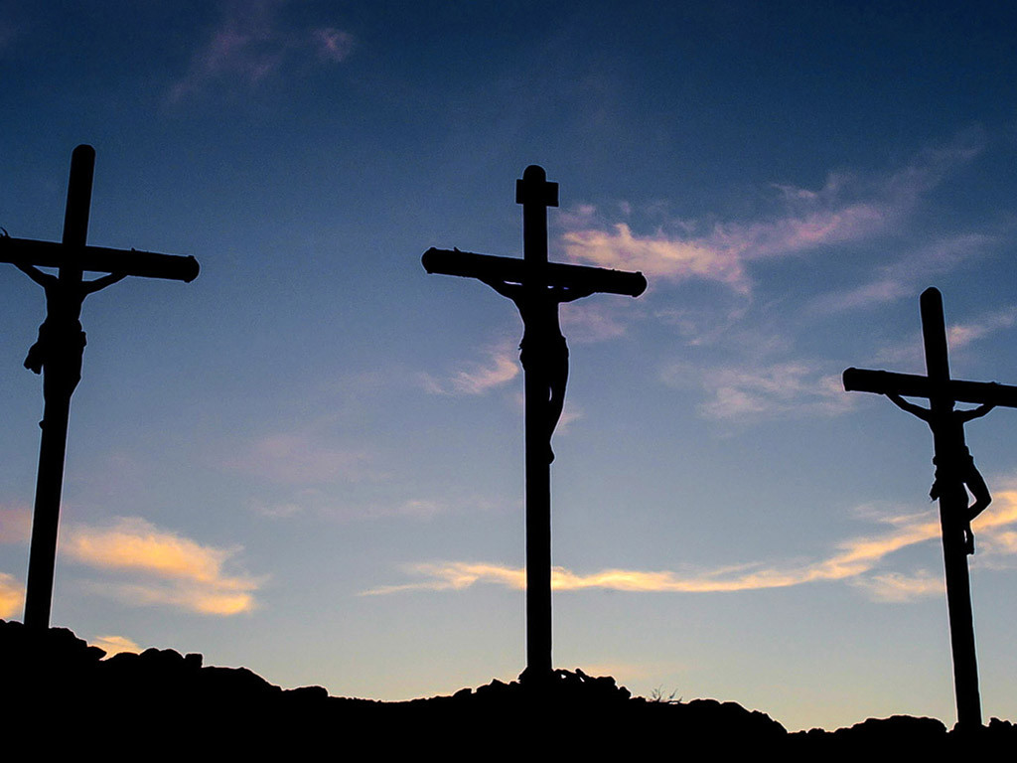
LUMO Project

Slide 11
A Spiritual Kingdom
Not of this World John 18:36
Serves Spiritual Purposes 1 Peter 3:18; Eph. 6:12
Christ’s disciples are its citizens Eph. 2:19; Phil. 3:20

Slide 12
Do you acknowledge Jesus as your Risen King?

