Slide 1
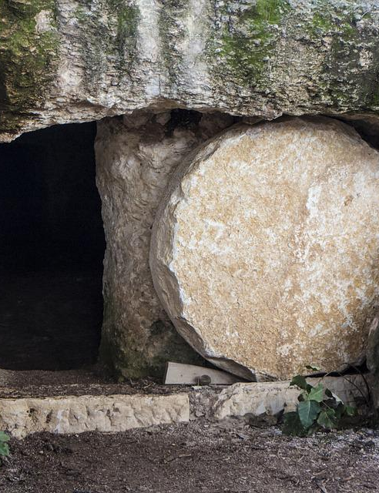
This Changes Everything

Slide 2
“Why do you seek the living among the dead?”
The resurrection (Luke 24:1-9)
Two events follow:
The road to Emmaus (Luke 24:19-21)
The appearance to the eleven (Luke 24:44-47)
Because Jesus is risen...

Slide 3
“Why do you stand looking into the sky?”
The ascension (Acts 1:9-11)
Two events follow:
The appointing of Matthias (Acts 1:12-26)
The pouring out of the Spirit. (Acts 2:33-36)
Because Jesus ascended...

Slide 4
Nothing Will Ever Be The Same!
“Why do you seek the living One among the dead?” (Luke 24:5)
“Men of Galilee, why do you stand looking into the sky?” (Acts 1:11)
This reality transforms...
Our relationships
Our priorities
Our problems

