Slide 1
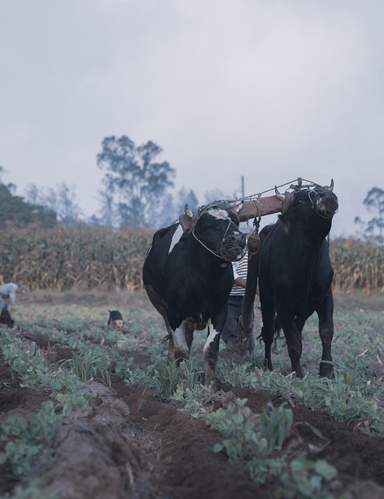
Do Not Be Bound Together With Unbelievers!
2 Corinthians 6:14-7:1

Slide 2
“Do not be bound together with unbelievers!” (2 Corinthians 6:14-16a)
Do not be bound together with unbelievers. (2 Cor. 6:14a)
Leviticus 19:19
Deuteronomy 22:10
Five questions; one answer.
Righteousness and lawlessness?
Light and darkness?
Christ with Belial?
Believer with an unbeliever?
The temple of God with idols?

Slide 3
“We are the temple of the living God!” (2 Corinthians 6:16b-18)
“For we are the temple of the living God.”
Cf. 2 Peter 2:4-9
Our context is about relationship!
“I will dwell in them and walk among them...”
Leviticus 26:11-12
Ezekiel 37:26-27
“Come out from their midst and be separate...”
Isaiah 52:11-12
Ezekiel 20:34
2 Samuel 7:14

Slide 4
“Let us cleanse ourselves from all defilement!” (2 Corinthians 7:1)
“Having these promises...”
The promise is of the presence of God!
The God who loved us and delivered us is with us!
“Let us cleanse ourselves...”
Put away the filth of the world.
Put away the relationships that might compromise our holiness.

