Slide 1
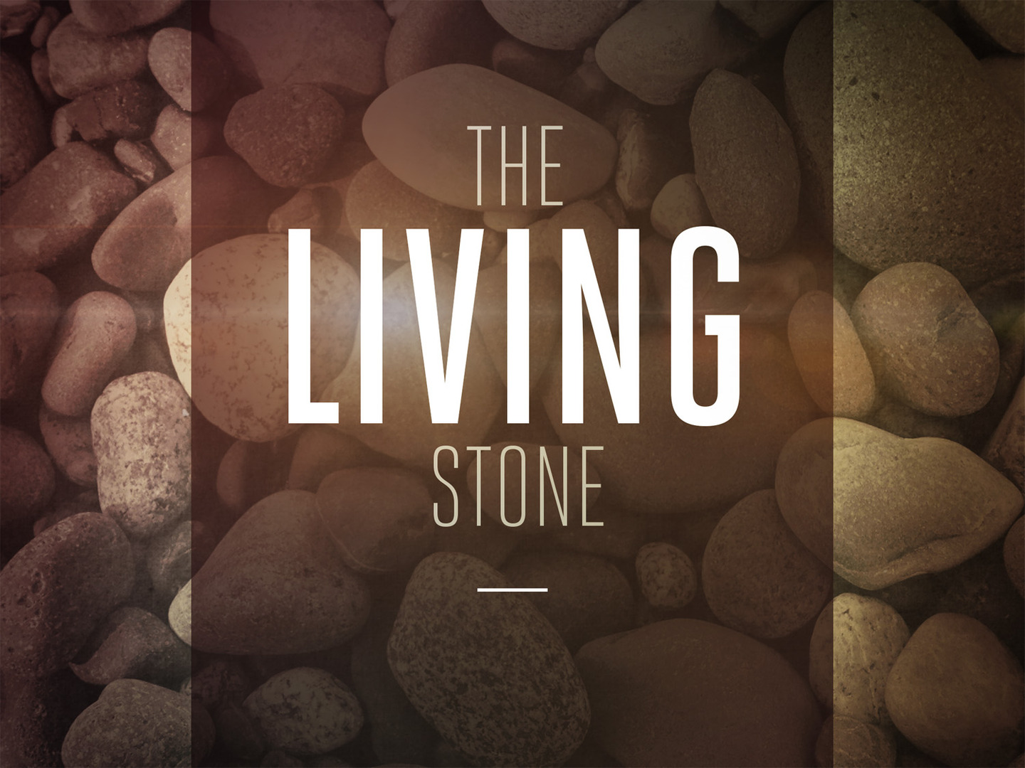

Slide 2
Stones and The Messianic Kingdom
Is. 8:14-15; 28:16; Ps. 118:22; Dan. 2:35, 44

Slide 3
Jesus Described as…
A Stone of Stumbling/Rock of Offense 1 Pet. 2:4; Jn. 1:10-11; Mk. 6:2-6
Someone that people trip over; take offense to
Jews stumbled because He didn’t fit their mold of who the Messiah should be
Gentiles stumbled because they viewed the message of the cross as foolish (1 Cor. 1:22-24)
Many today stumble because of an unwillingness to deny self to follow Him

Slide 4
Jesus Described as…
A Stone of Stumbling/Rock of Offense 1 Pet. 2:4; Jn. 1:10-11; Mk. 6:2-6
Stumbling will result in destruction (Matt. 21:33-44)

Slide 5
Jesus Described as…
A Cornerstone
Stone that ensures the structure is straight and structurally sound; sets the standard
Jesus sets the standard/brings soundness to His church (Eph. 1:20-23)

Slide 6
Jesus Described as…
A Living Stone
Not dead (e.g. an idol); Jesus has been resurrected and He reigns! (1 Pet. 1:3)
He has life and gives life (Jn. 6:35; 14:6)
He is the chosen and precious living stone (1 Pet. 1:20-21; Matt. 3:17; 17:5)

Slide 7
We are Described as…
Living Stones
We are pattered after the Living Stone
Share in His death and resurrection (Rom. 6:4-5; 8:29-30)
Chosen and precious (vv. 9-10)
Will face rejection (Jn. 15:18; 2 Tim. 3:13; 1 Pet. 2:21; 4:12-13)

Slide 8
We are Described as…
A Spiritual House
We are being built around the cornerstone as the spiritual temple (Eph. 2:19-22; 1 Cor. 3:9, 16; 6:19)
A Holy Priesthood
Set apart for service to God to offer spiritual sacrifices (Rom. 12:1-2; Heb. 13:15; 2 Tim. 4:6-8)

Slide 9
Who is Jesus to you?
The Living Cornerstone or a stone of stumbling and rock of offense?

