Slide 2
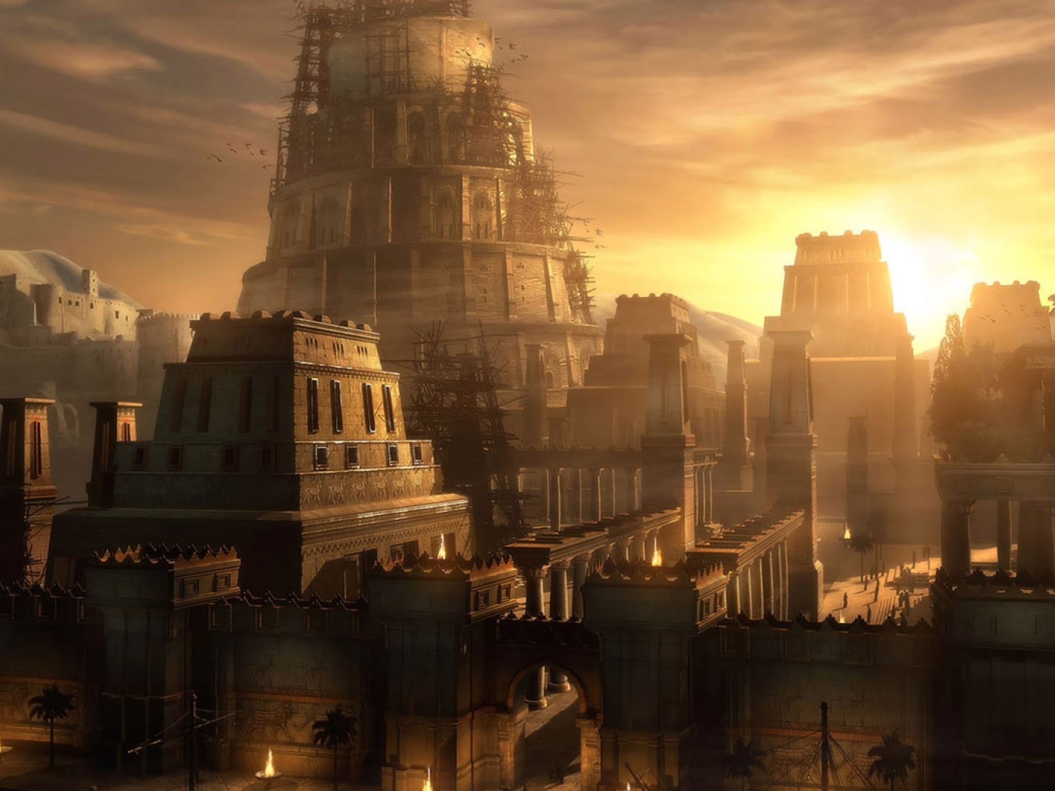
From Tower to Temple
Genesis 11

Slide 3
The Tower of Babel
Time Period : 2850 BC
Population : 300,000
Location: The plains of Shinar
Language: Adamic? Turkish?

Slide 4
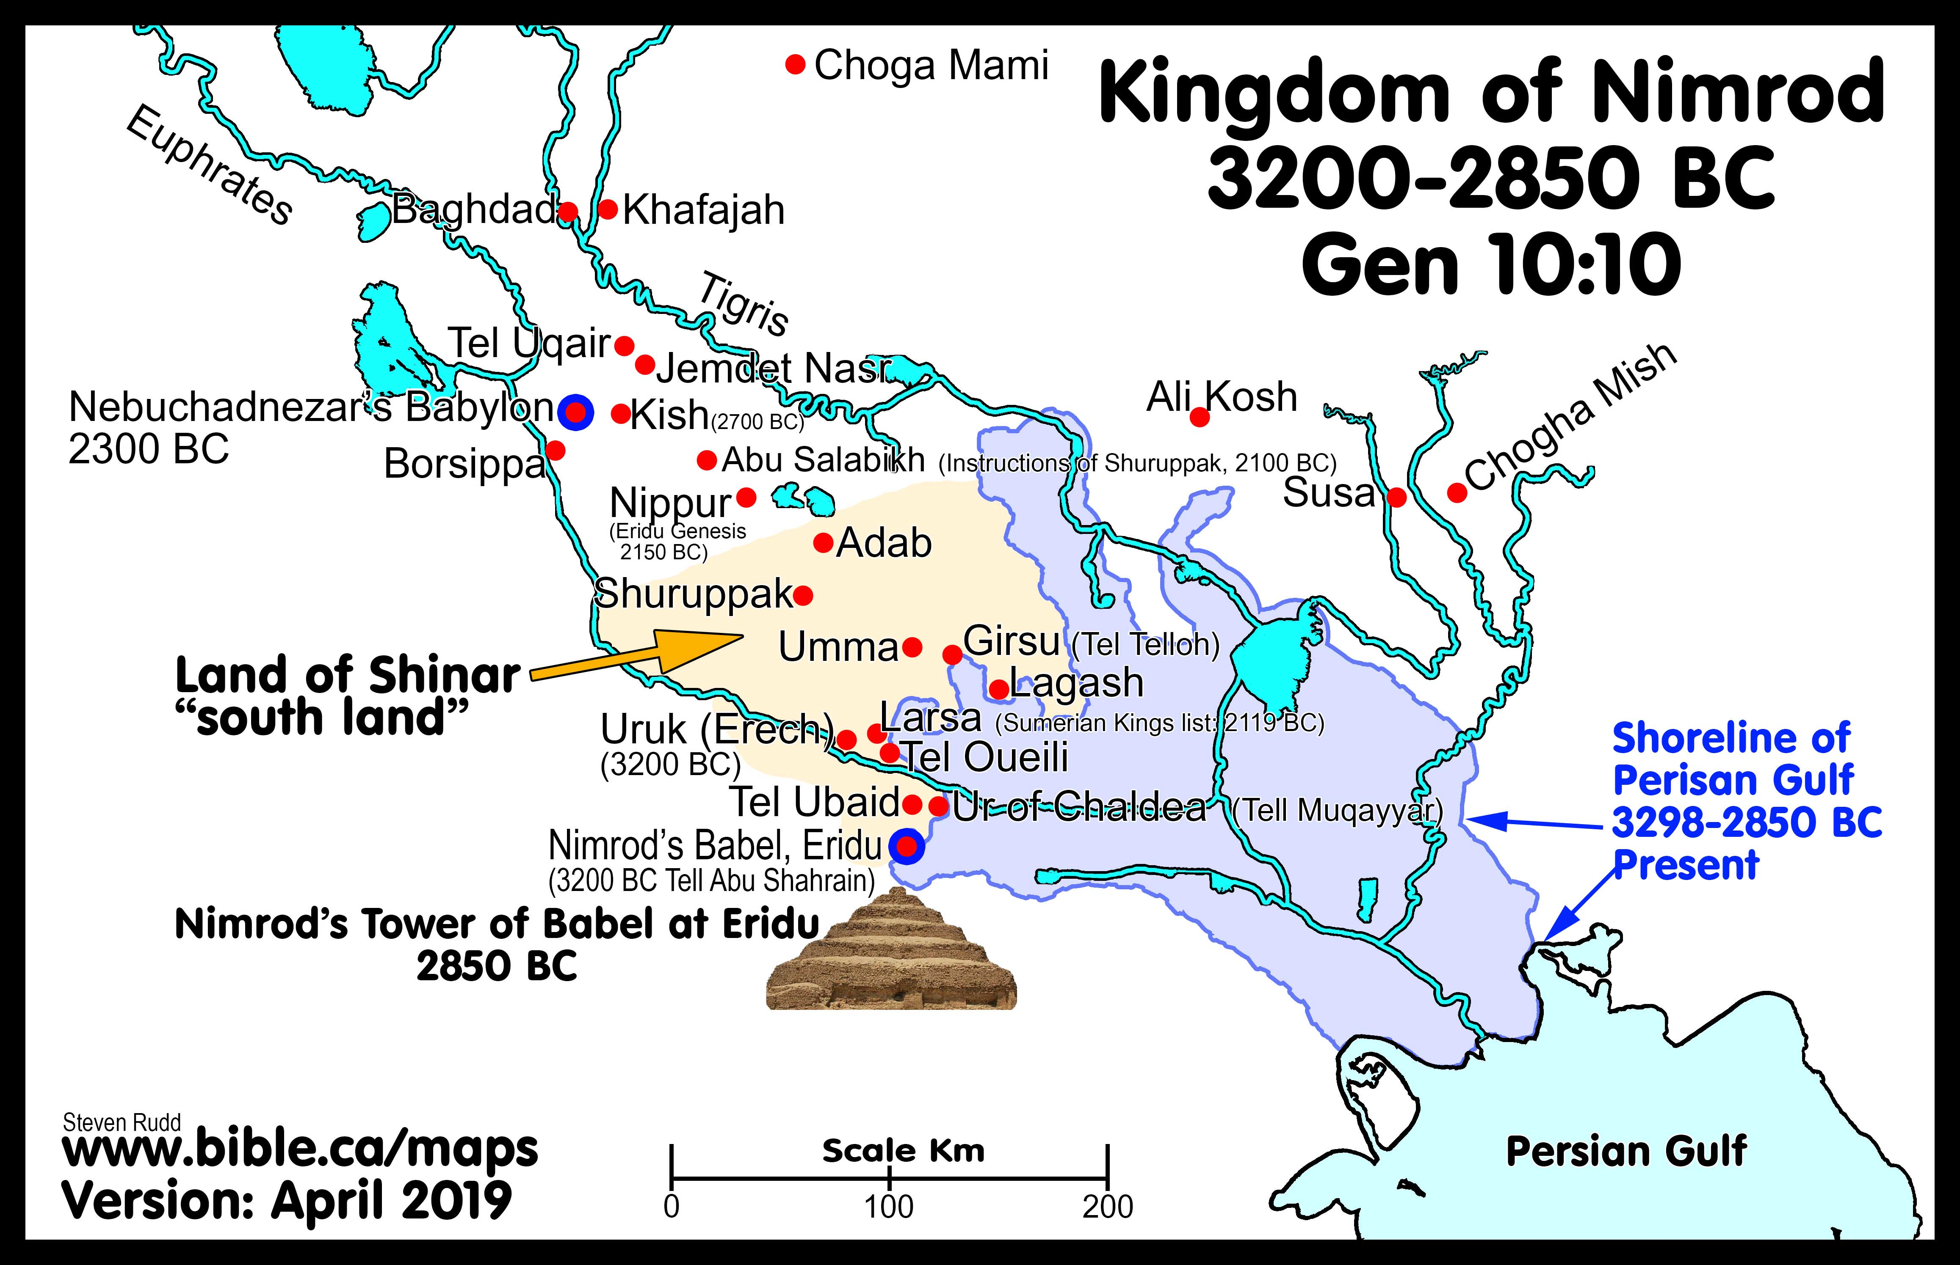
Caption

Slide 5
The Tower of Babel
NIMROD = Rebel Founder of Babel
rejected authority of parents
rejected authority of patriarchs
rejected the authority of God
NIMROD = identified with the god Enki the rebel

Slide 6
The Tower of Babel
The people’s crossroad:
Genesis 9:1 (ESV)
1 And God blessed Noah and his sons and said to them, “Be fruitful and multiply and fill the earth.

Slide 7
The Tower of Babel
Post Confusion:
Written languages
Stage set for Abraham and Sarah
Suburban cultures develop
Hebrew language - Heber

Slide 9
The Tower of Babel represents false world religions and false Christian doctrines.

Slide 10
ZIGGURAT
The Sumerians believed that the Gods lived in the temple at the top of the Ziggurats, so only priests and other highly respected individuals could enter.
Wikipedia

Slide 11
1 Corinthians 3:16 (ESV)
16 Do you not know that you are God's temple and that God's Spirit dwells in you?

Slide 12
"For though we walk in the flesh, we do not war according to the flesh, for the weapons of our warfare are not of the flesh, but divinely powerful for the destruction of fortresses. We are destroying speculations and every lofty thing raised up against the knowledge of God, and we are taking every thought captive to the obedience of Christ"
(2 Corinthians 10:3–6)

Slide 13
What sole source of authority is your beliefs and practices based on?
Matthew 15:7-9

Slide 14
2. How does God want to be worshipped based on New Testament scripture?
John 4:24

Slide 15
1 Corinthians 11:26
3. When should you take
The Lord's supper and why?

Slide 16
4. Is faith alive without faithful works?
Hebrews 11

Slide 17
5. What role does the Holy Spirit play in a Christian's life today?

Slide 18
6. What scriptural guidelines does your church use for spending the Lord's money?

Slide 19
7. What "title" does your preacher go by and who can be one?
Matthew 23:8-10

Slide 20
8. What congregational roles do men/women
take part in?

Slide 21
9. What must you do to be saved?

Slide 22
10. Can you be lost after being saved?
Revelation 2:10

Slide 23
From Tower to Temple
Genesis 11

