Slide 1
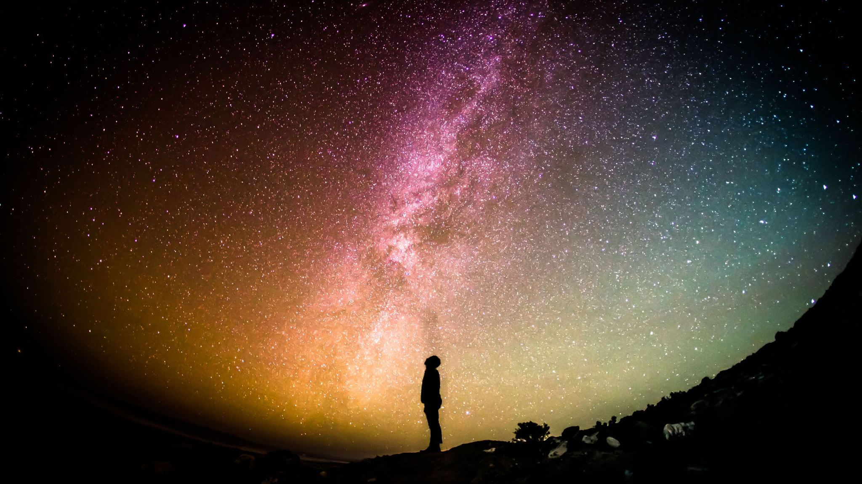
Spiritual Reminders All Around Us
Notes:
Been thinking a great deal about all the reminders of God all around us.
So that is what I’d like to talk to you today about.
Some of these are going to be very evident. Others perhaps you haven’t thought about.

Slide 2
The Temple of God
I Cor 3:16 – Do you not know that you are God’s temple…
Notes:
Sid has been emphasizing this concept of Christians as the Temple of God and the Holy Spirit dwelling within us. I Cor 3:16
Encourage you to attend the next session that he will be holding on this.
Clearly this is a metaphor. And one that we probably have a hard time understanding because we are so far removed from physical temple worship.
Got me to thinking about all the ways that God reminds us of Him in ways that perhaps we don’t think of as spiritual in nature.

Slide 3
God’s Use of Reminders
Reminder | Purpose | Passage
Tassels on Garments | Commandments of God | Num. 15:37-41
Passover | God’s deliverance from Egypt | Deut 16:1-3
The Lord’s Supper | Christ’s death | I Cor 11:23-26
Notes:
God regularly uses reminders:
Children of Israel instructed to put tassels on their garments as a reminder of the commandments of the God and to do them. Num (15:37-41)
Passover – Annual reminder of God’s deliverance from Egypt and that the death angel passed over all those that had the blood on the door. (Deut 16:1-3)
The Lord’s Supper – Weekly reminder of Jesus’ death, burial and resurrection. Specifically his body and blood offered for us. (I Cor 11)

Slide 4
Two Types of Reminders
Natural World
Relationships
Notes:
As I was thinking about all the different types of reminders, I felt like they could be categorized two ways: Natural World and Relationships.

Slide 5
Natural World
Universe
Nature
Seasons
Days
Notes:
Regarding the Natural World, I want to think about 4 things that can and should remind us of God:
Universe
Nature
The Seasons
The Days of the Week

Slide 6
Universe
The universe given to mankind to provide structure and order. Gen 1:14-18
And to declare the glory of God. Psalms 19:1-6
God’s invisible attributes are clearly seen in the Universe. Rom. 1:20
Notes:
The universe has been given to mankind to provide structure and order. Gen 1:14-18
¹⁴ And God said, “Let there be lights in the expanse of the heavens to separate the day from the night. And let them be for signs and for seasons,^{[f]} and for days and years, ¹⁵ and let them be lights in the expanse of the heavens to give light upon the earth.” And it was so. ¹⁶ And God made the two great lights—the greater light to rule the day and the lesser light to rule the night—and the stars. ¹⁷ And God set them in the expanse of the heavens to give light on the earth, ¹⁸ to rule over the day and over the night, and to separate the light from the darkness. And God saw that it was good.
But they also declare the glory of God. Psalms 19:1-6
And the universe clearly demonstrates the attributes of God. Rom 1:20
²⁰ For his invisible attributes, namely, his eternal power and divine nature, have been clearly perceived, ever since the creation of the world,^{[a]} in the things that have been made. So they are without excuse.

Slide 7
Nature
All of nature has been created for humans. Gen 1:28-29
God has control over all nature. Psalms 29; Job 38
Notes:
All of nature has been created for humans. Gen 1:28-29
God has control over nature. Psalms 29:3-10; Job 38
Job 38:8-11 – God has set the boundaries of the seas.
Job 38:19-20 – God knows the dwelling of light.
Job 38:25-30; 34-38 – God controls the weather.
Job 38:39-40 – God understands the ways of all the animals.

Slide 8
Seasons
The seasons are part of God’s Creation and intended for man. Gen 1:14
We should praise God for changing times and seasons. Dan 2:20-22
They are a reminder of God’s covenant with mankind via Noah. Gen 8:22
Notes:
The seasons are all part of God’s creation and intended for our purpose. Gen 1:14
They are a reminder of God’s covenant with mankind via Noah.
While the earth remains, seedtime and harvest, cold and heat, summer and winter, day and night, shall not cease.” Gen 8:22
We should praise God for the changing times and seasons:
Dan: 2:20-22: Daniel answered and said:
“Blessed be the name of God forever and ever, to whom belong wisdom and might. ²¹ He changes times and seasons; he removes kings and sets up kings; he gives wisdom to the wise and knowledge to those who have understanding; ²² he reveals deep and hidden things; he knows what is in the darkness, and the light dwells with him.

Slide 9
Days of the week.
Even the days of the week should remind us of God.
Seven days: completeness; perfection. Corresponds with God’s work of creation. Exo 20:8-11
God commands the morning and the dawn. Job 38:12-15
Notes:
Even the days of the week should remind us of God.
Why seven days?
The number seven corresponds to completeness; perfection.
The seven days in the week correspond with God’s work of creation. Exo 20:8-11
God commands the morning and the dawn. Job 38:12-15
¹² “Have you commanded the morning since your days began, and caused the dawn to know its place, ¹³ that it might take hold of the skirts of the earth, and the wicked be shaken out of it? ¹⁴ It is changed like clay under the seal, and its features stand out like a garment. ¹⁵ From the wicked their light is withheld, and their uplifted arm is broken.

Slide 10
Relationships
MARRIAGE
PARENT / CHILD
BODY
EMPLOYER / EMPLOYEE
Notes:
Not only are we reminded of God though all of physical creation, but we see God in our physical relationships. Our physical lives and interactions should be a constant reminder of and pointing us to our relationship with God.
We can see this in:
The husband / wife relationship
The parent / child relationship
The employee / employer relationship
The relationship of all of the parts of the body.

Slide 11
Marriage
Marriage is designed to remind us of Christ’s relationship to the church. Eph. 5:22-32
New Jerusalem is described as the Bride of Christ. Rev 21:9
Notes:
This is probably the most recognizable of the relationships meant to remind us of God.
We are to understand the relationship that Jesus has with the church based upon the relationship of husband and wife.
Paul tells us:
Husband has the leadership role in the marriage just as Christ is the head of the church. Eph 5:23
The church submits itself to Christ just as the wife is to submit to the husband. Eph 5:24
Husbands are to love their wives just as Christ loved the church – to the point that He gave Himself up for her. Eph 5:25
We should model the way we treat our spouses after the relationship that Christ has with the church. And so we should be reminded of Jesus and the church whenever we see and interact with our spouse.
Finally, we have New Jerusalem described as the Bride of Christ. Rev 21 provides us with a picture of the glorified church as Christ’s bride.

Slide 12
Parent / Child
The parent / child relationship helps to explain the love of God. Gen 22; John 3:16
Children are to learn obedience. Eph 6:1; Heb 5:7-8
Fathers are to discipline their children. Eph 6:4; Heb 12:5-11
Expectation for growth. I Pet 2:2; Heb 5:12-14; I Cor 3:1-3
Notes:
God has provided the parent / child relationship to help us understand the love of God and the responsibility of the child.
The parent / child relationship helps to explain the love of God. John 3:16
The account of Abraham offering Isaac resonates so strongly. (Gen 22). It is so hard to comprehend. We understand that because of the parent / child relationship. But then we understand that is exactly what God did in offering Jesus. John 3:16
Responsibility of the child
Children are to learn obedience. Eph 6:1 just as Jesus learned obedience as a Son. Heb 5:7-8
So we have the physical example and the spiritual expectation.
Fathers are to train and discipline their children (Eph 6:4) just as God disciplines his children. (Deut 8:5; Heb 12:5-11)
Fathers have the physical requirement to train and the spiritual expectation to be trained.
Expectation for growth.
Newborn children grow. So should newborn Christians. (I Pet 2:2) The physical should remind us of the spiritual.
Children grow into adults and demonstrate increasing maturity. The same is expected of Christians (Heb 5:12-14; I Cor 3:1-3)
As you rear your children, be reminded that this is another way that God is teaching us about His relationship with us.

Slide 13
Employee / Employer
Employees are to work as they would for Christ. Eph 6:5-7; Col 3:23-24
Employers are to treat employees in a way that is conscience that Christ is their master. Eph 6:9
Notes:
Employees are to work as they would for Christ Eph 6:5-7; Col 3:23-24
Employers are to treat employees with the reminder that Christ is our Master and he does not show partiality. Eph 6:9

Slide 14
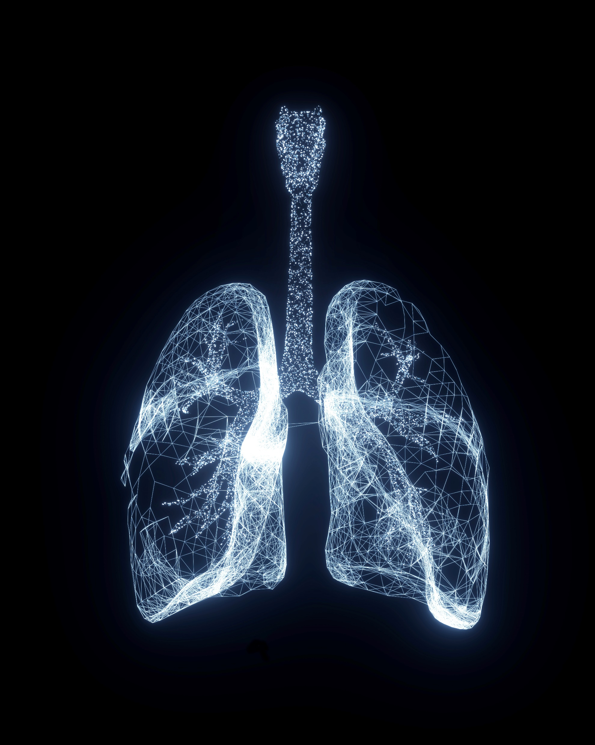
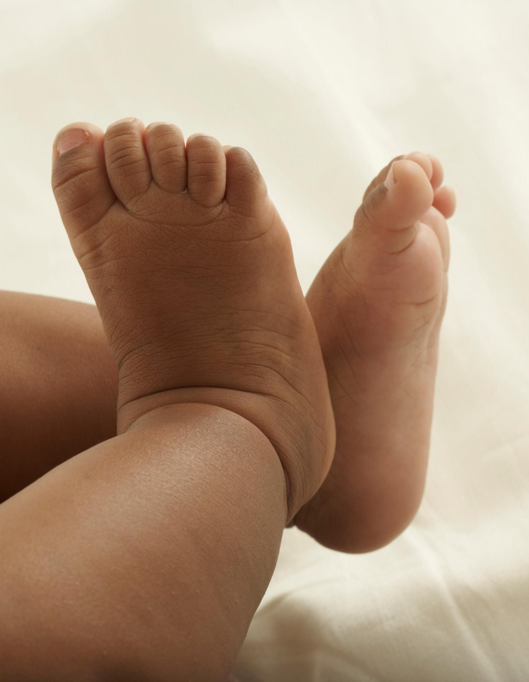
Members of the Body
God uses the body of mankind to demonstrate the spiritual realities of the church (the body of Christ) I Cor. 12:4-5
The physical body has many members just like the spiritual body. I Cor 12:1
The members of the physical body have to work together just like the members of the spiritual body. I Cor 12:12-31
The members of the physical body have different roles. Same is true of spiritual body. I Cor 12:27-30
The physical body suffers and rejoices together. The spiritual body does the same. I Cor 12:25-26
Notes:
Our very own bodies are used to demonstrate the spiritual realities of the Church. (I Cor 12:4-5)
Just as the one physical body has many members so do does the body of Christ, the church have many members. (I Cor 12:1)
Just as the body needs its members, the body of Christ needs its members to work together. (I Cor 12:12-31)
The members of the body have different roles, so too do the members of the body of Christ have different roles (I Cor 12: 27-30)
Just as the members of the body suffer together and rejoice together so should the members of the body of Christ. (I Cor 12:25-26)

Slide 15
Be Reminded of the Spiritual in Every Aspect of Life
Natural World
Relationships
Universe
Nature
Seasons
Days
Husband / Wife
Parent / Child
Employee / Employer
Members of the Body
Notes:
Hopefully, I have impressed upon you a strong reminder of God in all of these aspects of our everyday life.
And as you think about these things in the days and weeks ahead, it will in some small way help to bring you a little closer to God. Because in all of these things, he is teaching us a little more about Himself.

