Slide 1
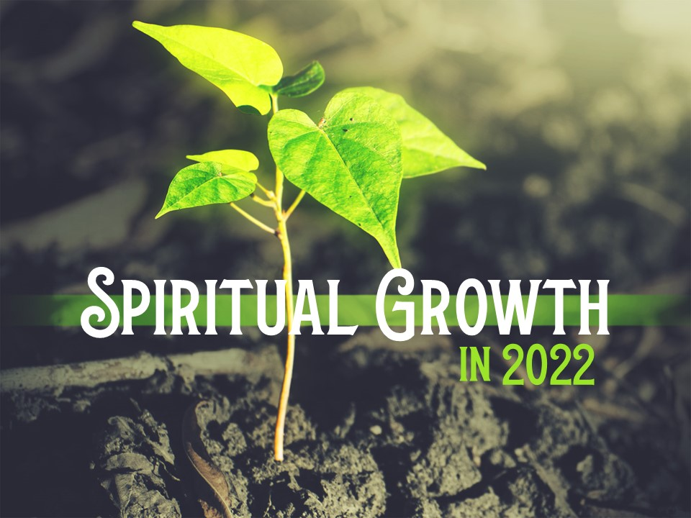

Slide 2
Growth is Expected
Heb. 6:1; 1 Cor. 3:1-3; 1 Pet. 2:3; 2 Pet. 2:5-8; 3:18; Rom. 12:2; Heb. 5:11-14

Slide 3
Growth is Necessary
We are alive in Christ
Rom. 6:11; Eph. 2:5; Jn. 10:10
Prevents ineffectiveness and unfruitfulness
2 Pet. 2:5-8
Instills Confidence
2 Pet. 2:9-11

Slide 4
What Prevents Growth?
Excuses
“I’m spiritual enough…”
There is no ceiling to our growth! (consider 1 Thess. 3:12; 4:1)
Unwillingness to sacrifice time killers
Social media, television, etc...
Unrealistic Expectations
The Christian journey is a series of small steps.

Slide 5
Questions to Consider
What are things you are currently doing, but can still grow in?
What are things you are not doing that you need to start doing?

Slide 6
Areas of Growth in 2022
Bible reading
Prayer
Relationships
Giving
Encouragement
Stewardship
Patience
Self-control
Service
Mentoring
Speech
Hospitality

Slide 7
How Can We Grow in 2022?
Find an encourager
Phil. 1:27; 2:3
Realize growth takes effort
Matt. 25:14-30; Heb. 5:14; 1 Cor. 9:24-27
Take it one step at a time
Don’t fear failure
2 Pet. 1:3; Phil. 4:13

