Slide 4
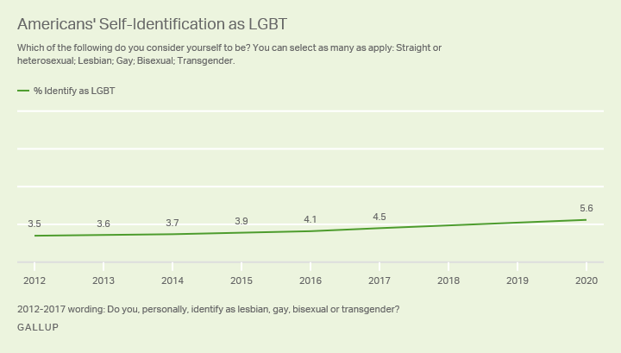

Slide 5
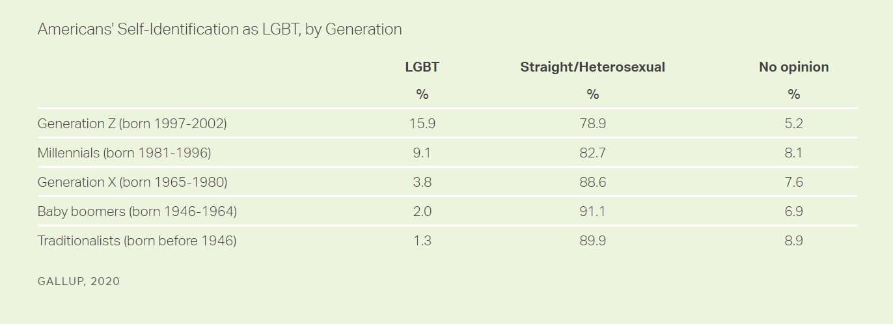

Slide 6
Christians need to know where to stand on this issue, and why.

Slide 7
Definitions
Biological Sex – the physical characteristics that distinguish a male body from a female body (e.g. chromosomes, reproductive organs)

Slide 8
Definitions
Gender - the behavioral, cultural, or psychological traits typically associated with one sex (Merriam-Webster).
Modern society has divorced gender from sex claiming gender is not determined by one’s body, but by ones internal sense of self.

Slide 9
Definitions
Gender Identity – The gender* a person identifies with.
May or may not align with one’s biological sex.
*based on modern usage

Slide 10
Definitions
Gender Dysphoria – The disconnect a person feels between their biological sex and their gender* (internal sense of self).
5th edition (2013) of Diagnostic and Statistical Manuel of Mental Disorders replaced “Gender Identity Disorder” with “Gender Dysphoria.”
*based on modern usage

Slide 11
“People with gender dysphoria may often experience significant distress and/or problems functioning associated with this conflict between the way they feel and think of themselves (referred to as experienced or expressed gender) and their physical or assigned gender.”
- American Psychiatric Association

Slide 12
Definitions
Transgender – denoting or relating to a person whose sense of personal identity and gender does not correspond with their birth sex. - Oxford Languages

Slide 13
Definitions
Transgender – “An umbrella term for the many ways in which people might experience and/or present and express (or live out) their gender identities differently from people whose sense of gender identity is congruent with their biological sex” -Mark Yarhouse

Slide 14
Scripture is not silent on this issue!
2 Pet. 1:3-4; Eccl. 1:9-10

Slide 15
Genesis 1:26-28
Page 1 in pew Bible

Slide 16
The Bible and Transgenderism
God created male and female
Creation went from “good” to “very good” (Gen. 1:31)
Each sex/gender complimented and completed the other (Gen. 2:23-24)
Sexual expression was found in a one male, one female marriage relationship (Gen. 1:28; 2:24)

Slide 17
The Bible and Transgenderism
God created male and female
This original design remained the standard (Matt. 19:4-5; Eph. 5:22-33; 1 Cor. 11:1-16; 1 Pet. 3:1-7)

Slide 18
The Bible and Transgenderism
Male and female were created in His image
The male and female body are unique reflections of God’s image.
Heb. for “image” (Gen. 1:27) is selem
Often used to describe a physical image that represents an invisible (false) deity (e.g. 2 Chr. 23:17).
Our physical bodies are representations of the invisible, True and Living God.

Slide 19
The image of God as it relates to our male and female bodies:
“a declaration that God intended to create human persons to be the physical means through which he would manifest his own divine presence
in the world.”
-Marc Cortez

Slide 20
1 Corinthians 6:18-20
Page 955 in pew Bible

Slide 21
The Bible and Transgenderism
How We View Our Bodies Matters
The male and female body were designed with purpose – to be the temple of God’s Spirit.
Just as the actual temple wasn’t to be defiled, neither is the male/female body.
We are called to glorify God in the bodies we’ve been given.

Slide 22
The Bible and Transgenderism
The Body and Our Inner Self (spirit) are Linked
1 Cor. 6:19, “body” (male/female body) and “you” (body, mind, and spirit) are used interchangeably (see also Rom. 6:13; 12:1).
This truth goes against “how I feel about myself determines who I am…” or “I have a male brain in a female body…”

Slide 23
The Bible and Transgenderism
Feelings Do Not Determine Male or Female, etc…
Gender dysphoria and transgenderism is about how one feels about themselves.
The heart is not a reliable guide! (Jer. 17:9; Pr. 3:5-6; 14:12)

Slide 24
The Bible and Transgenderism
We can embrace our true identity in Jesus Christ
We were created as male and female image bearers of God (Gen. 1:27).
Although we’ve shattered this image through sin, Jesus can bring restoration and help us see our true identity in Him more clearly (Col. 3:9b-11).

Slide 26
By the fifth edition of the DSM (2013), “Gender Identity Disorder” was replaced with “Gender Dysphoria” to remove the stigma associated with the word “disorder.” -
A BIBLICAL PERSPECTIVE ON
transgenderism

