Slide 1
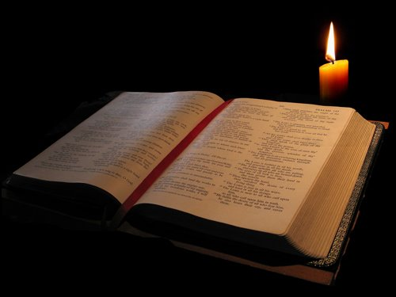
Christianity is Gospel Centered

Slide 2
The Philippian Church
Paul, the apostle who had first taught in Philippi was in prison facing possible death. (1:12-13, 21ff)
The church at Philippi is facing persecution. (1:28-30)
Epaphroditus, their messenger, nearly died trying to take their gift to Paul. (2:25-27)
They are plagued by false teachers. (3:2, 18-19)
There is strife in the congregation. (4:2-3)

Slide 3
Our Relationships are Gospel Centered!
Paul’s relationship with the Philippians was a direct result of their joint participation in the Gospel. (Philippians 1:3-8)
The purpose of this relationship was to realize the gospel in the lives of the Philippian brethren. (Philippians 1:9-11)

Slide 4
Our Goals are Gospel Centered!
Paul’s Circumstances:
He was in prison...
The Jews in Rome had largely rejected his message.
Some of the brethren were trying to take advantage of his circumstances.
Paul’s only concern was the furtherance of the gospel! (Philippians 1:12-18)

Slide 5
Our Hope is Gospel Centered!
Paul is confident that he will not be put to shame. (Philippians 1:19-20)
Christ will be exalted in his body!
The physical outcome is uncertain. The spiritual outcome is not.
“For to me, to live is Christ and to die is gain.” (Philippians 1:21)

