Slide 1
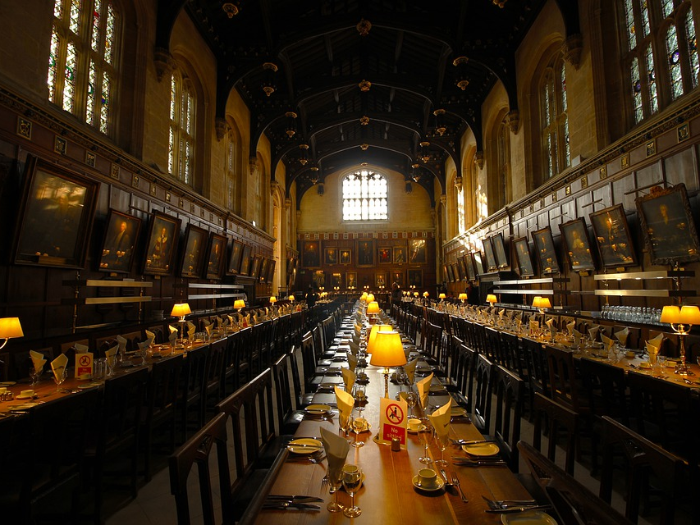
The Love Feast?

Slide 2
What Is The Love Feast?
Only one or two passages speak to this.
Jude 12-13
2 Peter 2:12-15
The other text that is appealed to is 1 Corinthians 11:17ff.

Slide 3
Where Does This Leave Us?
Is there more evidence?
Early Christians?
Biblical Scholarship?
New Testament worship is simple and spiritual. (John 4:23-24)
There are two kinds of meals established in the New Testament. (Luke 22:14ff; Acts 2:46)

Slide 4
In Conclusion...
We need to be careful about leaping to conclusions.
Christians do need to be together!
In Worship
Outside of Worship
Colossians 3:17

