Slide 2
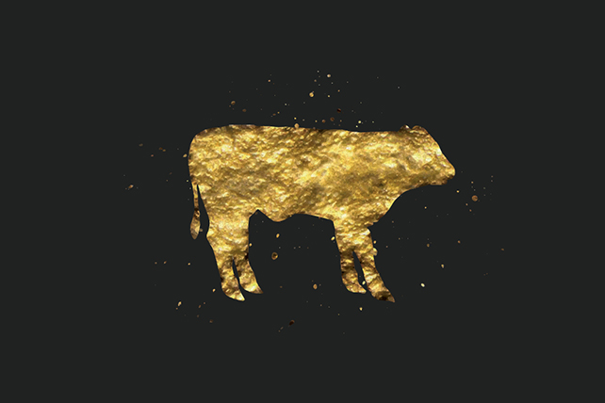
Idolatry in The Old Testament
Prevalent among the nations
EX: Dagon (Philistines); Baal (Canaanites); Chemosh (Moabites)
Strictly Forbidden
Exodus 20:3-4
Among the Israelites
In Egypt (Ezek. 20:6-9)
At Sinai (Ex. 32)
Among the kings
(1 Kgs. 11:5-8; 16:32-33)

Slide 3
Idolatry prevented the Israelites from being the holy nation God had called them to be (Ex. 19:5-6)

Slide 4
Idolatry in The Old Testament
Idolatry resulted in judgement (Micah 1:7; Hos. 13:1-3)

Slide 5
Motivation for Idolatry
To acknowledge a higher power(s)
The acknowledgement of false gods meant the suppression of the true God (Rom. 1:18-23)
For a perceived benefit
Dagon (god of water and grain)
Astarte (goddess of fertility)
Molech (promised financial security)

Slide 6
The Foolishness of Idolatry
Isaiah 44:9-20
Page 605 in pew Bible

Slide 7
We need to be careful! Idolatry is still alive and present in our society.

Slide 8
Modern-Day Idols
Objects (houses, cars, money, video games, smart phones…)
People (athletes, musicians, politicians, actors, activists, CEO’s, children, spouses…)
Goals (education, retirement, health, career…)

Slide 9
Like idolators of old, we idolize certain things because we believe it will benefit us in some way.
Living a life of modern-day idolatry prevents us from being the holy nation God has called us to be (1 Pet. 2:9)

Slide 10
Overcoming Modern-Day Idolatry
Identify what consumes the most of your time/mental energy.
Ask, “have these become more important than my service to God?”
See the world for what it is
Broken and fleeting
1 Jn. 2:17; 2 Pet. 3:10
See God for who He is
Is. 40:18-20

