Slide 2
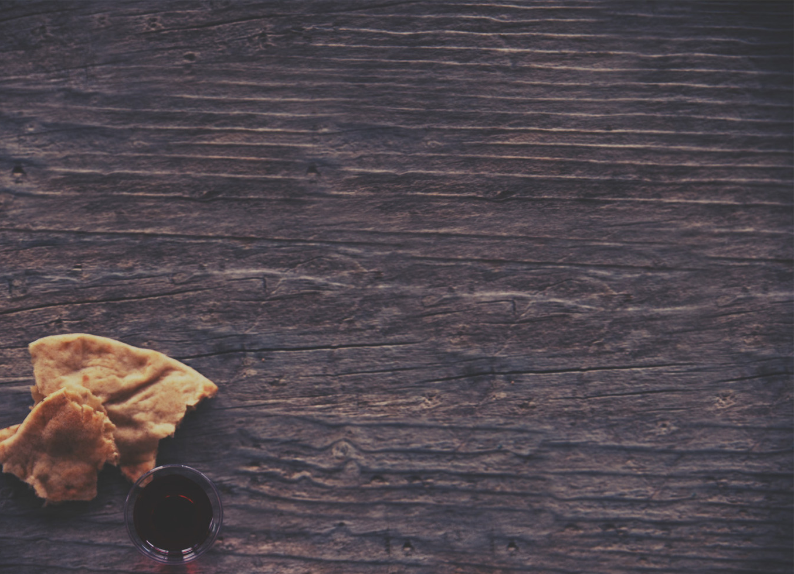
Do this in Remembrance of Me!
1 Corinthians 11:24-25
This began in the context of the Passover.
Luke22:8
Exodus 12:25-27
The same is true with the Lord’s supper!
Matthew 26:26-28
1 Corinthians 10:14-16; 11:26

Slide 3
The Bread – This is My Body...
“This is My body, which is for you…”
The “for you” indicates that Jesus suffered in our place!
2 Corinthians 5:21
Isaiah 53:4-6

Slide 4
The Cup – This is the New Covenant...
The blood is about forgiveness of sins! (Matthew 26:28)
Leviticus 4:30
Hebrew 10:12,19
The blood is about a New Covenant! (Matthew 26:27-28)
Hebrew 8:8-12
Jeremiah 31:31-34

Slide 5
We will know we are doing it right when...
We are a changed people!
Luke 9:23-24
1 Corinthians 11:27
We are a people of hope! (1 Corinthians 11:26)
We are a united people! (1 Corinthians 10:16-17)

