Slide 1
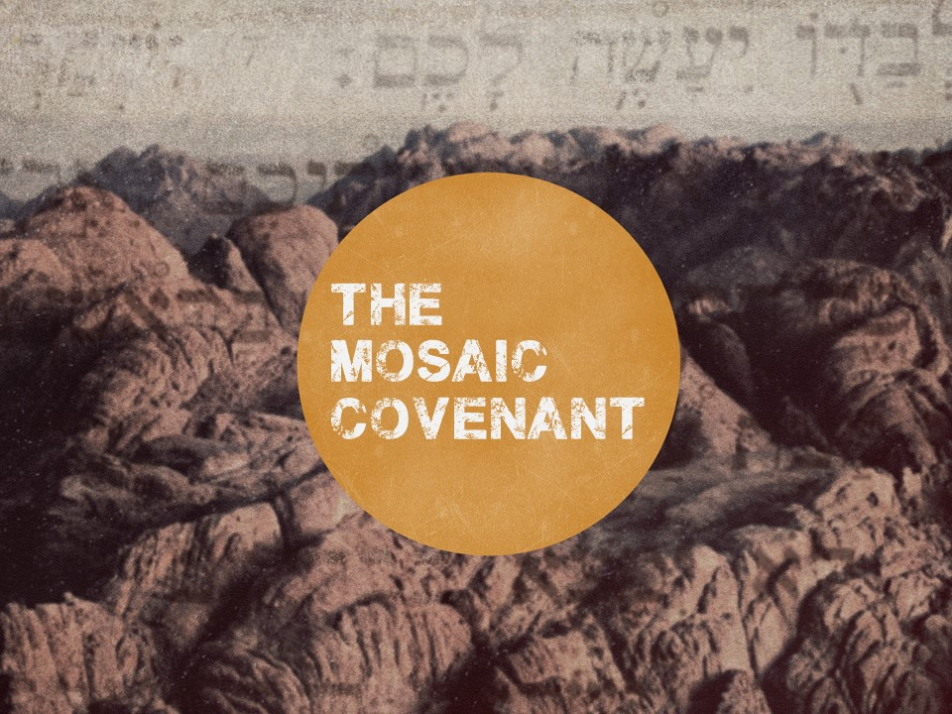

Slide 2
Exodus 19:3-6
³ …Moses went up to God. The Lord called to him out of the mountain, saying, “Thus you shall say to the house of Jacob, and tell the people of Israel: ⁴ ‘You yourselves have seen what I did to the Egyptians, and how I bore you on eagles' wings and brought you to myself. ⁵ Now therefore, if you will indeed obey my voice and keep my covenant, you shall be my treasured possession among all peoples, for all the earth is mine; ⁶ and you shall be to me a kingdom of priests and a holy nation.’ These are the words that you shall speak to the people of Israel.”

Slide 3
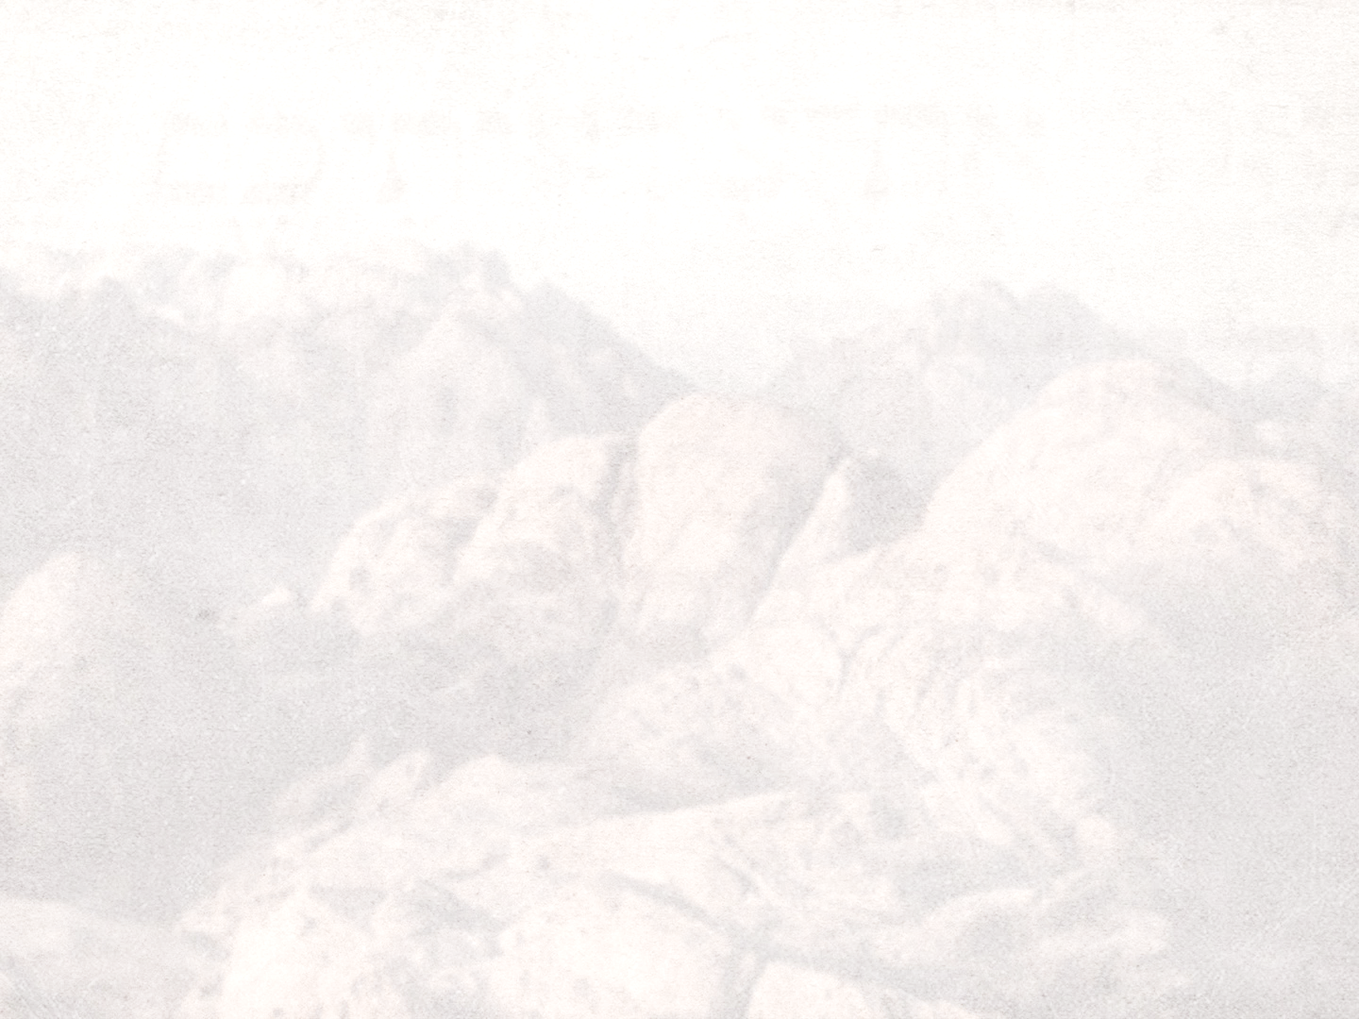
Features of the Mosaic Covenant
Entered into with a nation, not an individual
Set them apart from the other nations (vv. 5-6)
God’s representatives on earth
Bring other nations to God
Conditional (v. 5)
“if you will indeed obey…”
Blessings for obedience, curses for disobedience (Deut. 28)

Slide 4
Exodus 19:8-9
⁸ All the people answered together and said, “All that the Lord has spoken we will do.” And Moses reported the words of the people to the Lord. ⁹ And the Lord said to Moses, “Behold, I am coming to you in a thick cloud, that the people may hear when I speak with you, and may also believe you forever.”

Slide 5
Exodus 19:16-20
¹⁶ On the morning of the third day there were thunders and lightnings and a thick cloud on the mountain and a very loud trumpet blast, so that all the people in the camp trembled. ¹⁷ Then Moses brought the people out of the camp to meet God, and they took their stand at the foot of the mountain. ¹⁸ Now Mount Sinai was wrapped in smoke because the Lord had descended on it in fire. The smoke of it went up like the smoke of a kiln, and the whole mountain trembled greatly. ¹⁹ And as the sound of the trumpet grew louder and louder, Moses spoke, and God answered him in thunder. ²⁰ The Lord came down on Mount Sinai, to the top of the mountain. And the Lord called Moses to the top of the mountain, and Moses went up.

Slide 6
Features of the Mosaic Covenant
God delivered His law
10 commandments reflect the principles of the entirety of the law
Teach the importance of holiness (Ex. Lev. 19:19; cf. Lev. 19:2)
Teach the need for a Savior! (Js. 2:10; Gal. 3:10; 24; Matt. 5:17; Heb. 10:3-4)

Slide 7
Exodus 24:1-8
¹ Then he said to Moses, “Come up to the Lord, you and Aaron, Nadab, and Abihu, and seventy of the elders of Israel, and worship from afar. ² Moses alone shall come near to the Lord, but the others shall not come near, and the people shall not come up with him.” ³ Moses came and told the people all the words of the Lord and all the rules. And all the people answered with one voice and said, “All the words that the Lord has spoken we will do.”

Slide 8
Exodus 24:1-8
⁴ And Moses wrote down all the words of the Lord. He rose early in the morning and built an altar at the foot of the mountain, and twelve pillars, according to the twelve tribes of Israel. ⁵ And he sent young men of the people of Israel, who offered burnt offerings and sacrificed peace offerings of oxen to the Lord. ⁶ And Moses took half of the blood and put it in basins, and half of the blood he threw against the altar.

Slide 9
Exodus 24:1-8
⁷ Then he took the Book of the Covenant and read it in the hearing of the people. And they said, “All that the Lord has spoken we will do, and we will be obedient.” ⁸ And Moses took the blood and threw it on the people and said, “Behold the blood of the covenant that the Lord has made with you in accordance with all these words.”

Slide 10
Exodus 24:1-8
¹² The Lord said to Moses, “Come up to me on the mountain and wait there, that I may give you the tablets of stone, with the law and the commandment, which I have written for their instruction.”

Slide 11
Exodus 24:15-18
¹⁵ Then Moses went up on the mountain, and the cloud covered the mountain. ¹⁶ The glory of the Lord dwelt on Mount Sinai, and the cloud covered it six days. And on the seventh day he called to Moses out of the midst of the cloud. ¹⁷ Now the appearance of the glory of the Lord was like a devouring fire on the top of the mountain in the sight of the people of Israel. ¹⁸ Moses entered the cloud and went up on the mountain. And Moses was on the mountain forty days and forty nights.

Slide 12
The Broken Covenant In The Prophets
Jeremiah 11:10-11
¹⁰ They have turned back to the iniquities of their forefathers, who refused to hear my words. They have gone after other gods to serve them. The house of Israel and the house of Judah have broken my covenant that I made with their fathers. ¹¹ Therefore, thus says the Lord, Behold, I am bringing disaster upon them that they cannot escape. Though they cry to me, I will not listen to them.

Slide 13
The Broken Covenant In The Prophets
Jeremiah 22:8-9
⁸ “‘And many nations will pass by this city, and every man will say to his neighbor, “Why has the Lord dealt thus with this great city?” ⁹ And they will answer, “Because they have forsaken the covenant of the Lord their God and worshiped other gods and served them.”’”

Slide 14
The Broken Covenant In The Prophets
Ezekiel 44:6-7
⁶ And say to the rebellious house, to the house of Israel, Thus says the Lord God: O house of Israel, enough of all your abominations, ⁷ in admitting foreigners, uncircumcised in heart and flesh, to be in my sanctuary, profaning my temple, when you offer to me my food, the fat and the blood. You have broken my covenant, in addition to all your abominations.

Slide 15
The Broken Covenant In The Prophets
Hosea 8:1-3
¹ Set the trumpet to your lips!
One like a vulture is over the house of the Lord,
because they have transgressed my covenant
and rebelled against my law.
² To me they cry,
“My God, we—Israel—know you.”
³ Israel has spurned the good;
the enemy shall pursue him.

Slide 16
We Are Not Under the Mosaic Covenant
Hebrews 8:13
In speaking of a new covenant, he makes the first one obsolete. And what is becoming obsolete and growing old is ready to vanish away.
Romans 7:6
But now we are released from the law, having died to that which held us captive, so that we serve in the new way of the Spirit and not in the old way of the written code.

Slide 17
But The Covenant Still Holds Immense Value
2 Timothy 3:16-17
¹⁶ All Scripture is breathed out by God and profitable for teaching, for reproof, for correction, and for training in righteousness, ¹⁷ that the man of God may be complete, equipped for every good work.

Slide 18
The Mosaic Covenant and Us
Teaches about God and His character
His holiness
a failure to honor the covenant was a failure to honor the Holy Covenant Maker
There were consequences for transgression (Ex. 32; Lev. 10; Num. 14:23)
His love
He wants to have covenant relationship with His people
He wants His creation to be His representatives

Slide 19
The Mosaic Covenant and Us
Reminds us that worship is from the heart
The heart was just as important in the old covenant as the new (Deut. 6:5; Is. 29:13; 1 Sam. 15:22; Hos. 6:6)
Worship void of the heart isn’t true worship at all

Slide 20
The Mosaic Covenant and Us
Prepares us for our service to the Lord
Moses served as a “type” of Christ (deliverer and intercessor; Heb. 7:25; 10:12-14)
Our calling resembles that of Israel (Ex. 19:5-6; 1 Pet. 2:9)
Like Israel, we are solely dependent on our Savior! (Rom. 3:23-24; 6:23)

