Slide 1
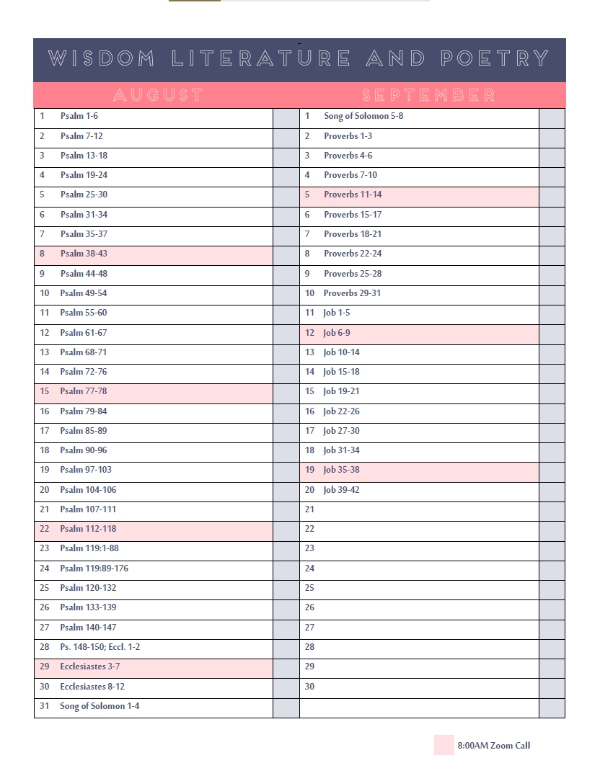

Slide 2
GOD’S GUIDEPOSTS

Slide 4
The Forms of God’s Guideposts
Direct Statements/Commands
1 Cor. 6:18; Jn. 13:34
Examples
Acts 6:1-6; 20:7
Necessary conclusions/Inferences
Some subjects are not specifically mentioned in scripture, but solid conclusions can still be drawn.
e.g. the sin of abortion (Ps. 139; Jer. 1; Ex. 21)
GOD’S GUIDEPOSTS

Slide 5
The Forms of God’s Guideposts
All forms of communication (written/oral/non-verbal) use these same guideposts.
GOD’S GUIDEPOSTS

Slide 6
Why Pay Attention to God’s Guideposts?
Our own guidance is flawed Pr. 3:5-6; Jer. 17:9; 2 Sam. 6:1-11
For our good Ps. 119:105; Eph. 6:1-3; Is. 55:8-9
Disastrous if ignored Lk. 6:47-49; 1 Jn. 2:4; Pr. 13:20; Titus 2:5
To glorify God’s name Ex. 19:5-6; 1 Pet. 2:9-12; Dan. 3:28-29; Jn. 13:34-35
GOD’S GUIDEPOSTS

Slide 7
Why Pay Attention to God’s Guideposts?
They lead to Him! Matt. 7:21; Ps. 18:30; Jn. 17:17; Rom. 10:9-10, 17; Acts 2:38; 16:22; Mk. 16:16
GOD’S GUIDEPOSTS

Slide 8
GOD’S GUIDEPOSTS

