Slide 1
OUR GOD, HE IS ALIVE

Slide 3
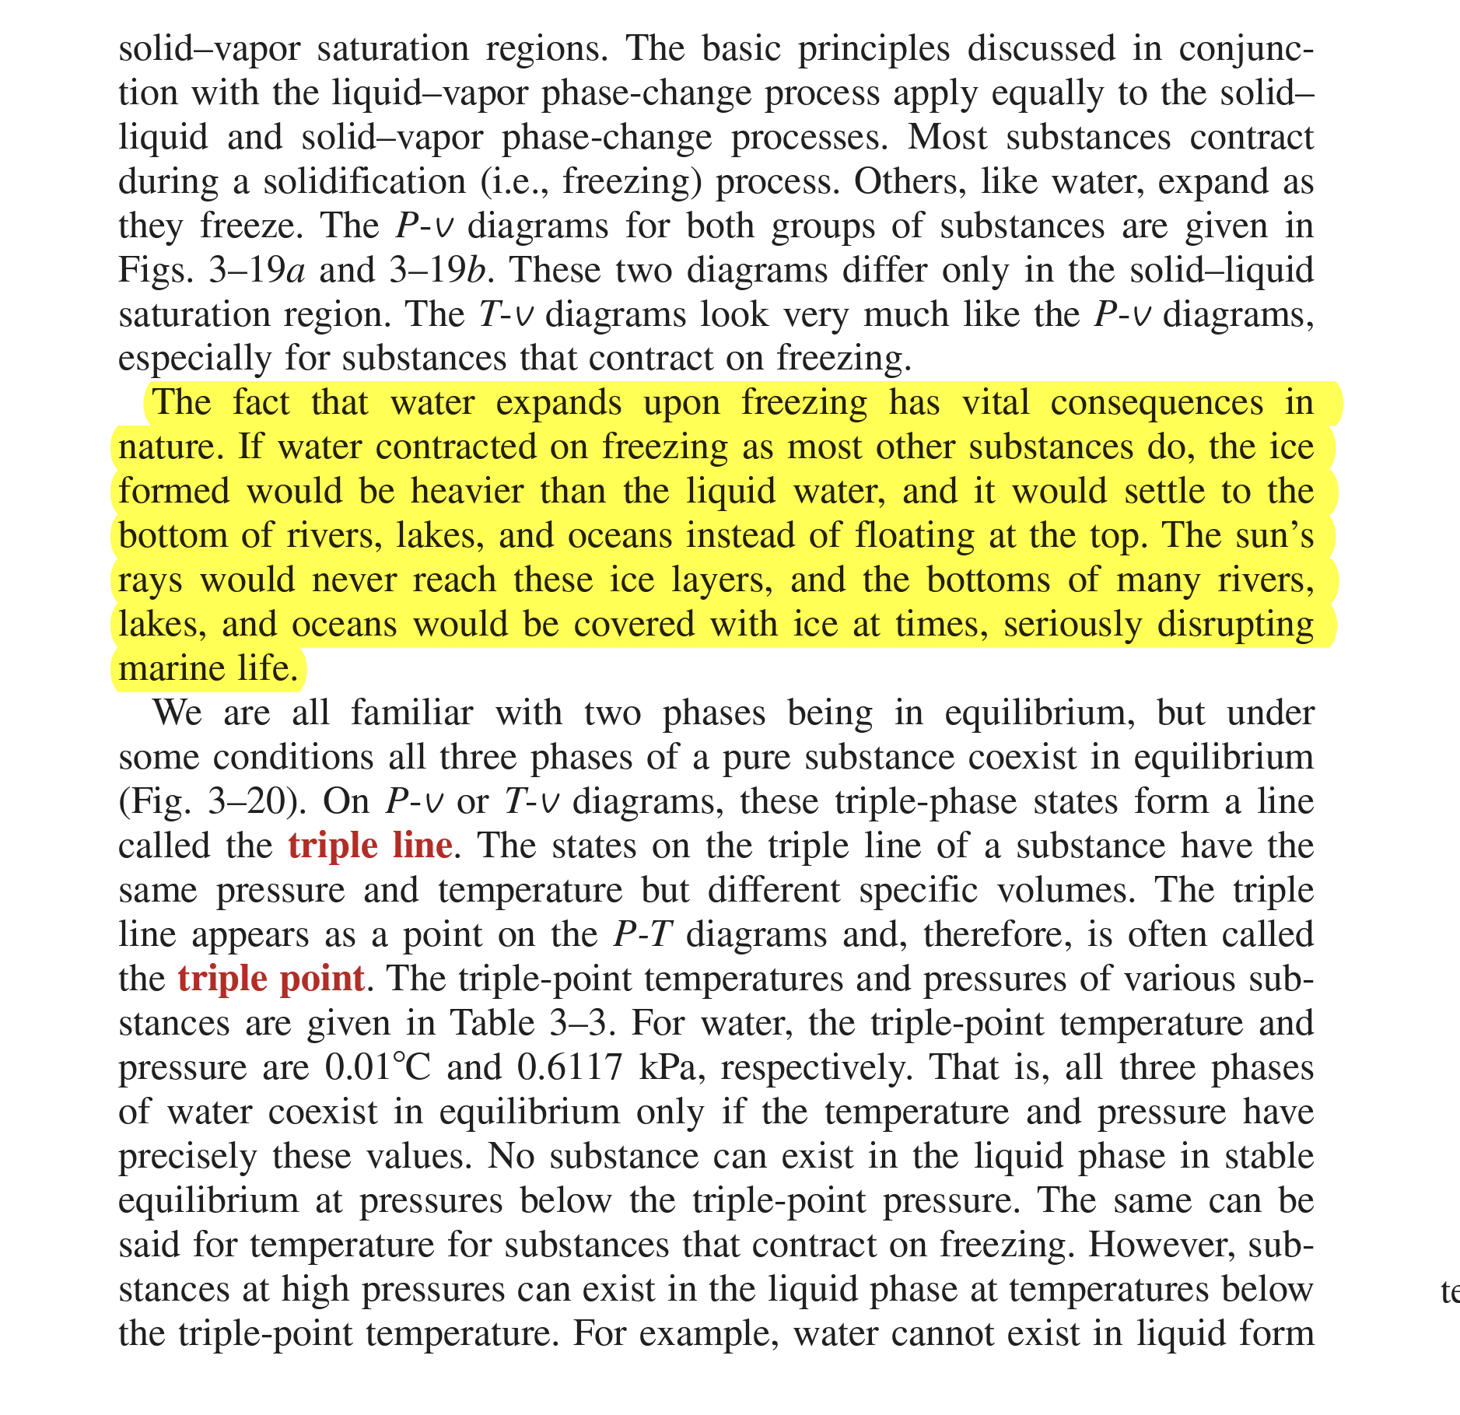

Slide 4
BACKGROUND
Written by Aaron Wesley Dicus
Born in 1888, obeyed the gospel in 1908
Received both a Masters Degree and a PHD in physics, credited with inventing the turn signal in 1920, as well as a few other inventions
Worked on the development on the atomic bomb to end WW2
In the 1950’s, he was invited to serve as academic dean at Florida College
Composed around 25 hymns, Our God, He is Alive being the most well known
Written in 1966 during a period where Modern Philosophy was trending towards “God is Dead”

Slide 5
OUR GOD, HE IS ALIVE
Four Verses
1. The invisible nature and limitless power of God
2. A God who spoke through prophets, who served as prof of his existence
3. The Giver of Life
4. The Ultimate Giver, A God willing to give us the means by which we may seek salvation

Slide 6
VERSE 1:
THE CREATOR OF THE WORLD
There is, beyond the azure blue
God exists outside our physical realm, above the heavens

Slide 7
VERSE 1:
THE CREATOR OF THE WORLD
There is, beyond the azure blue
God exists outside our physical realm, above the heavens
A God, Concealed from Human Sight
We cannot see God, not on this world.
This is crucial in creation, as for someone to create our universe, they had to be greater and beyond our limitations and understanding
Does not mean there is no evidence of His existence and Power
Romans 1:20

Slide 8
THREE ARGUMENTS THAT POINT TO A CREATOR
1. The Teleological Argument
A theology relating to the doctrine of design and purpose in the material world
“Design demands a designer”
2. The Cosmological Argument
Someone, or something, had to be outside the universe in order to create it. God fits that description
3. The Moral Argument
The existence of a true moral standard demands something greater than this world

Slide 9
VERSE 1: THE CREATOR OF THE WORLD
There is, beyond the azure blue
God exists outside our physical realm, above the heavens
A God, Concealed from Human Sight
We cannot see God, not on this world.
This is crucial in creation, as for someone to create our universe, they had to be greater and beyond our limitations and understanding
Does not mean there is no evidence of His existence and Power
Romans 1:20
The Bible also declares God has revealed himself to us
Colossians 1:15-16
He tinted skies with heavenly hue, and framed the worlds with his great might.
God created all things, and gave them his beauty
Psalm 19:1, Genesis 1:1-3, Hebrews 11:3

Slide 10
VERSE 2:
A GOD, REVEALED THROUGH THE PROPHETS
There was, a long, long time ago, A God, whose voice the prophets heard
The prophets lived between 2000-4000 years ago
Prophecy is a major reason why we should believe the Bible is what it says it is, and accept it as such
First Recorded prophet most likely Moses, roughly 1500 BC
He wrote about Jesus - Acts 3:22
Around 300 OT prophecies concerning Jesus, some so specific they cannot be anything but divine in nature
Jesus referred back to the prophets – Luke 24:44

Slide 11
VERSE 2:
A GOD, REVEALED THROUGH THE PROPHETS
There was, a long, long time ago, A God, whose voice the prophets heard
The prophets lived between 2000-4000 years ago
Prophecy is a major reason why we should believe the Bible is what it says it is, and accept it as such
First Recorded prophet most likely Moses, roughly 1500 BC
He wrote about Jesus - Acts 3:22
Around 300 OT prophecies concerning Jesus, some so specific they cannot be anything but divine in nature
Jesus referred back to the prophets – Luke 24:44
He is the God that we should know, who speaks from his inspired word.
Consider Isaiah 46:9-10
2 Timothy 3:16-17 – God speaks, we listen

Slide 12
GOD – THE GIVER OF LIFE
Secure is life from mortal mind, God holds the germ within his hand
Man cannot accurately explain our origins without the Bible
Man cannot create life, cannot provide the spark
The germ, or spark, is the source of life
Concerning life, God spoke and it happened –Genesis 1:11-12;20-22;24-26
We are created In God’s image
God is the giver of life – 1 Timothy 6:13, Acts 17:25

Slide 13
GOD – THE GIVER OF LIFE
Secure is life from mortal mind, God holds the germ within his hand
Man cannot accurately explain our origins without the Bible
Man cannot create life, cannot provide the spark
The germ, or spark, is the source of life
Concerning life, God spoke and it happened –Genesis 1:11-12;20-22;24-26
We are created In God’s image
God is the giver of life – 1 Timothy 6:13, Acts 17:25
Though men may search, they cannot find, for God alone does understand.
Consider the Mind of God
He knows why and we often do not, His ways are not our ways
Isaiah 55:8-9

Slide 14
GOD - THE ULTIMATE GIVER
Our God, whose Son upon a tree, a life was willing there to give
This verse establishes a spiritual purpose, declaring the gospel
God demonstrated his unmatched love by sending His Son to willingly die on a cross
John 3:16, Romans 5:6-9, Philippians 2:5-8

Slide 15
GOD - THE ULTIMATE GIVER
Our God, whose Son upon a tree, a life was willing there to give
This verse establishes a spiritual purpose, declaring the gospel
God demonstrated his unmatched love by sending His Son to willingly die on a cross
John 3:16, Romans 5:6-9, Philippians 2:5-8
That He from sin might set man free
Redemption – to be set free
Titus 2:14, Acts 2:38

Slide 16
GOD - THE ULTIMATE GIVER
Our God, whose Son upon a tree, a life was willing there to give
This verse establishes a spiritual purpose, declaring the gospel
God demonstrated his unmatched love by sending His Son to willingly die on a cross
John 3:16, Romans 5:6-9, Philippians 2:5-8
That He from sin might set man free
Redemption – to be set free
Titus 2:14, Acts 2:38
And evermore with Him could live
We are those who seek glory, honor, and immortality
Philippians 3:9-11, 1 Thessalonians 4:17, 1 Corinthians 15:51-58

Slide 17
THERE IS A GOD, HE IS ALIVE
There is a God
He Is alive
God is described as eternal and everlasting
Psalm 90:2, Psalm 102:12, Romans 16:26
In Him we live, and we survive
Jesus offers us an opportunity for eternal life
When this world ends, we will live on, in eternity with him – Matthew 25:46
From dust our God created Man, He is our God, the Great I Am
Genesis 2:7
Revealed to Moses at Mt. Sinai – Exodus 3:13-14

