Slide 1
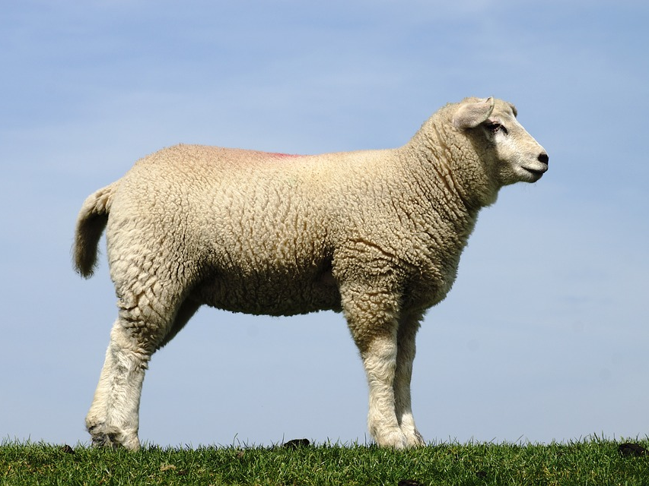
“Behold the Lamb of God who takes away the sin of the world!”

Slide 2
The Passover: Freedom From Bondage
God brought them to Himself.
Exodus 3:7-8
Colossians 1:13-14
God freed them from oppression and blessed them!
Hebrews 2:14-15
Ephesians 1:3

Slide 3
The Passover: Salvation From Sin and Judgment
God delivered them from judgment!
Exodus 12:12-13
Exodus 8:23
Ezekiel 20:6-8
In the same way we have been saved by the blood of the Lamb!
John 1:29
Romans 5:8-9
Revelation 12:11

Slide 4
The Passover:
A Picture of Redemption
God redeemed His people!
Exodus 6:6; 15:13
Exodus 13:2; Numbers 3:12
In the same way we have been redeemed by the blood of the Lamb!
1 Peter 1:18-19
Hebrews 12:22-23; 1 Peter 2:9
1 Corinthians 6:19-20

