Slide 1
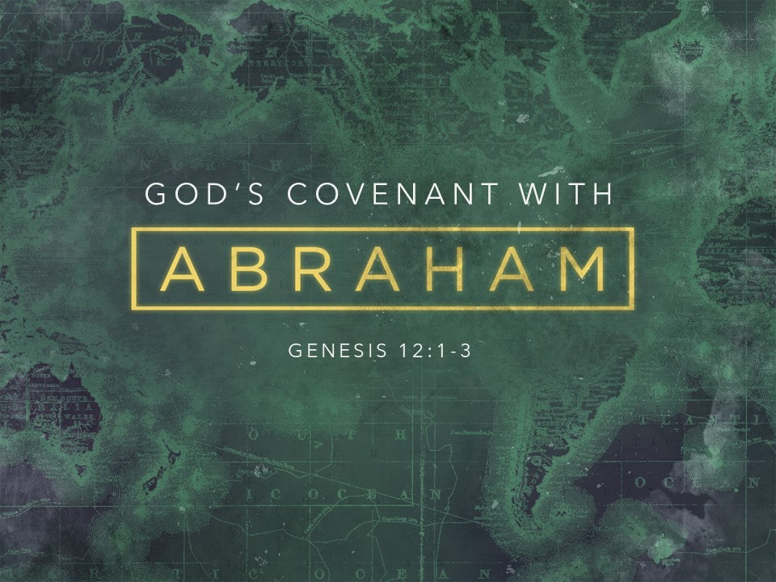

Slide 2
Genesis 12:1-3
¹ Now the Lord said to Abram, “Go from your country and your kindred and your father's house to the land that I will show you. ² And I will make of you a great nation, and I will bless you and make your name great, so that you will be a blessing. ³ I will bless those who bless you, and him who dishonors you I will curse, and in you all the families of the earth shall be blessed.”

Slide 3
The Righteous are Characterized by Obedience
Gen 6:22; 12:4; Jn 8:31; 1 Jn. 2:4
Faith is The Fuel of Obedience
Heb. 11; James 2:18-26

Slide 4
The Covenant Promises
The Seed Promise (Gen. 12:2; 15:5; 17:6)
Abraham would be blessed with innumerable descendants
The Land Promise (Gen. 12:1, 7)
Abraham’s descendants would occupy the land of Canaan (“The Promised Land”)
The Blessing Promise (Gen. 12:3)
One of Abraham’s descendant’s (Christ, cf. Matt. 1:1) would bring a blessing tor the whole world.

Slide 5
The Covenant Confirmed (Genesis 15)
Genesis 15:8-11
⁸ But he said, “O Lord God, how am I to know that I shall possess it?” ⁹ He said to him, “Bring me a heifer three years old, a female goat three years old, a ram three years old, a turtledove, and a young pigeon.” ¹⁰ And he brought him all these, cut them in half, and laid each half over against the other. But he did not cut the birds in half. ¹¹ And when birds of prey came down on the carcasses, Abram drove them away

Slide 6
The Covenant Confirmed (Genesis 15)
Genesis 15:17
When the sun had gone down and it was dark, behold, a smoking fire pot and a flaming torch passed between these pieces.
Walking between the pieces of a sacrifice was a common way of ratifying a covenant
The act communicated, “May what has been done to this animal be done to me if I break this covenant”

Slide 7
The Sign of The Covenant (Genesis 17)
Genesis 17:1-5
¹ When Abram was ninety-nine years old the Lord appeared to Abram and said to him, “I am God Almighty; walk before me, and be blameless, ² that I may make my covenant between me and you, and may multiply you greatly.” ³ Then Abram fell on his face. And God said to him, ⁴ “Behold, my covenant is with you, and you shall be the father of a multitude of nations. ⁵ No longer shall your name be called Abram, but your name shall be Abraham, for I have made you the father of a multitude of nations...

Slide 8
The Sign of The Covenant (Genesis 17)
Genesis 17:9-11, 14
⁹ And God said to Abraham, “As for you, you shall keep my covenant, you and your offspring after you throughout their generations. ¹⁰ This is my covenant, which you shall keep, between me and you and your offspring after you: Every male among you shall be circumcised. ¹¹ You shall be circumcised in the flesh of your foreskins, and it shall be a sign of the covenant between me and you…¹⁴ Any uncircumcised male who is not circumcised in the flesh of his foreskin shall be cut off from his people; he has broken my covenant.”

Slide 9
The Fulfillment of the Covenant Promises
The Seed Promise (Gen. 12:2; 15:5; 17:6)
Made when Abram and Sarai were advanced in years and Sarai was barren (Gen. 11:30; 12:4; 21:5)
Abram’s descendants became numerous and powerful in Egypt (Ex. 1:1-10)
They were as “the stars of heaven” prior to entering Canaan (Deut. 1:10)

Slide 10
The Fulfillment of the Covenant Promises
2. The Land Promise (Gen. 12:1, 7)
Abraham’s descendants begin to occupy Canaan (Joshua 6)
The promise HAS BEEN fulfilled (Josh. 21:43-45; Neh. 9:7-8)

Slide 11
The Fulfillment of the Covenant Promises
The Blessing Promise (Gen. 12:3)
Christ, a descendant of Abraham, brought salvation for the world (Matt. 1:1; Jn. 3:16; Lk. 19:10)
Christ’s death and resurrection brough “the new covenant” (Lk. 22:20; Jer. 31:31; Heb. 9:15)
In Christ, “a circumcision without hands” occurs (Col. 2:11-12)

Slide 12
The Fulfillment of the Covenant Promises
The Blessing Promise (Gen. 12:3)
In Christ, we are spiritual descendants of Abraham (Gal. 3:28-29)
As his descendants, we await the spiritual Promised Land of heaven (Heb. 9:15;
In Christ, “a circumcision without hands” occurs (Col. 2:11-12)

Slide 13
Two Takeaways
Despite our failings, we can be in covenant relationship with God
Abraham fell short of God’s glory, and so have we (Rom. 3:23; 1 Jn. 1:8-10)
Despite our shortcomings, God desires to be in covenant relationship with us.
Possible through Abraham-like faith in Jesus Christ (Rom. 4:10-12)

Slide 14
Two Takeaways
Being in covenant relationship with God changes our identity
God changed Abram’s name to Abraham (father of a multitude)
When we enter into covenant relationship though Christ, we wear the name of Christ (Gal. 3:27-28; Acts 11:26).
Our new identity communicates who we are in Christ and how we live in Him.

