Slide 1
The Habits of Jesus

Slide 2
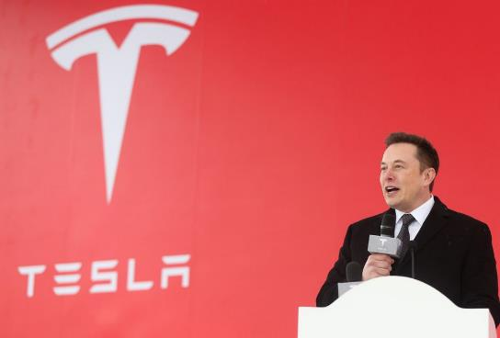
Elon Musk
https://cnet1.cbsistatic.com/img/t0F_0OeuYahLBRhCtP1x-bKPd7g=/940x0/2019/03/08/cb1cb096-1ce0-48cb-a247-a50d8534d980/gettyimages-1079242950.jpg

Slide 3
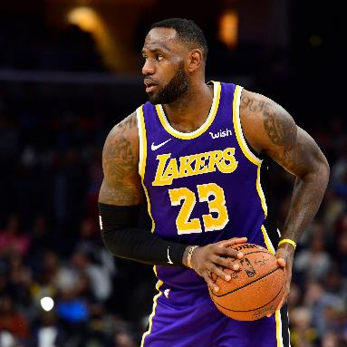
LeBron
James
https://static01.nyt.com/images/2020/06/10/us/politics/10lebron-voters/10lebron-voters-mediumSquareAt3X.jpg

Slide 4
J.K.
Rowling
https://encrypted-tbn0.gstatic.com/images?q=tbn:ANd9GcSAC65yYCPIragZS0Uchkti5-05OhdmwH62uw&usqp=CAU

Slide 5
The Habits of Jesus
Solitude
-Jesus set time aside to be alone, in solitude, to spend time with the Father.
Commitment
-Jesus was fully committed to doing the will of the Father.
3. Focus
-Jesus had an undivided focus on HIS mission.
4. Passion
-Jesus had a passion for building relationships.

Slide 6
The Habits of Jesus

