Slide 3
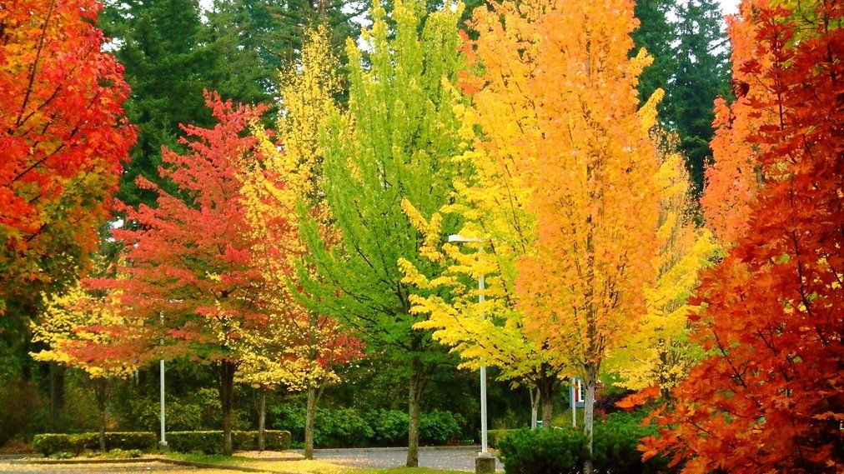

Slide 5
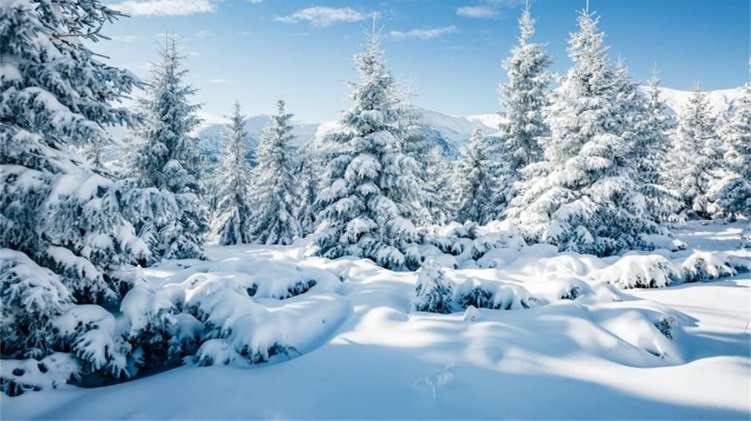

Slide 6
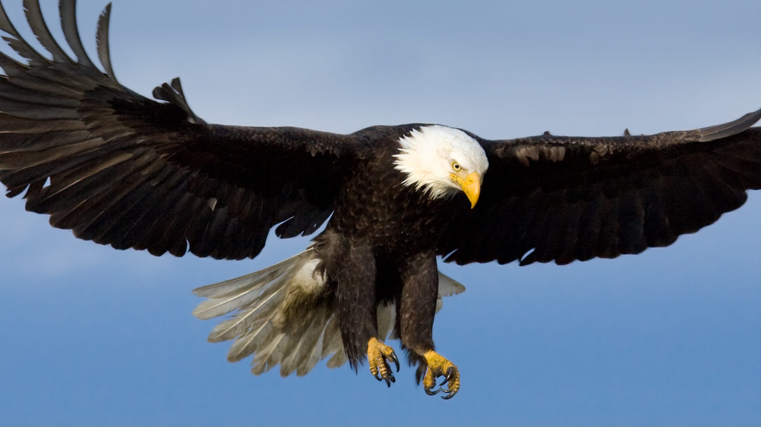

Slide 7
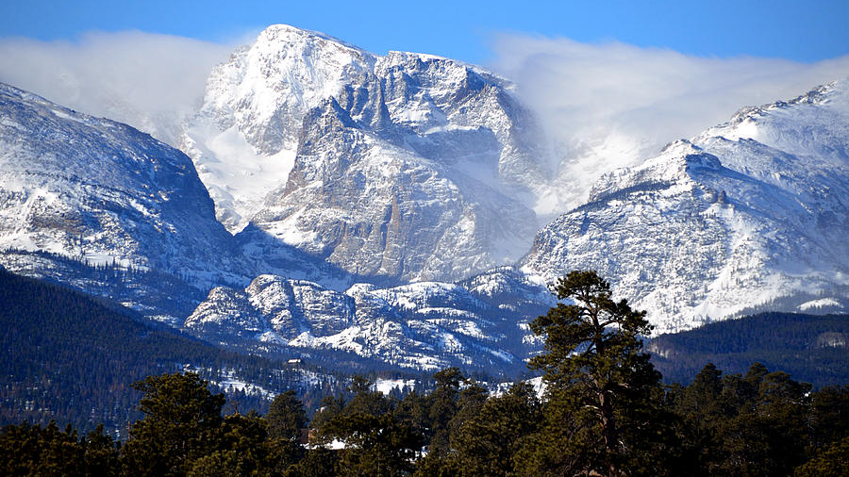

Slide 9
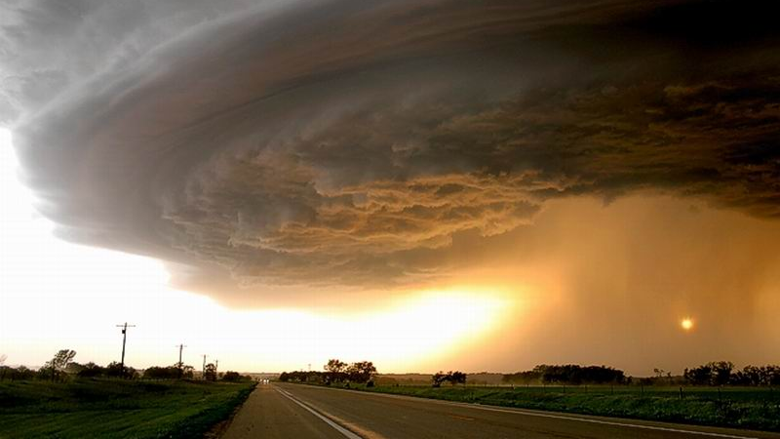

Slide 10
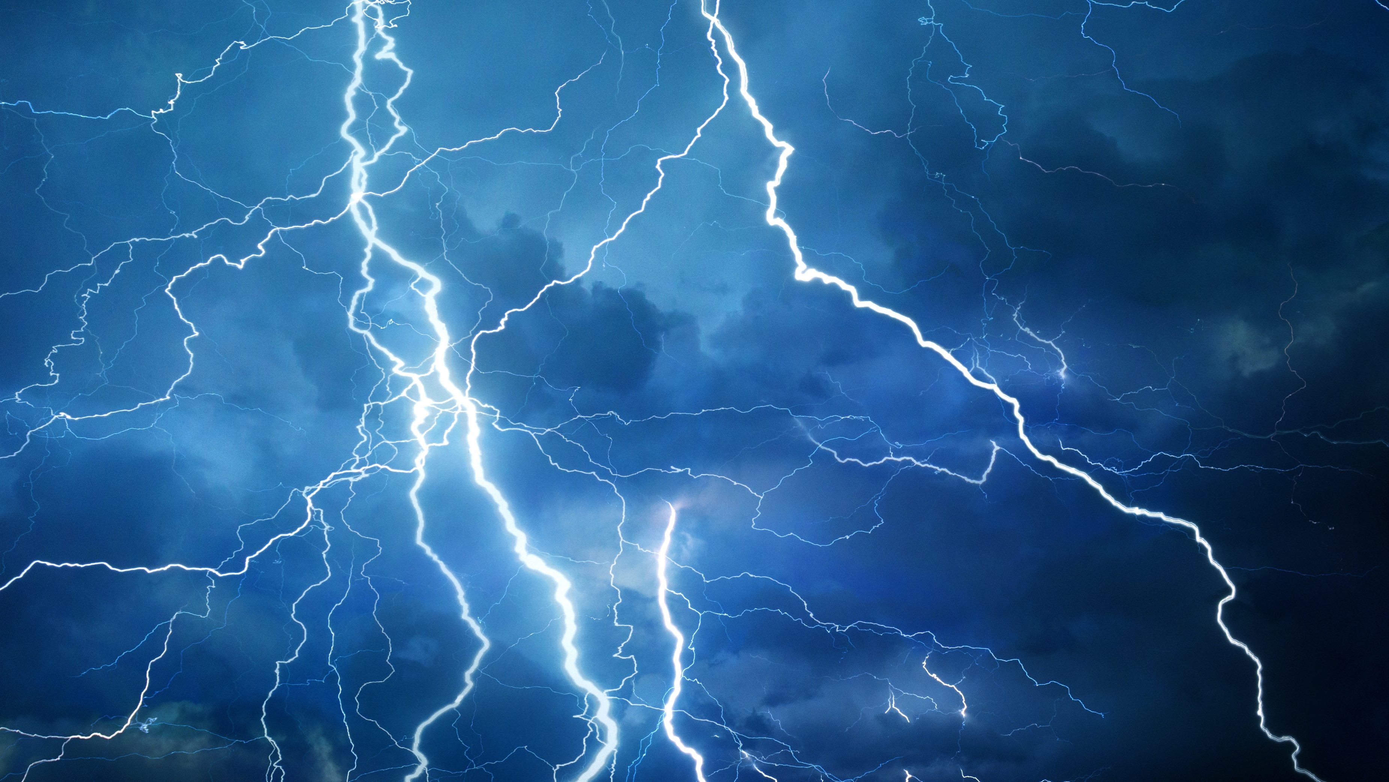

Slide 11
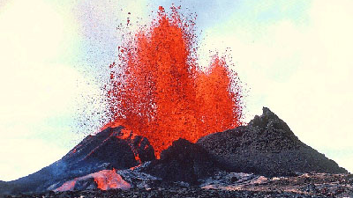

Slide 12
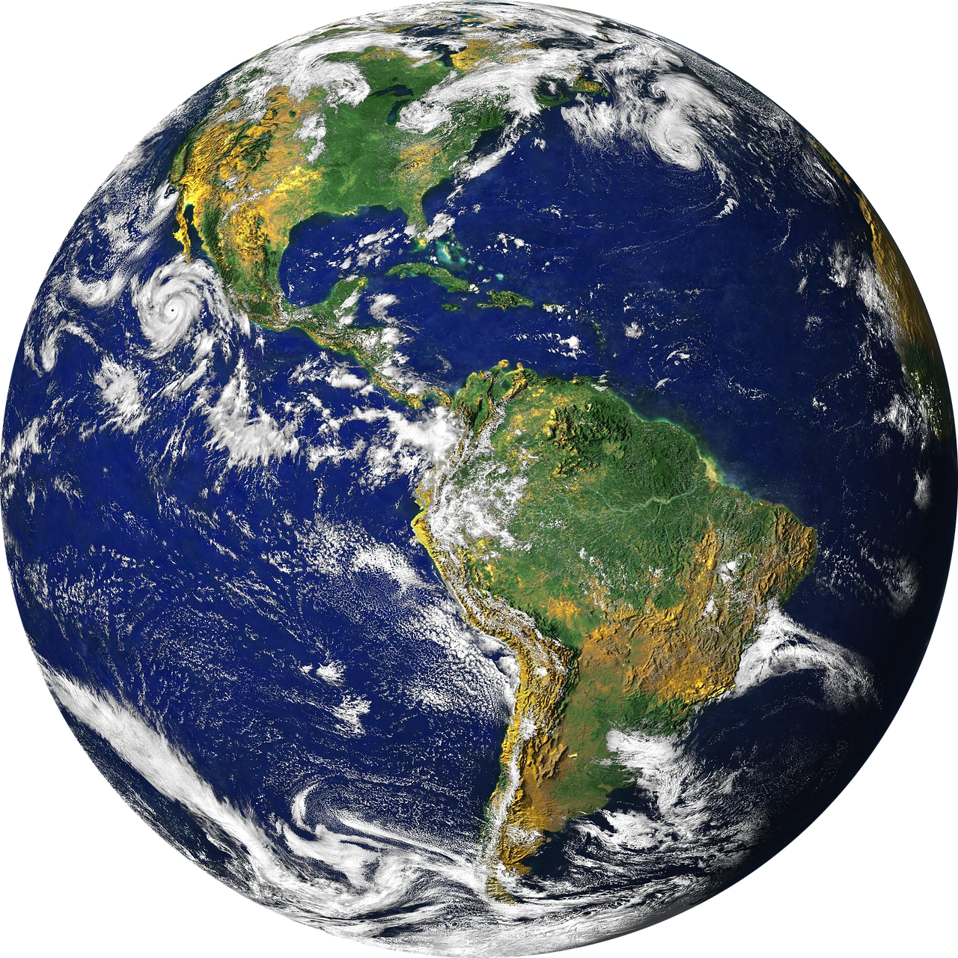
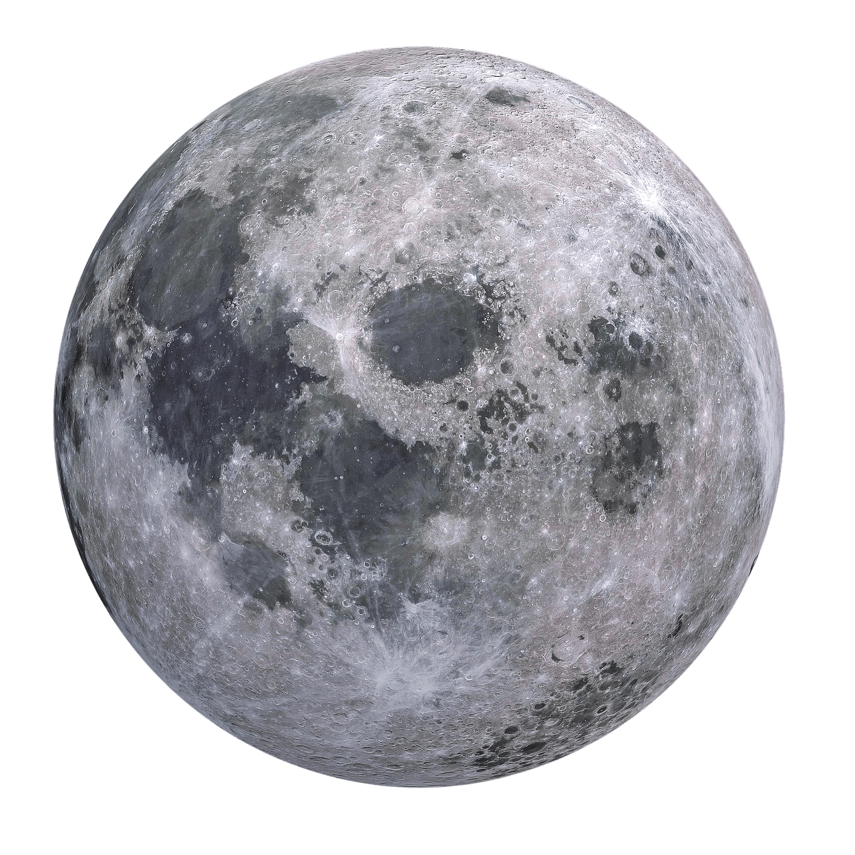

Slide 13
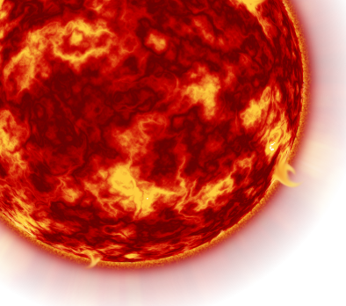

Slide 14
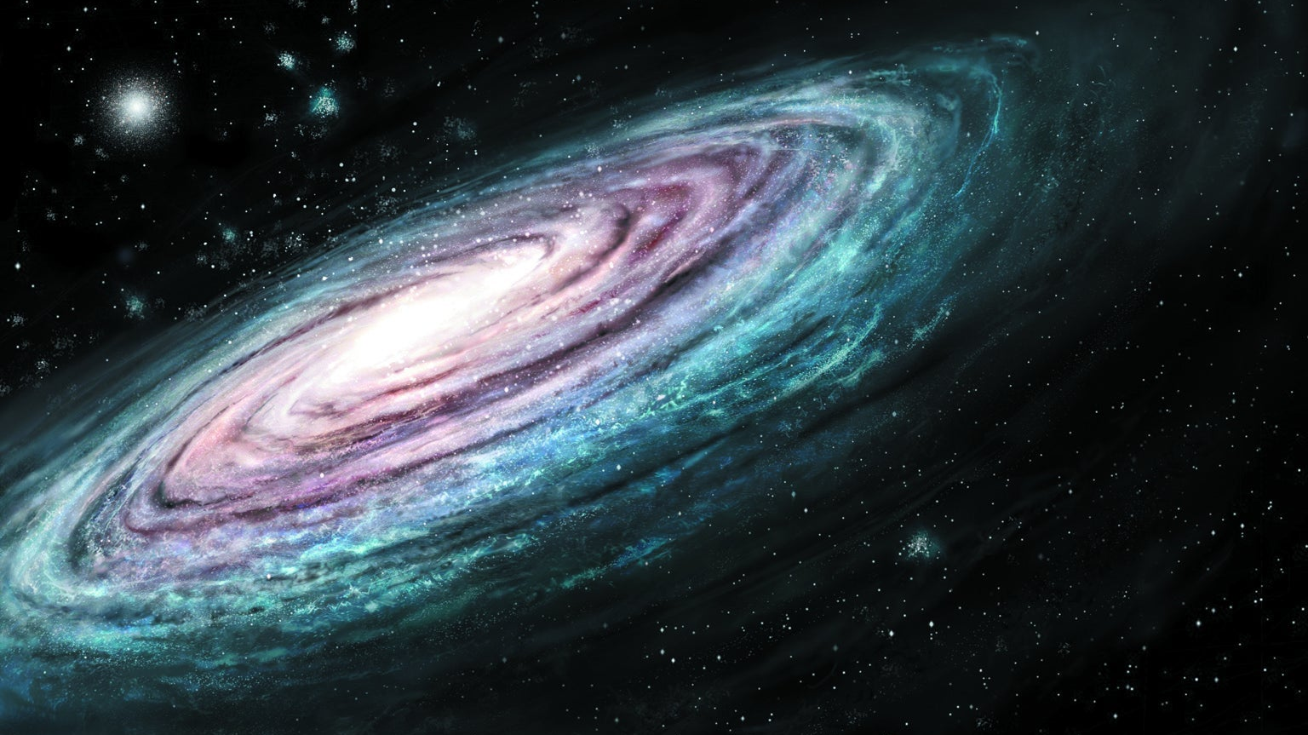

Slide 15
What would you want others to see in East End?

Slide 16
Acts 11:19-27
Then news of these things came to the ears of the church in Jerusalem, and they sent out Barnabas to go as far as Antioch. When he came and had seen the grace of God, he was glad, and encouraged them all that with purpose of heart they should continue with the Lord.

Slide 17
Acts 11:19-27
Then news of these things came to the ears of the church in Jerusalem, and they sent out Barnabas to go as far as Antioch. When he came and had seen the grace of God, he was glad, and encouraged them all that with purpose of heart they should continue with the Lord.

Slide 18
Grace
“Unmerited favor”
Unmerited divine assistance given to humans for their regeneration or sanctification
A state of sanctification enjoyed through divine assistance
Seeing The Grace Of God?

Slide 19
The Evidence Of Grace
A Love For Souls
An active outreach
Romans 1:16
What Did Barnabas See?

Slide 20
For I am not ashamed of the gospel, because it is the power of God that brings salvation to everyone who believes: first to the Jew, then to the Gentile.
Romans 1:16

Slide 21
The Evidence Of Grace
A Love For Souls
An active outreach
Romans 1:16
It is why Jesus came
“The church is the only cooperative society in the world that exists for the benefit of its nonmembers.” William Temple
What Did Barnabas See?

Slide 22
The Evidence Of Grace
A Love For Souls
An active outreach
Romans 1:16
It is why Jesus came
Redemption & Change
“Believed &Turned”
What Did Barnabas See?

Slide 23
The Effects Of Grace
A Faithful Assembly
Considerable numbers
Growing Christians
“Disciples first called Christians at Antioch”
Christians – 3 times
Disciples – 270 times
What Did Barnabas See?

Slide 24
The Endeavor Of Grace
A Benevolent Church
Showed grace to others
“Determined to send a contribution”
2 Corinthians 8:1-5
2 Corinthians 9:8-9
What Did Barnabas See?

Slide 25
Seeing The Grace Of God At East End
A faithful, loving, growing, generous, actively working body of Christians!

Slide 26
God Will Do His Part
And God is able to make all grace abound toward you, that you, always having all sufficiency in all things, may have an abundance for every good work.
2 Corinthians 9:8-9

Slide 27
God Will Do His Part
And I am sure of this, that he who began a good work in you will bring it to completion at the day of Jesus Christ.
Philippians 1:6

Slide 28
Let’s Do Our Part
“As each one has received a gift, minister it to one another, as good stewards of the manifold grace of God.”
1 Peter 4:10
A Challenge For 2021
Find Your Gift – Use Your Gift

