Slide 2
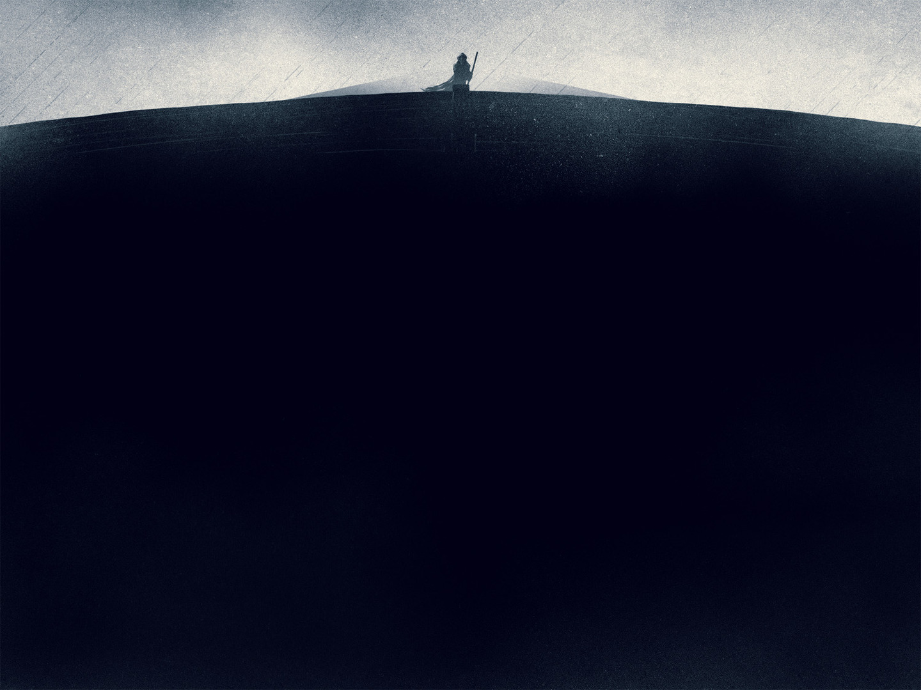
Covenant
“A binding relationship between two parties in which each [pledges] to perform some service for the other.”
– Holman Illustrated Bible Dictionary

Slide 3
Throughout Scripture, God establishes covenants with mankind known as “suzerain covenants.”

Slide 4
The Wickedness The Earth
Genesis 6:5 -The Lord saw that the wickedness of man was great in the earth, and that every intention of the thoughts of his heart was only evil continually.
Genesis 6:11 - ¹¹ Now the earth was corrupt in God's sight, and the earth was filled with violence. ¹² And God saw the earth, and behold, it was corrupt, for all flesh had corrupted their way on the earth.

Slide 5
The Judgment of God
Genesis 6:7 - So the Lord said, “I will blot out man whom I have created from the face of the land, man and animals and creeping things and birds of the heavens, for I am sorry that I have made them.”
Genesis 6:17 - ¹⁷ For behold, I will bring a flood of waters upon the earth to destroy all flesh in which is the breath of life under heaven. Everything that is on the earth shall die.

Slide 6
The Flood:
A Demonstration of God’s Patience
All sin is deserving of immediate judgement.
God waited around 1600 years before bringing the flood.
God will execute His righteous judgement, but His desire is reconciliation (Ex. 34:6; Rom. 2:4; 2 Pet. 3:9; 1 Tim. 2:3-4).

Slide 7
The Flood:
A Reminder of God’s Awareness
God is aware and cares about the status of His creation (Gen. 6:5, 7, 11)
God actively seeks to strengthen those who are His (2 Chr. 16:9)

Slide 8
The Righteousness of Noah
Genesis 6:8-9 - ⁸ But Noah found favor in the eyes of the Lord. ⁹ These are the generations of Noah. Noah was a righteous man, blameless in his generation. Noah walked with God.
Genesis 7:1 - Then the Lord said to Noah, “Go into the ark, you and all your household, for I have seen that you are righteous before me in this generation.

Slide 9
The Diligence of Noah
Over the period of multiple decades, Noah built the ark to God’s exact specifications (Gen. 6:22; 7:5).
How close do we pay attention to God’s words?
(Lev. 8-10; 2 Sam. 6).
We must revere Scripture for what it is – the Word of God (2 Tim. 3:16-17).

Slide 10
The Faith of Noah
Noah’s faith in God caused him to work diligently, even though he likely knew nothing of floods and rain (Gen. 2:5-6; Heb. 11:1, 7)
We can have faith in God and “events yet unseen” because of God’s faithfulness (Titus 1:2)

Slide 11
Genesis 7:11-24

Slide 12
Genesis 8:20-22

Slide 13
Genesis 9:8-17

Slide 14
We’re going back to (spiritual) Eden
(Gen. 9:1, 7; cf. Gen. 1:27-28; Rev. 21-22)
A Greater Judgement is Coming
(2 Pet. 3:1-12; 2 Cor. 5:10; Matt. 10:28)

