Slide 1
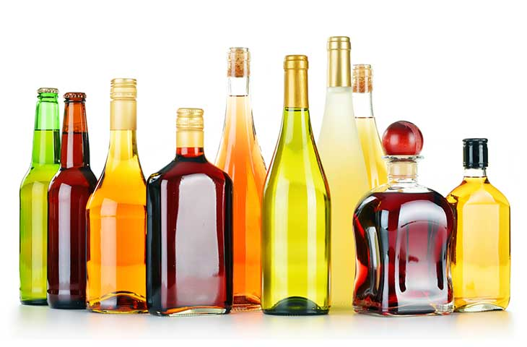
Why I Abstain From Drinking

Slide 2
For Your Consideration
“Wine” in the Bible may or may not be alcoholic
Gk. oinos is a generic term that can refer to fermented juice, non-fermented juice, or vinegar
Our Wine is Not Their Wine
Common ancient practice was to water down the wine (20:1 – 3:1)
3:2 was considered a strong drink (3% alcohol content)

Slide 3
Drunkenness is a sin!
Eph. 5:8; Rom. 13:13; 1 Cor. 5:11;
Gal. 5:21; Titus 1:7; 1 Pet. 4:3

Slide 4
Why I Abstain From Drinking
I’m a priest in the service of the Lord
Levitical priest were to abstain during their service (Ezk. 44:21; Lev. 10:9)
All Christians are priests under the new covenant (Rev. 1:6; 5:9-10; 20:6; 1 Pet. 2:5, 9)
Our bodies are the temple of God (1 Cor. 6:19-20)
Everything we do is about serving Him

Slide 5
Why I Abstain From Drinking
I’m a soldier who needs to be sober
Satan is a relentless foe (Rev. 13, 16, Eph. 6)
Alcohol leads to impaired judgement and reasoning (Hos. 4:10)
I’m fighting for my soul

Slide 6
Why I Abstain From Drinking
Wisdom’s Warnings
Wisdom cannot be despised (Pr. 1:7)
Wisdom warns about the dangers of wine (Pr. 20:1; 21:7; 23:29-35)

Slide 7
Why I Abstain From Drinking
I need to be filled with the Spirit
…as opposed to wine (Eph. 5:18)
Wine can prevent me from focusing that which brings me closer to God.

Slide 8
Why I Abstain From Drinking

