Slide 2
Ephesians 4:3
eager to maintain the unity of the Spirit in the
bond of peace.
Ephesians 4:13
until we all attain to the unity of the faith and of the knowledge of the Son of God…

Slide 3
Ephesians 4:7-10
⁷ But grace was given to each one of us according to the measure of Christ's gift. ⁸ Therefore it says,
“When he ascended on high he led a host of captives,
and he gave gifts to men.” ⁹ (In saying, “He ascended,” what does it mean but that he had also descended into the lower regions, the earth? ¹⁰ He who descended is the one who also ascended far above all the heavens, that he might fill all things.)

Slide 4
All Christians have been gifted and our gifts help to attain unity (v. 7).
1 Pet. 4; Rom. 12;
1 Cor. 12

Slide 5
Identifying Our Spiritual Gifts
In what areas do you accel in daily life?
Coach/teacher = leader/mentor
Administrative tasks = organizer/planner
Thinking of others = empathizer/encourager
What do others see in you that you may not?
perceptive, thoughtful, relatable, etc…
How can you become more self-aware of these and use them in the Kingdom?
What are your instinctual reactions?
e.g. when the fine china breaks?
Instruct? Empathize? Encourage? Give?

Slide 6
Ephesians 4:11
¹¹ And he gave the apostles, the prophets, the evangelists, the shepherds and teachers,

Slide 7
Ephesians 2:19-21
¹⁹ So then you are no longer strangers and aliens, but you are fellow citizens with the saints and members of the household of God, ²⁰ built on the foundation of the apostles and prophets, Christ Jesus himself being the cornerstone, ²¹ in whom the whole structure, being joined together, grows into a holy temple in the Lord.

Slide 8
Ephesians 4:11-12
¹¹ And he gave the apostles, the prophets, the evangelists, the shepherds and teachers,
¹² to equip the saints for the work of ministry, for building up the body of Christ,

Slide 9
Equipping is a
two-sided endeavor

Slide 10
Ephesians 4:13-14
¹³ until we all attain to the unity of the faith and of the knowledge of the Son of God, to mature manhood, to the measure of the stature of the fullness of Christ, ¹⁴ so that we may no longer be children, tossed to and fro by the waves and carried about by every wind of doctrine, by human cunning, by craftiness in deceitful schemes.

Slide 11
Hebrews 5:11-14
¹¹ About this we have much to say, and it is hard to explain, since you have become dull of hearing.¹² For though by this time you ought to be teachers, you need someone to teach you again the basic principles of the oracles of God. You need milk, not solid food, ¹³ for everyone who lives on milk is unskilled in the word of righteousness, since he is a child. ¹⁴ But solid food is for the mature, for those who have their powers of discernment trained by constant practice to distinguish
good from evil.

Slide 12
Ephesians 4:15-16
¹⁵ Rather, speaking the truth in love, we are to grow up in every way into him who is the head, into Christ, ¹⁶ from whom the whole body, joined and held together by every joint with which it is equipped, when each part is working properly, makes the body grow so that it builds itself up in love.

Slide 14
CHRIST
Christian
Christian
Christian
Christian

Slide 15
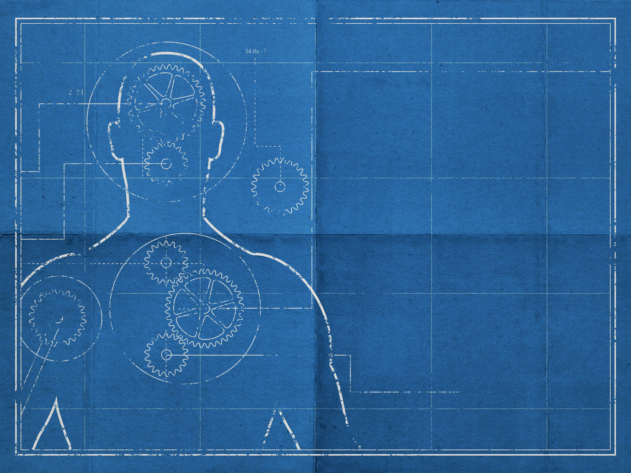
GIFTS THAT ATTAIN
unity
EPHESIANS 4:7-12

