Slide 1
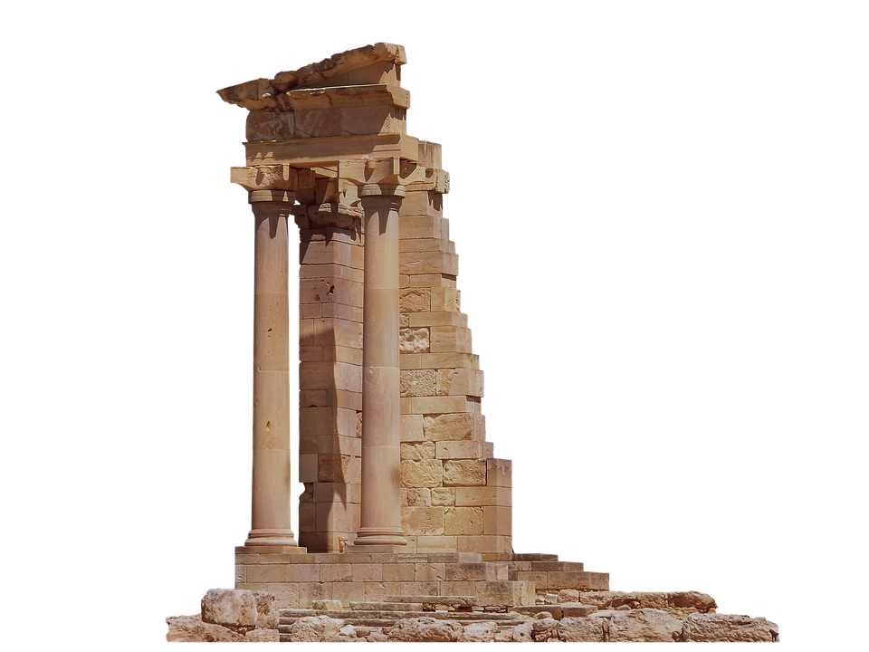
How We Became
The Temple of God

Slide 2
God’s Presence in Israel
The Foundation:
Isaiah 63:9-14
Nehemiah 9:19-21
God’s covenant relationship:
Exodus 19:4-6 / 1 Peter 2:4-5
Exodus 40:36-38
The Tabernacle / Temple: Exodus 40:33-35; Leviticus 9:23-24; 1 Kings 8:10-11; 2 Chronicles 7:1

Slide 3
God’s Presence Lost
The Reason: Ezekiel 8:6
God’s presence is withdrawn...
Ezekiel 10:4
Ezekiel 10:18-19
Ezekiel 11:22-23

Slide 4
The Promise of God’s Presence Restored
The Promise:
Isaiah 44:1-3
Ezekiel 39:29
Zechariah 12:10
This was not fulfilled in the second temple.
Ezra 6:15-16
Haggai 1:13; Malachi 3:1

Slide 5
The Fulfillment of the Promise
The Promise: Joel 2:28ff
The Fulfillment:
“...there came from heaven a noise like a violent rushing wind, and it filled the whole house...” (Acts 2:2)
“...tongues as of fire distributing themselves, and they rested on each one of them.” (Acts 2:3)
They were all filled with the Holy Spirit...” (Acts 2:4)

