Slide 1
APOLOGETICS
BEING READY TO GIVE A DEFENSE

Slide 2
[If we are going to discredit the NT for lack of the originals], “then we must deny that most facts of ancient history can be recovered, because whatever doubts we cast on the text of the NT must be cast a hundredfold on virtually any other ancient text.”
– J. Ed Komoszewski, Reinventing Jesus: How Contemporary Skeptics Miss the Real Jesus and Mislead Popular Culture

Slide 3
New Testament Manuscript Authority
Author and/or Work | Date Written | Earliest Known Copy | Time Between Original and Earliest Copy | Number of Known Copies
Homer’s Iliad | 900 BC | 400 BC | 500 years | 643
Aristotle | 350 BC | AD 1100 | 1400 years | 49
Plato’s Tetralogies | 400 BC | AD 900 | 1300 years | 7
New Testament | AD 40-100 | AD 350 (Codex Sinaiticus) | 250 years | 5300
*Earliest known NT fragment is from the gospel of John and is dated from AD 125-130. Depending on the dating of John’s writing, this fragment could be only 40 years older than the original.
Source: Holman QuickSource Guide to Christian Apologetics

Slide 4
What About the Variants?
Variants refer to differences between the manuscripts
There are some 20,000 variants in about 10,000 different locations
The number of variants are no cause for concern when we realize what the variants are.

Slide 5
Types of Variants
Misspellings and Spelling Differences
“Barnabas” vs. “Barnabus”

Slide 6
Types of Variants
Misspellings and Spelling Differences
“You all” vs. “Y’all”

Slide 7
Types of Variants
Inadvertent Differences
“Landon loves pizza” vs. “London loves pizza”

Slide 8
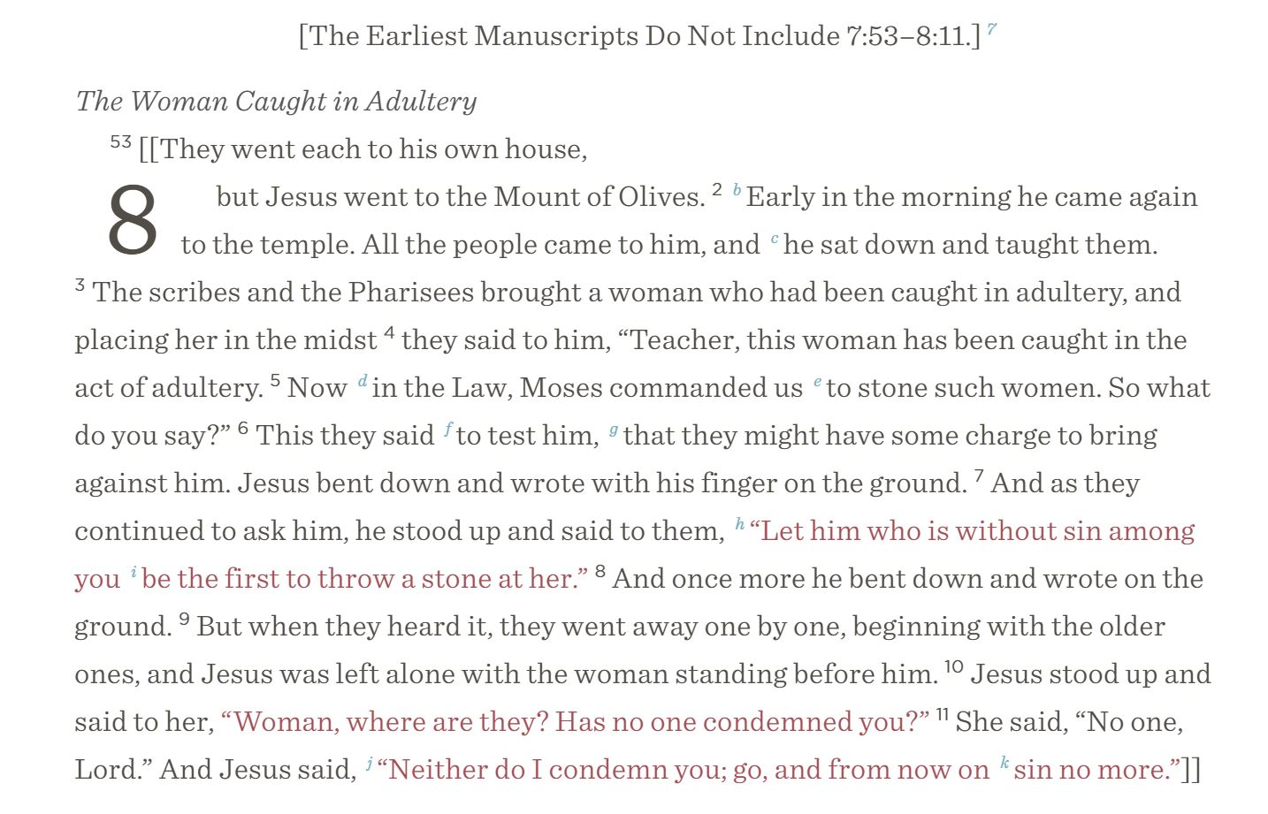
Types of Variants – textual inclusions/exclusions
ESV Study Bible

Slide 9
“Most historians accept the textual accuracy of other ancient works on far less adequate manuscript grounds than is available for the New Testament.”
– J.P. Moreland, Scaling the Secular City

Slide 10
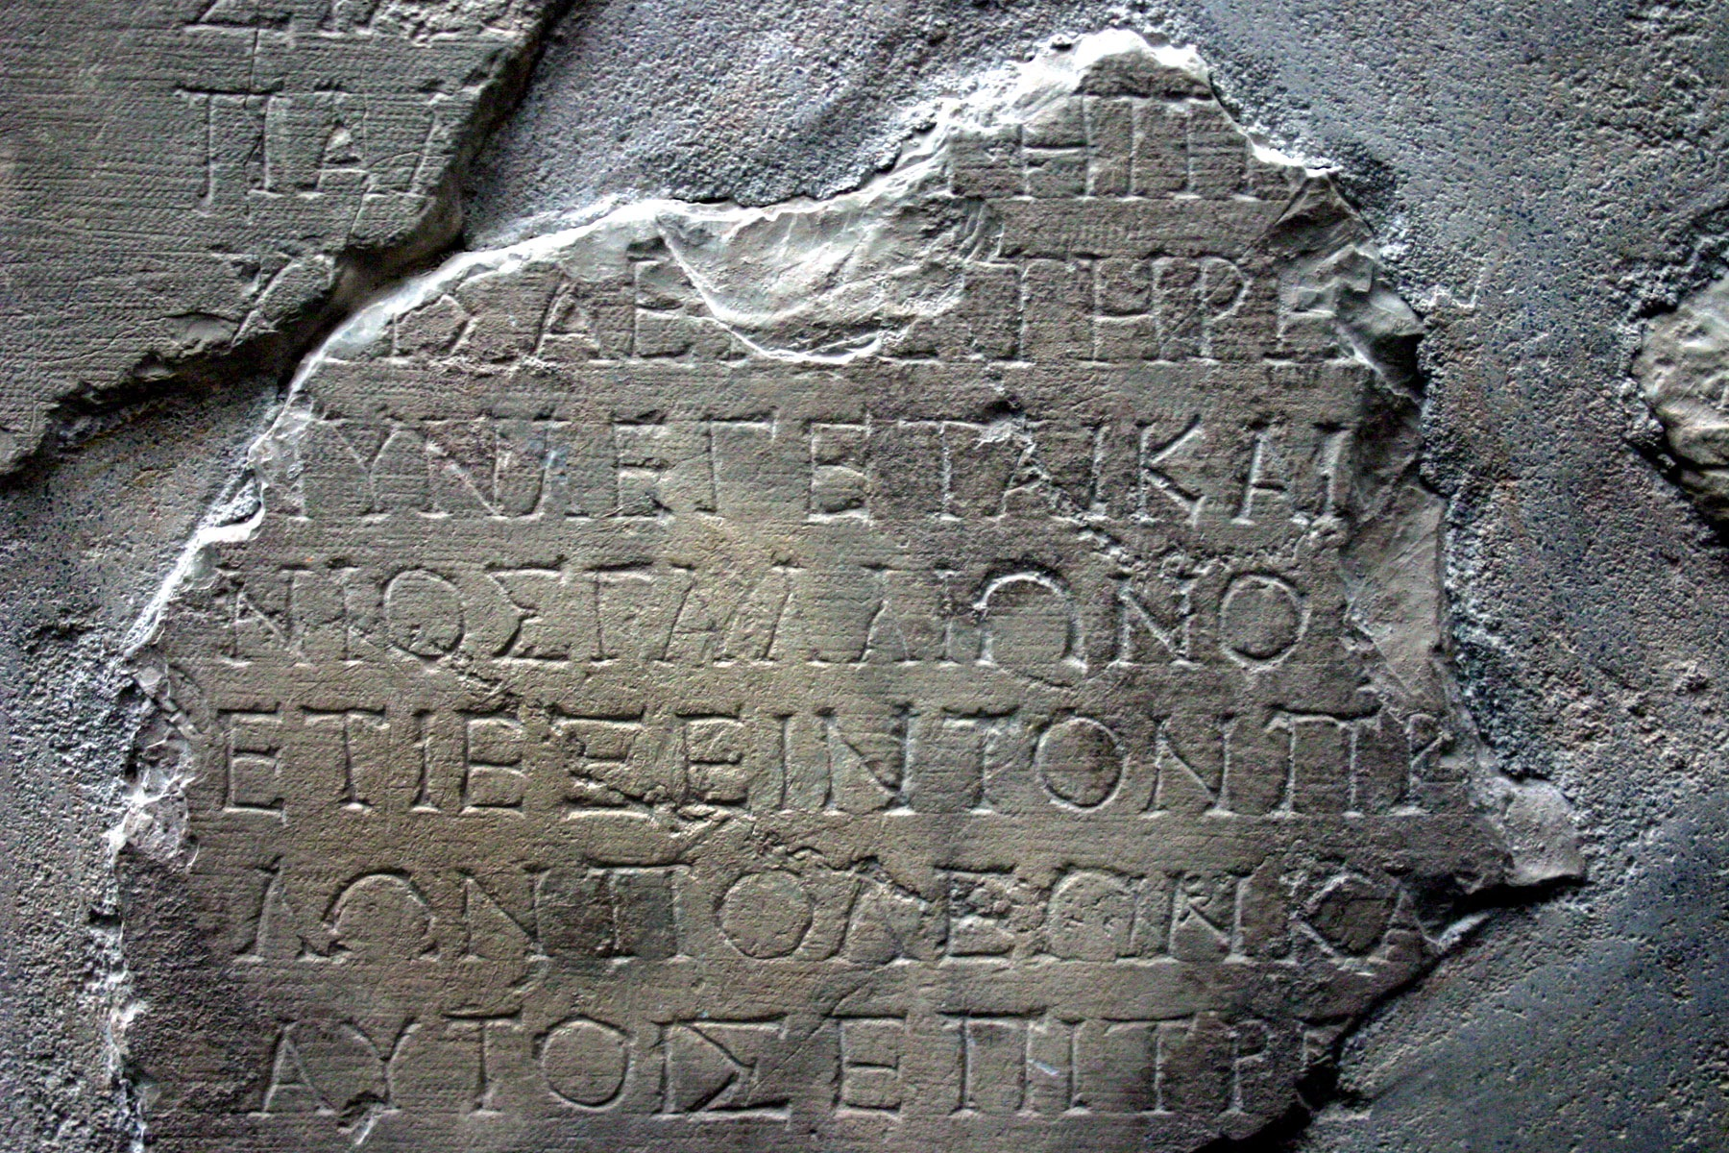
Gallio Inscription
Holylandphotos.wordpress.com

Slide 11
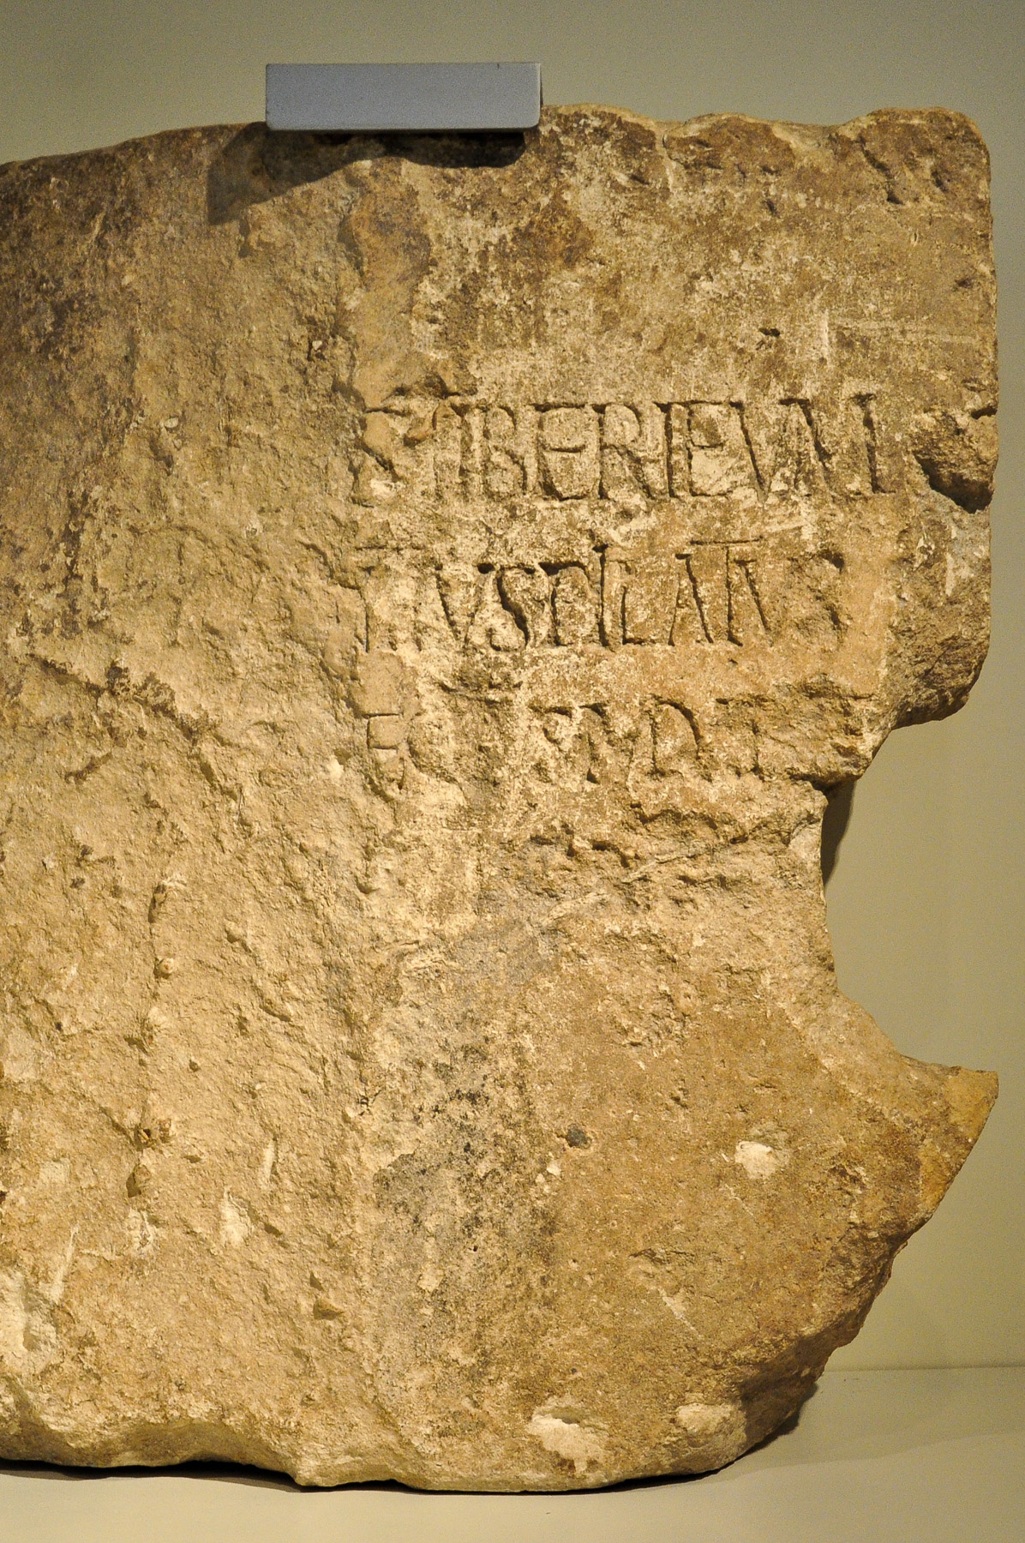
Pilate Stone
Holylandphotos.wordpress.com

Slide 12
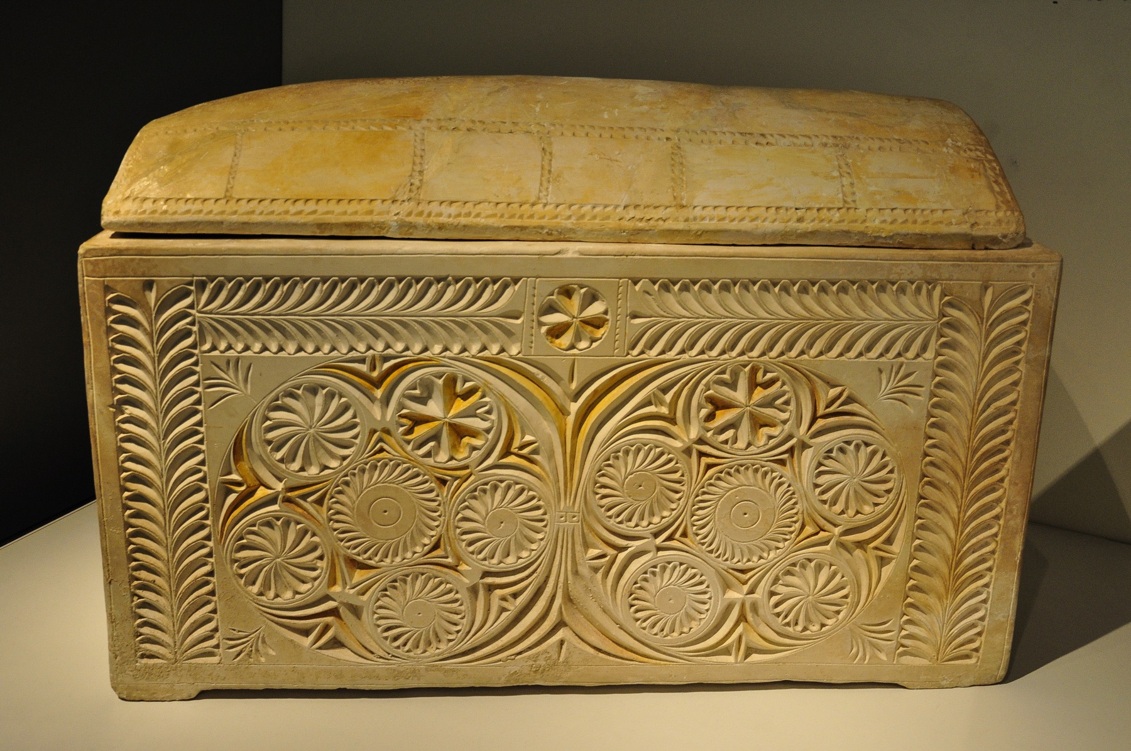
Caiaphas Ossuary
Holylandphotos.wordpress.com

Slide 13
Internal Evidence
No indication of “sugar coating”
Jesus rejected by family and friends (Mk. 3:21; 7:5)
Jesus rejected by His hometown (Mk. 6:2-4)
Repeated failures of the apostles (Mk. 9:18, 34; Gal. 2:11-14

Slide 14
The evidence suggests more than just a reliable book, but an inspired book.
2 Timothy 3:16-17
¹⁶ All Scripture is breathed out by God and profitable for teaching, for reproof, for correction, and for training in righteousness, ¹⁷ that the man of God may be complete, equipped for every good work.

Slide 15
APOLOGETICS
BEING READY TO GIVE A DEFENSE

Slide 16
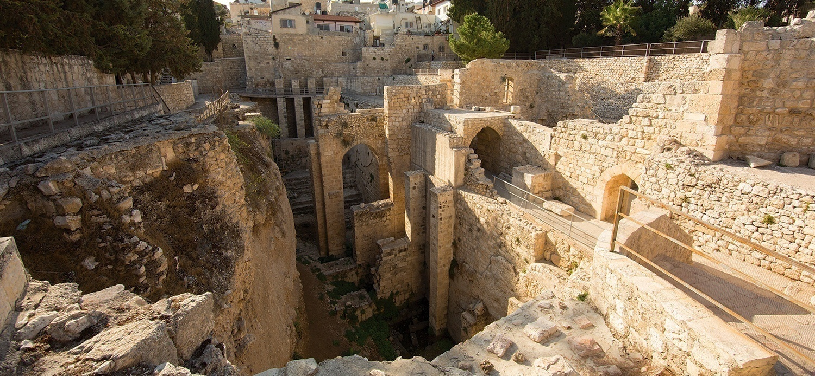
Pool of Bethesda
drivethruhistory.com

Slide 17
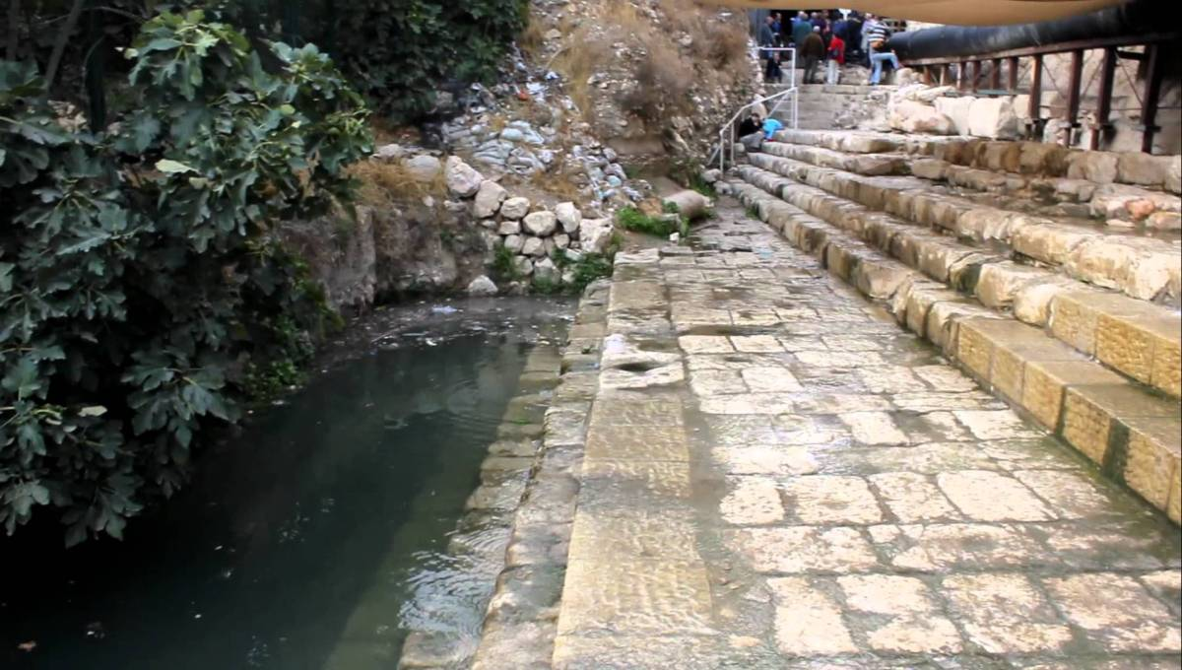
Pool of Siloam
bibliauthenticity.com

Slide 18
Types of Variants
Synonym Variations
“Jesus Christ” vs. “Christ Jesus”

