Slide 1
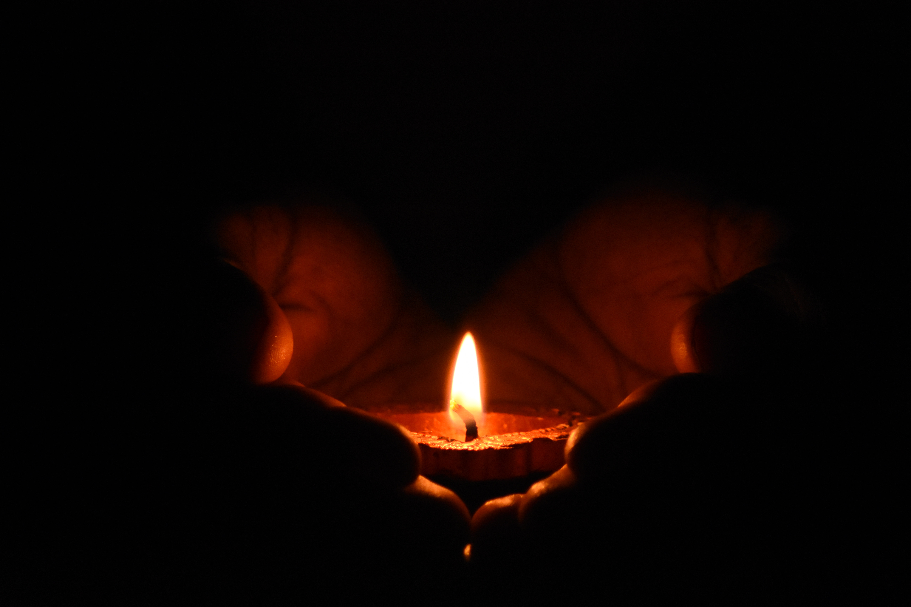
Lights In A Dark World
Shining as sons and daughters

Slide 2
Matthew 5:13-16
You are the salt of the earth, but if salt has lost its taste, how shall its saltiness be restored? It is no longer good for anything except to be thrown out and trampled under people’s feet. You are the light of the world. A city set on a hill cannot be hidden. Nor do people light a lamp and put it under a basket, but on a stand, and it gives light to all in the house. In the same way, let your light shine before others, so that they may see your good works and give glory to your Father who is in heaven.

Slide 3
Opening thoughts
The attitude of younger generations toward older is deteriorating. Seen in behavior and words. Relationship of children to parents has not been spared.
God is deeply concerned with how children treat their parents and not just while the child is under their roof.
*Saints can shine the light of Christ very brightly in this area.

Slide 4
Shining as a young child (Exodus 20:12)
Honor your father and mother, that your days may be long in the land that the Lord your God is giving you.

Slide 5
Shining as a young child (Exodus 20:12)
Obedience and honor go hand in hand. (Ephesians 6:1-3)
Children, obey your parents in the Lord, for this is right. “Honor your father and mother” (this is the first commandment with a promise), “that it may go well with you and that you may live long in the land.”

Slide 6
Shining as a young child (Exodus 20:12)
Obedience and honor go hand in hand. (Ephesians 6:1-3)
*In a sense, parents equal God to their young children. (Leviticus 19:2-3)
Speak to all the congregation of the people of Israel and say to them, “You shall be holy, for I the Lord your God am holy. Every one of you shall revere his mother and his father, and you shall keep my Sabbaths: I am the Lord your God.”

Slide 7
Shining as a young child (Exodus 20:12)
Obedience and honor go hand in hand. (Ephesians 6:1-3)
*In a sense, parents equal God to their young children. (Leviticus 19:2-3)
>This is where children first learn obedience, honor, and reverence. God intends these habits begin very young. (1 Timothy 5:1-2)
Do not rebuke an older man but encourage him as you would a father, younger men as brothers, older women as mothers, younger women as sisters, in all purity.

Slide 8
Shining as a young child (Exodus 20:12)
Obedience and honor go hand in hand. (Ephesians 6:1-3)
*But what if I don’t want to obey my parents? Hear God. (2 Timothy 3:1-5)
Honoring and obeying parents is God’s expectation and delight. It also lays the groundwork for the child’s relationship with God as they age.

Slide 9
Shining as an adult child (Proverbs 23:25)
Let your father and mother be glad; let her who bore you rejoice.

Slide 10
The honor of a child to a parent must increase as the years pass. Why?
Increased recognition of the sacrifices their parents made for them over the years.
*Should result in a loving and grateful desire to reciprocate. (1 Timothy 5:3-4)
Honor widows who are truly widows. But if a widow has children or grandchildren, let them first learn to show godliness to their own household and to make some return to their parents, for this is pleasing in the sight of God.

Slide 11
The honor of a child to a parent must increase as the years pass. Why?
Refusing to honor parents is a grave sin in the eyes of God.
But if anyone does not provide for his relatives, and especially for members of his own household, he has denied the faith and is worse than an unbeliever. (1 Timothy 5:8) There are those who curse their fathers and do not bless their mothers. There are those who are clean in their own eyes but are not washed of their filth. (Proverbs 30:11-12) Whoever robs his father or mother and says, “That is no transgression,” is companion to a man who destroys. (28:24)

Slide 12
The honor of a child to a parent must increase as the years pass. Why?
Refusing to honor parents is a grave sin in the eyes of God.
If one curses his father or his mother, his lamp will be put out in utter darkness. (20:20) He who does violence to his father and chases away his mother is a son who brings shame and reproach. (19:26) “Cursed be anyone who dishonors his father or his mother.” And all the people shall say, “Amen.” (Deuteronomy 27:16) You shall not mistreat any widow or fatherless child. If you do mistreat them, and they cry out to me, I will surely hear their cry. (Exodus 22:22-23)

Slide 13
The honor of a child to a parent must increase as the years pass. Why?
Refusing to honor parents is a grave sin in the eyes of God.
Behold, the princes of Israel in you, every one according to his power, have been bent on shedding blood. Father and mother are treated with contempt in you; the sojourner suffers extortion in your midst, the fatherless and the widow are wronged in you. You have despised my holy things and profaned my Sabbaths. (Ezekiel 22:6-8)

Slide 14
The honor of a child to a parent must increase as the years pass. Why?
The child’s honor toward God has increased over the years. (2 Peter 3:17-18)
You, therefore, beloved, knowing this beforehand, take care that you are not carried away with the error of lawless people and lose your own stability. But grow in the grace and knowledge of the Lord and Savior Jesus Christ. To him be the glory both now and to day of eternity. Amen.

Slide 15
Lights In A Dark World
Shining as sons and daughters

