Slide 1
APOLOGETICS
BEING READY TO GIVE A DEFENSE

Slide 2
1 Peter 3:15
but in your hearts honor Christ the Lord as holy, always being prepared to make a defense to anyone who asks you for a reason for the hope that is in you; yet do it with gentleness and respect…

Slide 3
“Men became scientific because they expected law in nature, and they expected law in nature because they believed in the Law Giver.”
-Alfred North Whitehead

Slide 4
“The question of whether there exists a supernatural creator, a God, is one of the most important that we have to answer. I think that it is a scientific question. My answer is no.”
-Richard Dawkins

Slide 5
God is the source of man’s greatest need: salvation.
Ephesians 2:8
For by grace you have been saved through faith. And this is not your own doing;
it is the gift of God,

Slide 6
The Evidence
Universal Morality
the argument for individual morality (relativism), is self-defeating.
All cultures generally uphold certain values (honesty, integrity, faithfulness, fairness, kindness…)
We were created in the image of the standard of perfect morality (Gen 1:27; Ex. 34:6-7; 1 Jn. 4:8; Matt. 7:12)

Slide 7
The Evidence
2. Something can’t come from nothing
Psalm 19:1-4
¹ The heavens declare the glory of God, and the sky above proclaims his handiwork. ² Day to day pours out speech, and night to night reveals knowledge. ³ There is no speech, nor are there words, whose voice is not heard. ⁴ Their voice goes out through all the earth, and their words to the end of the world.

Slide 8
The Evidence
2. Something can’t come from nothing
Genesis 1:1
In the beginning, God created the heavens and the earth.

Slide 9
The Evidence
2. Something can’t come from nothing
Hebrews 11:3
By faith we understand that the universe was created by the word of God, so that what is seen was not made out of things that are visible.

Slide 10
The Evidence
2. Something can’t come from nothing
Acts 17:23-24
For as I passed along and observed the objects of your worship, I found also an altar with this inscription: ‘To the unknown god.’ What therefore you worship as unknown, this I proclaim to you. The God who made the world and everything in it, being Lord of heaven and earth

Slide 11
The Evidence
3. Purpose and Design
Romans 1:19-20
For what can be known about God is plain to them, because God has shown it to them. For his invisible attributes, namely, his eternal power and divine nature, have been clearly perceived, ever since the creation of the world, in the things that have been made.

Slide 12
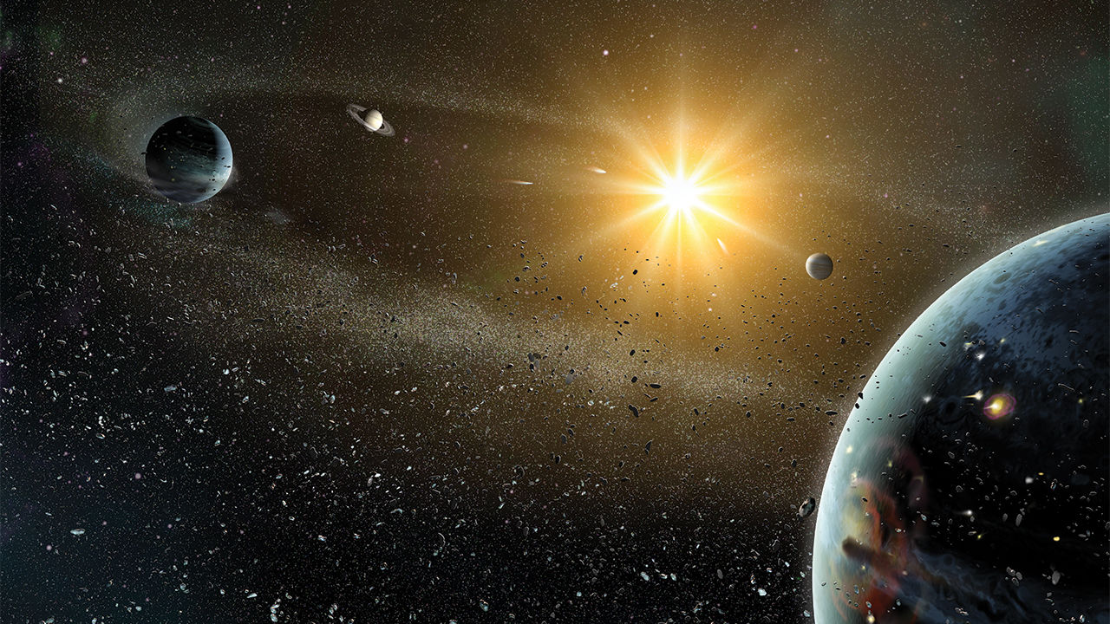
sciencemag.org

Slide 13
The Evidence
3. Purpose and Design
Colossians 1:16
For by him all things were created, in heaven and on earth, visible and invisible, whether thrones or dominions or rulers or authorities—all things were created through him and for him.

Slide 14
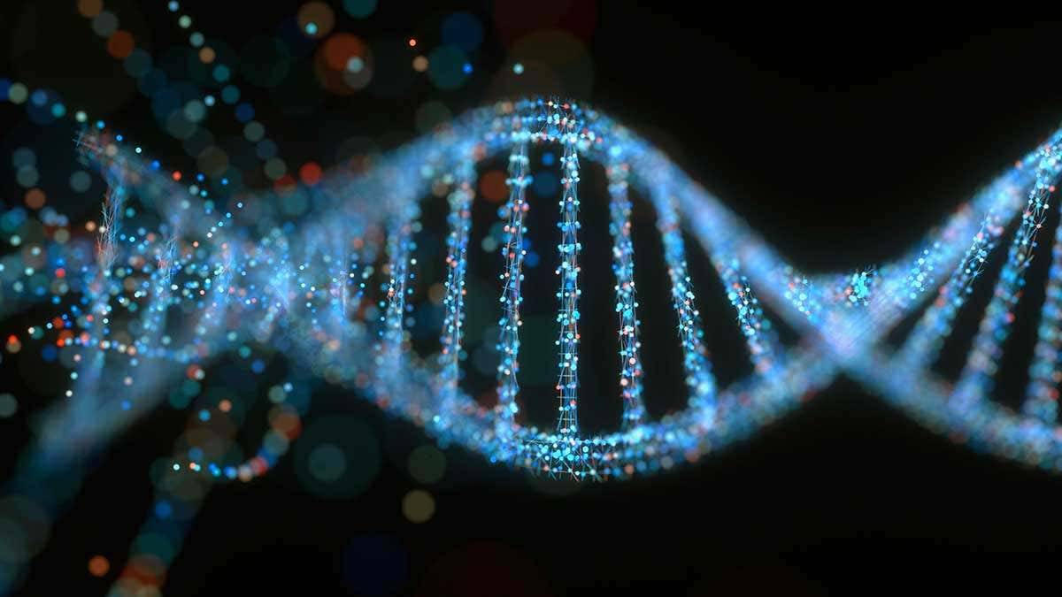
newscientist.com

Slide 15
Mark 16:16
Whoever believes and is baptized will be saved, but whoever does not believe will be condemned.

Slide 16
APOLOGETICS
BEING READY TO GIVE A DEFENSE

