Slide 2
Mark 4:35-41
Page 839 in pew Bible

Slide 3
Mark 4:35-36
³⁵ On that day, when evening had come, he said to them, “Let us go across to the other side.” ³⁶ And leaving the crowd, they took him with them in the boat, just as he was. And other boats were with him.

Slide 4
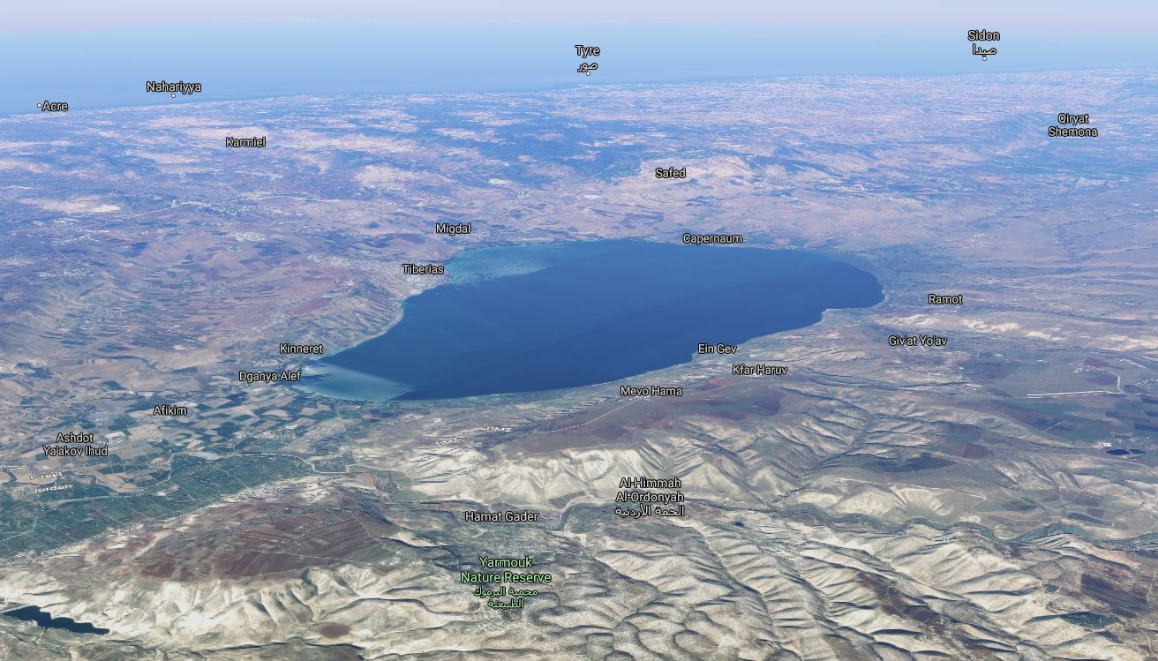
Google Maps

Slide 5
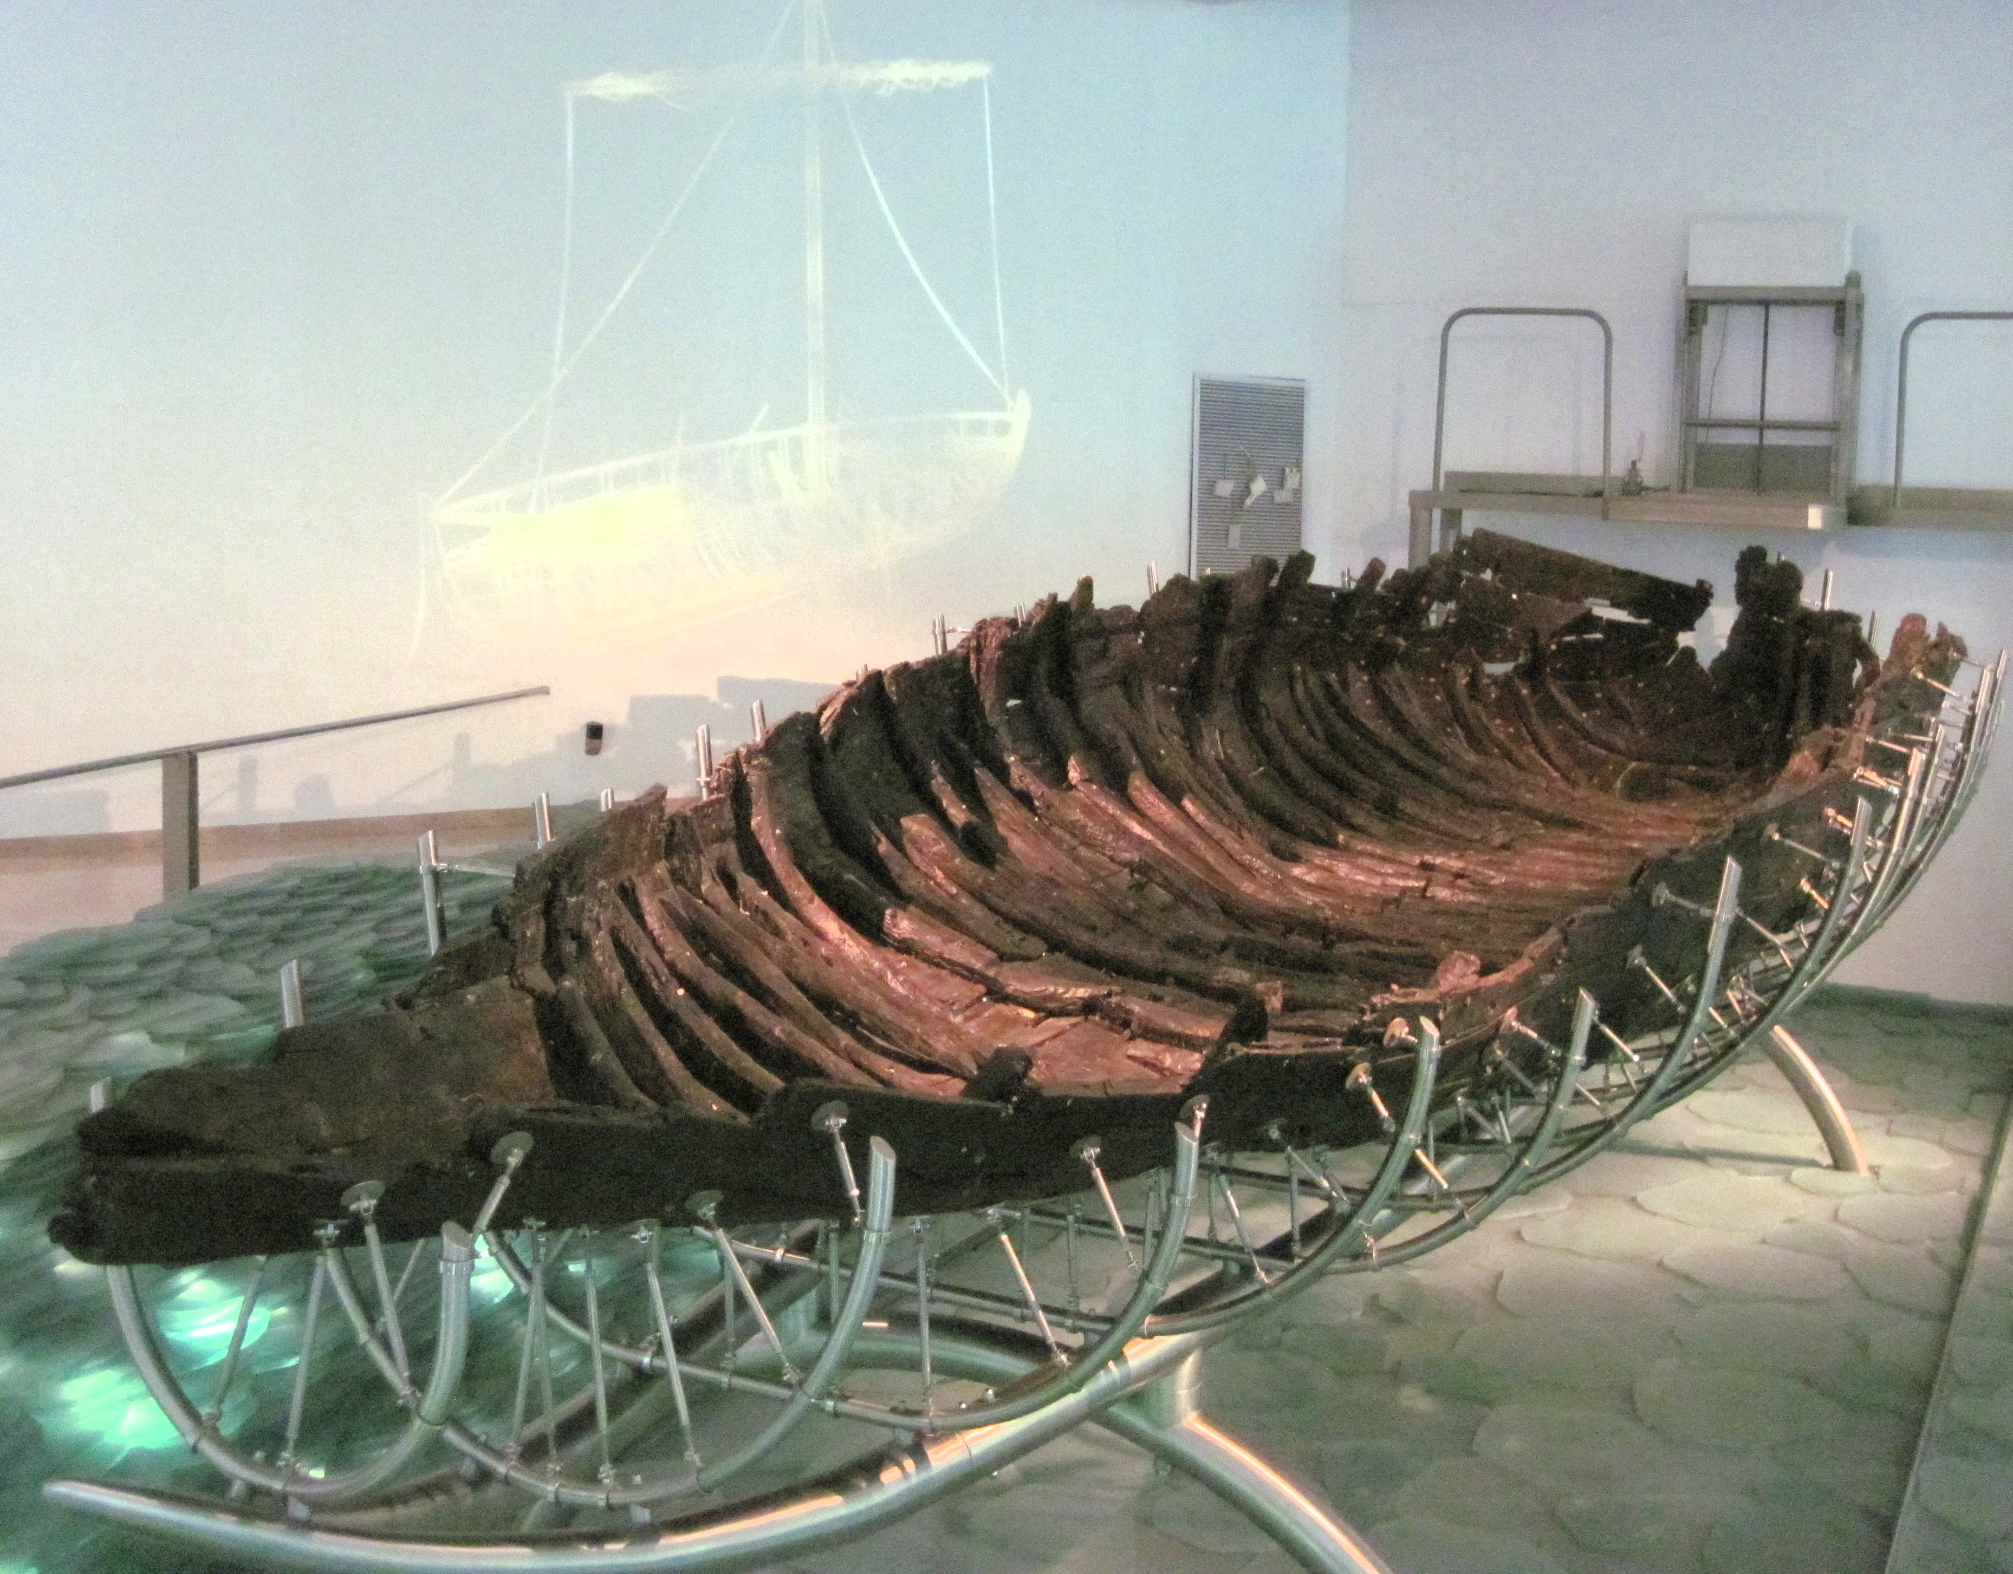

Slide 6
Mark 4:37
³⁷ And a great windstorm arose, and the waves were breaking into the boat, so that the boat was already filling.

Slide 7
Mark 4:37-38
³⁷ And a great windstorm arose, and the waves were breaking into the boat, so that the boat was already filling.
³⁸ But he was in the stern, asleep on the cushion.

Slide 8
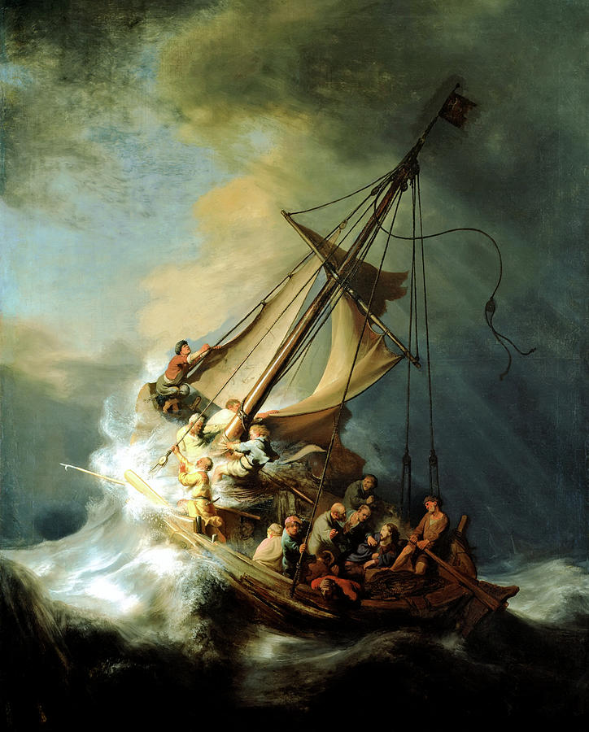

Slide 9
Even in the midst of your storm,
JESUS CARES
Keep your eye on what He’s done for us in the past and never for get His promises about the future (Rom. 5:8; 1 Pet. 1:3-5).

Slide 10
Mark 4:39
³⁹ And he awoke and rebuked the wind and said to the sea, “Peace! Be still!” And the wind ceased, and there was a great calm.

Slide 11
Mark 4:40-41
⁴⁰ He said to them, “Why are you so afraid? Have you still no faith?” ⁴¹ And they were filled with great fear and said to one another, “Who then is this, that even the wind and the sea obey him?”

Slide 12
Who is Jesus?
Psalm 89:8-9
⁸ O Lord God of hosts,
who is mighty as you are, O Lord,
with your faithfulness all around you?
⁹ You rule the raging of the sea;
when its waves rise, you still them.

Slide 13
Who is Jesus?
Psalm 65:5-8
⁵ By awesome deeds you answer us with righteousness,
O God of our salvation,
the hope of all the ends of the earth
and of the farthest seas;
⁶ the one who by his strength established the mountains,
being girded with might;

Slide 14
Who is Jesus?
Psalm 65:5-8
⁷ who stills the roaring of the seas,
the roaring of their waves,
the tumult of the peoples,
⁸ so that those who dwell at the ends of the earth are in awe at your signs. You make the going out of the morning and the evening to shout for joy.

Slide 15
Who is Jesus?
Isaiah 51:9-10
⁹ Awake, awake, put on strength,
O arm of the Lord;
awake, as in days of old,
the generations of long ago.
Was it not you who cut Rahab in pieces,
who pierced the dragon?

Slide 16
Who is Jesus?
Isaiah 51:9-10
¹⁰ Was it not you who dried up the sea,
the waters of the great deep,
who made the depths of the sea a way
for the redeemed to pass over?

Slide 17
Who is Jesus?
The God of Salvation

Slide 18
Fear is the natural response to being in the presence of God.
Isa. 6:5; Ezk. 1:28; Rev. 1:17

Slide 19
Do you see Jesus for who He truly is?

