Slide 2
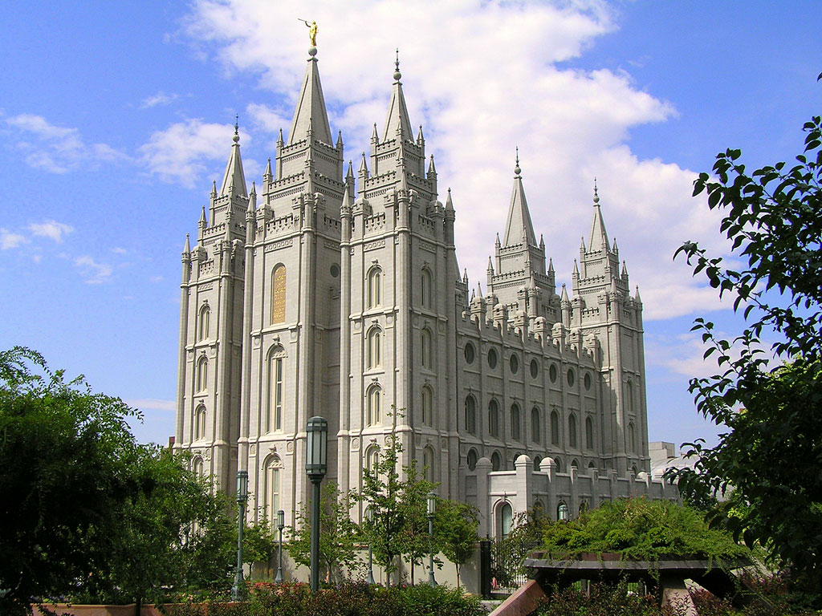

Slide 3
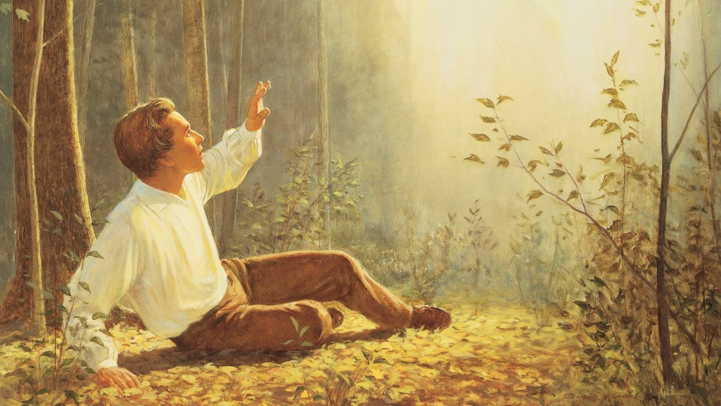

Slide 4
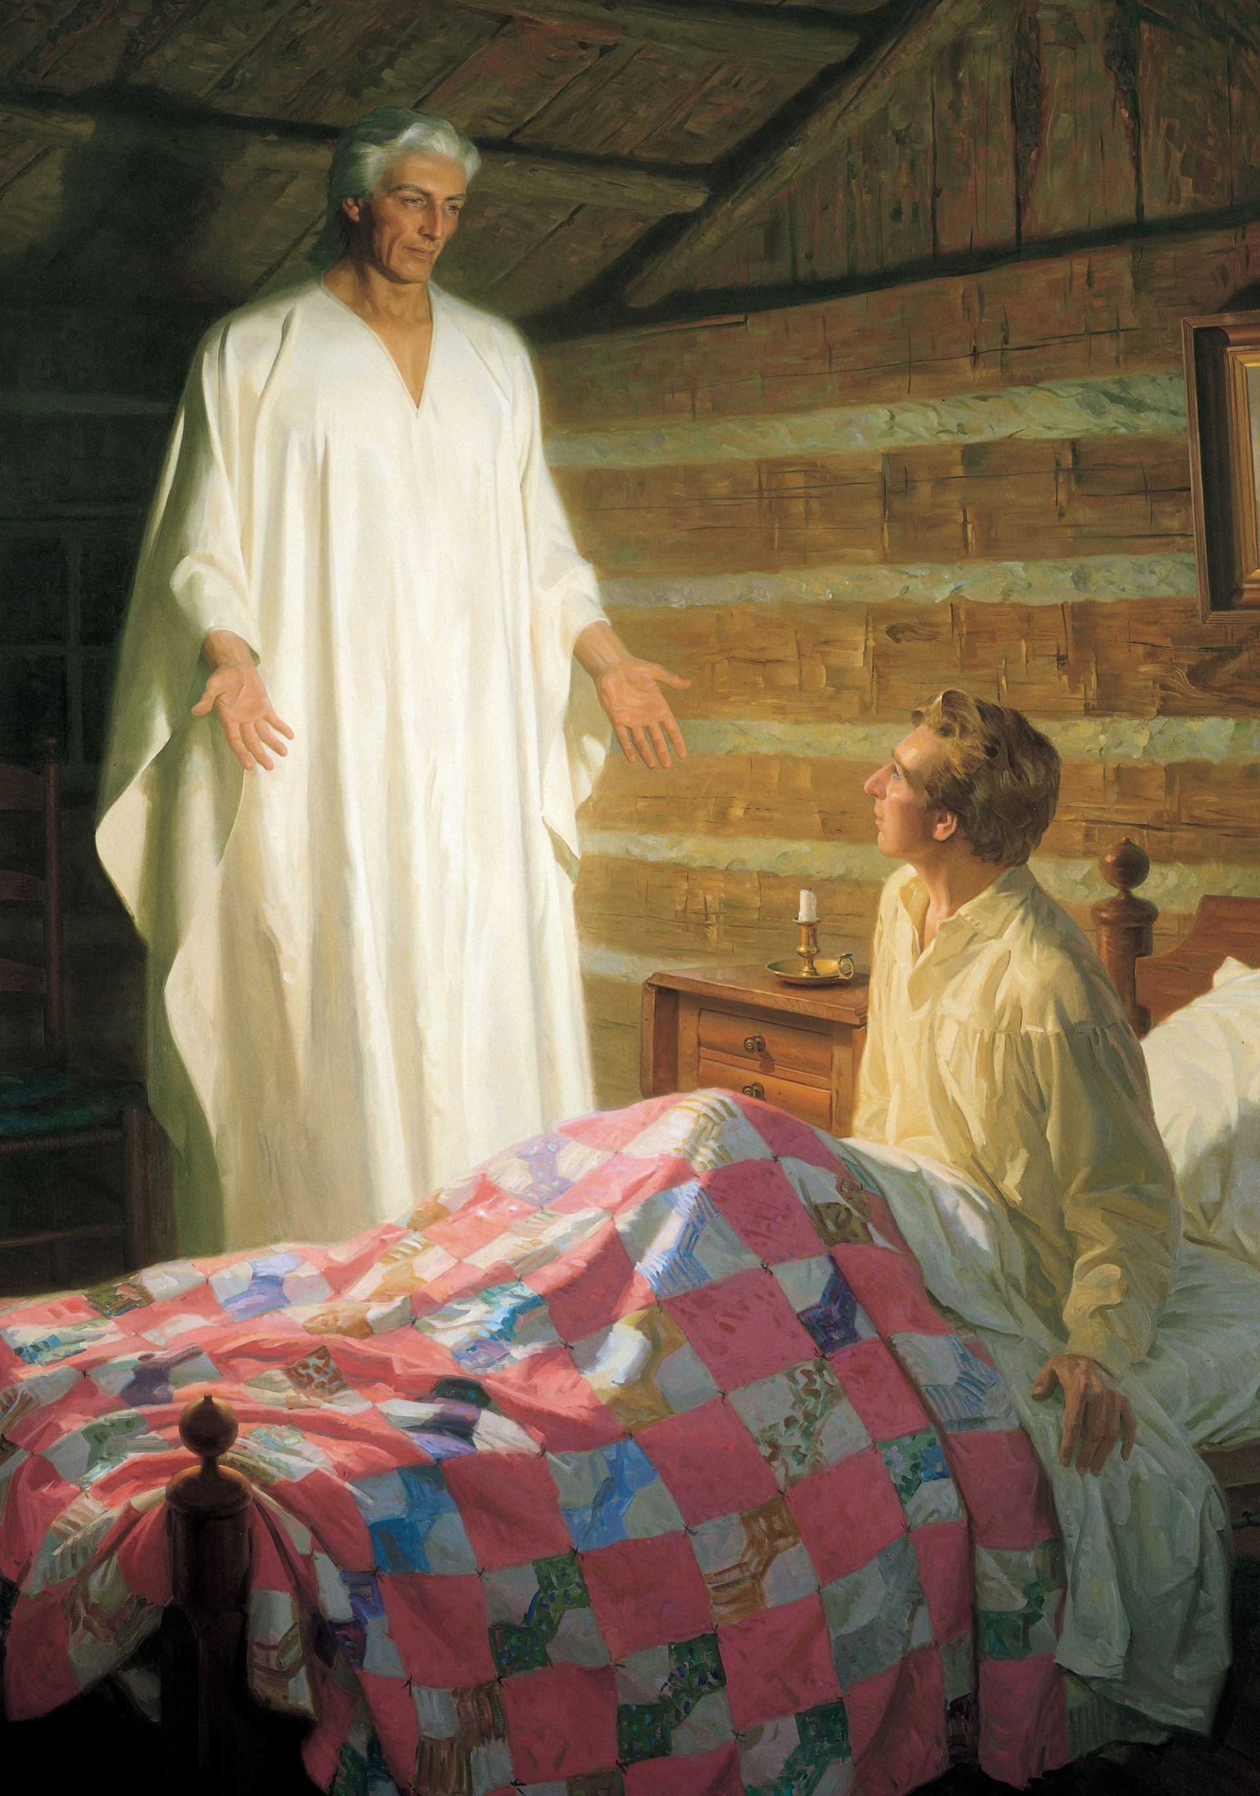

Slide 5
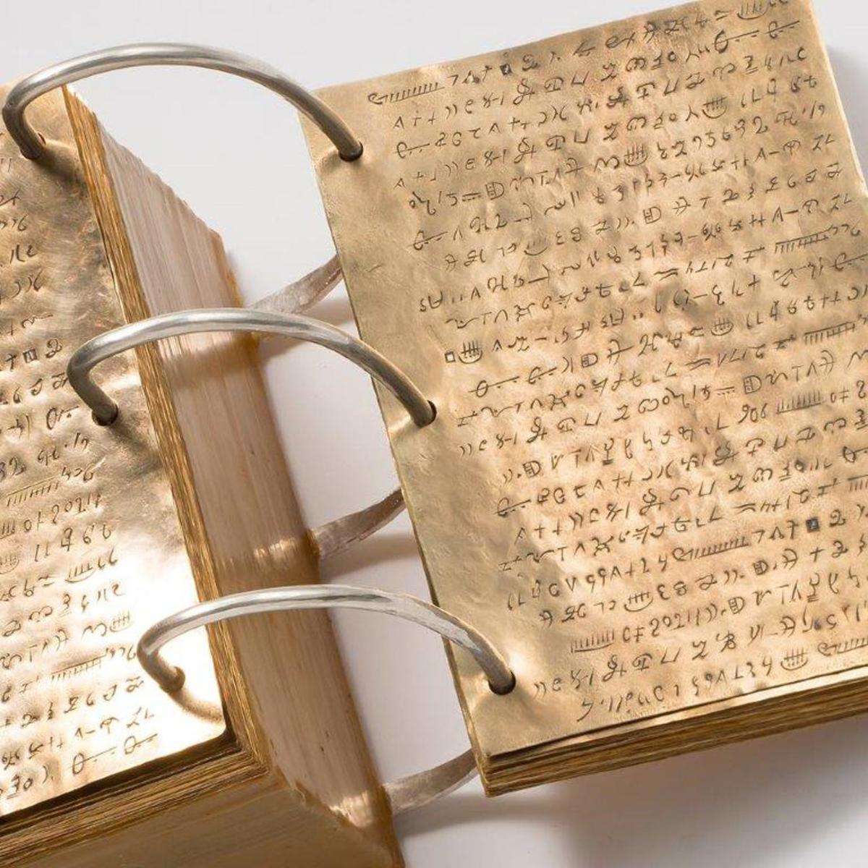
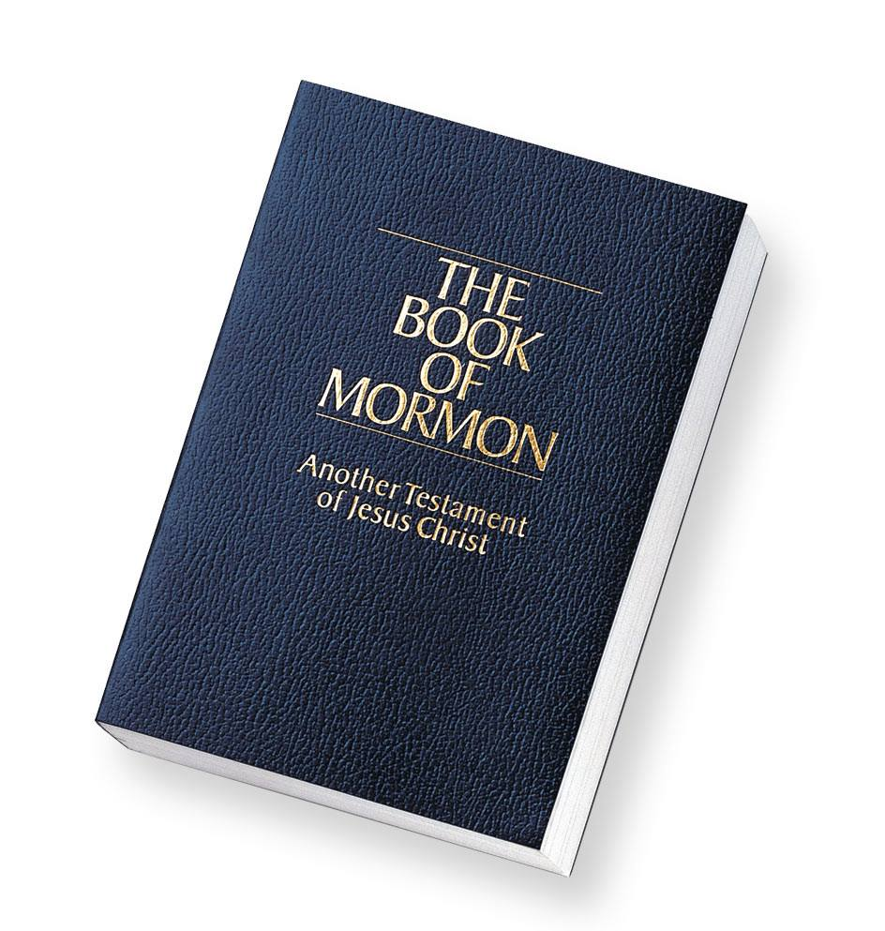

Slide 6
Five Authoritative Sources of the Mormon Church
Book of Mormon: Another Testament of Jesus Christ
Doctrine & Covenants
Pearl of Great Price
Holy Bible*
Living apostles and president

Slide 7
Same Names, Different Meaning
Bible
Christian View: Unadulterated Word of God that has been preserved through the ages.
LDS View: The unadulterated word of God that has been revealed by Joseph Smith (JST)

Slide 8
Same Names, Different Meaning
God the Father
Christian View: He is the only God; He is eternal and the Creator
LDS View: God is not eternal, not the Creator, and not the only God

Slide 9
“God himself was once as we are now, and is an exalted man and sits enthroned in yonder heavens!...I say, if you were to see him today, you would see him like a man in form-like yourselves in all the person, image, and very form as a man…We have imagined and supposed that God was God from all eternity. I will refute that idea, and take away the veil so that you may see…He was once a man like us; yea, that God himself, the Father of us all, dwelt on an earth, the same as Jesus Christ himself did…”
Joseph Smith
The King Follet Sermon, April 7, 1844

Slide 10
Isaiah 43:10
…before me no god was formed nor shall there be any after me.
Psalm 90:2
Before the mountains were brought forth,
or ever you had formed the earth and the world,
from everlasting to everlasting you are God.

Slide 11
Same Names, Different Meaning
Jesus Christ
Christian View: Always existed as God (Jn. 1:1-5; 8:58); Came to earth a Deity in the flesh to redeem mankind.
LDS View: Jesus is not eternal, came to earth not as God, but to become a god.

Slide 12
“In bearing testimony of Jesus Christ, President Hinkley spoke of those out the Chuch who say Latter-day Saints ‘do no believe in the traditional Christ.’ No, I don’t. The traditional Christ of whom they speak is not the Christ of whom I speak. For the Christ of whom I speak has been revealed in this the Dispensation of the Fullness of Times. He together with His Father, appeared to the boy Joseph Smith in the year 1820, and when Joseph left the grove that day, he knew more of the nature of God than all the learned ministers of the gospel of the ages.’”
LDS Church News Week
ending June 20, 1997, p. 7

Slide 13
Same Names, Different Meaning
The Afterlife
Christian View: All mankind will receive what is due him (2 Cor. 5:10); two destinations: heaven or hell
LDS View: Nearly universal salvation; apostate Mormons will be sent to outer darkness, others will go to one of three levels of heaven

Slide 15
Mormonism’s Faulty Foundation
Reputation of Joseph Smith
Polygamist (taught it was acceptable to God)
False revelations (e.g. – inhabitants of the moon and The Book of Abraham)
Modified Teachings
E.g. – the renouncement of polygamy on 1890; the acceptance of African Americans as “priests” in 1978.

Slide 16
Mormonism’s Faulty Foundation
The Witnesses
Mormonism claims 8 men witnessed the golden plates.
Unlike those who were witness to the resurrected Christ (most who died as martyrs), the Mormon witnesses were expelled from/renounced the Mormon faith.

Slide 17
Our Response
Be Patient and Compassionate (Matt. 9:36; Col. 3:12)
They are genuine, but misguided
What if we were in their shoes?
Encourage them to investigate the facts of their religion (1 Jn. 4:1; )
Pray (Rom. 10:1; 1 Tim. 2:1-4; Eph. 3:20)
Share with them the true gospel of Jesus Christ (Rom. 1:16-17; Eph. 2:8)

