Slide 2
Marriage
The coming together of a man and woman for the purpose of living together as husband and wife.

Slide 3
The Bond of Marriage
“What God has joined together…” (Matt. 19:6; cf. Mal. 2:3)
The law which unites a husband and wife (one mate for life)
Gen. 2:24; Matt. 19: 3; Rom. 7:2
Other than a couple of God ordained exceptions, the bond CANNOT be broken.

Slide 4
The Main Point of Romans 7
Jews were no longer under obligation (bound) to the law of Moses because a spiritual death had occurred (cf. Rom. 6:1-8).
That death allowed them to “belong to [Christ]” (Rom. 7:4)

Slide 5
Romans 7:1-3
¹ Or do you not know, brothers—for I am speaking to those who know the law—that the law is binding on a person only as long as he lives? ² For a married woman is bound by law to her husband while he lives, but if her husband dies she is released from the law of marriage. ³ Accordingly, she will be called an adulteress if she lives with another man while her husband is alive. But if her husband dies, she is free from that law, and if she marries another man she is not an adulteress.

Slide 6
Marriage Lessons From Rom. 7
Someone can be married to one, but bound to another (Rom. 7:3; Mk. 6:14-29)

Slide 7
Mark 6:16-18
¹⁶ But when Herod heard of it [the name of Jesus], he said, “John, whom I beheaded, has been raised.” ¹⁷ For it was Herod who had sent and seized John and bound him in prison for the sake of Herodias, his brother Philip's wife, because he had married her. ¹⁸ For John had been saying to Herod, “It is not lawful for you to have your brother's wife.”

Slide 8
Marriage Lessons From Rom. 7
Someone can be married to one, but bound to another (Rom. 7:3; Mk. 6:14-29)
God only breaks the bond when one spouse passes (Rom. 7:3)
ONE exception: divorce for the cause of sexual immorality (the physical act of adultery; Matt. 5:32; 19:9)
It is possible to live in adultery (Rom. 7:3)
A result of being married to one but bound to another.

Slide 10
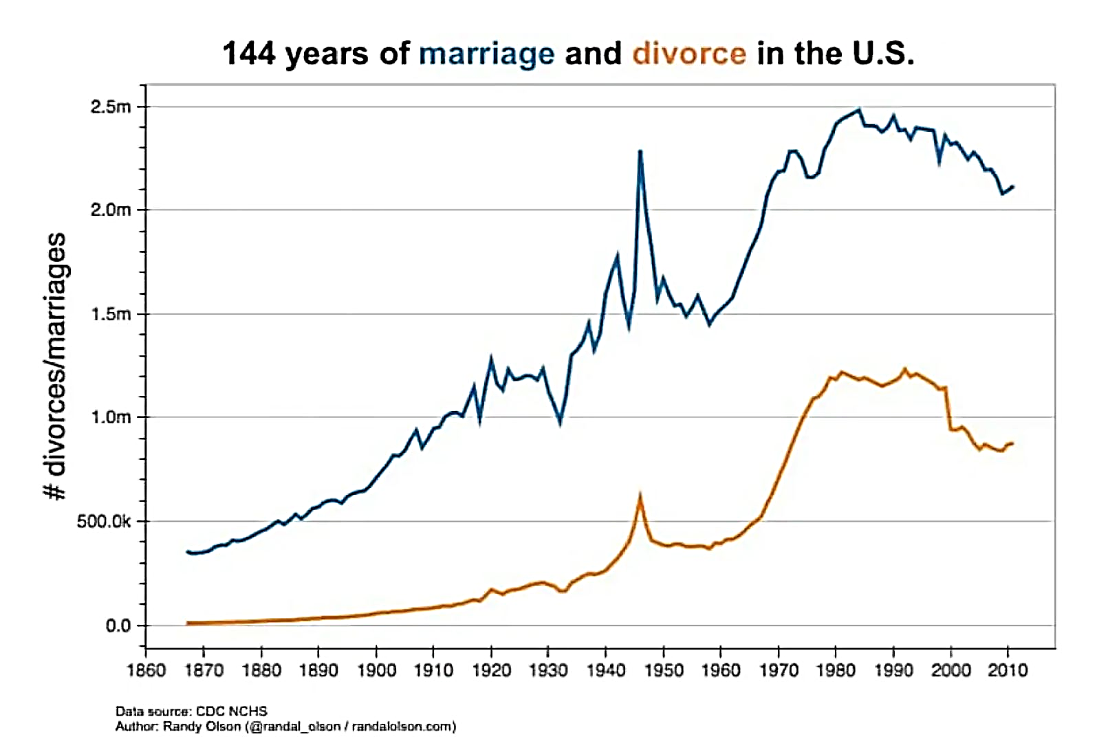

Slide 11
bound
ROMANS 7:1-3

Slide 12
bound

