Slide 2
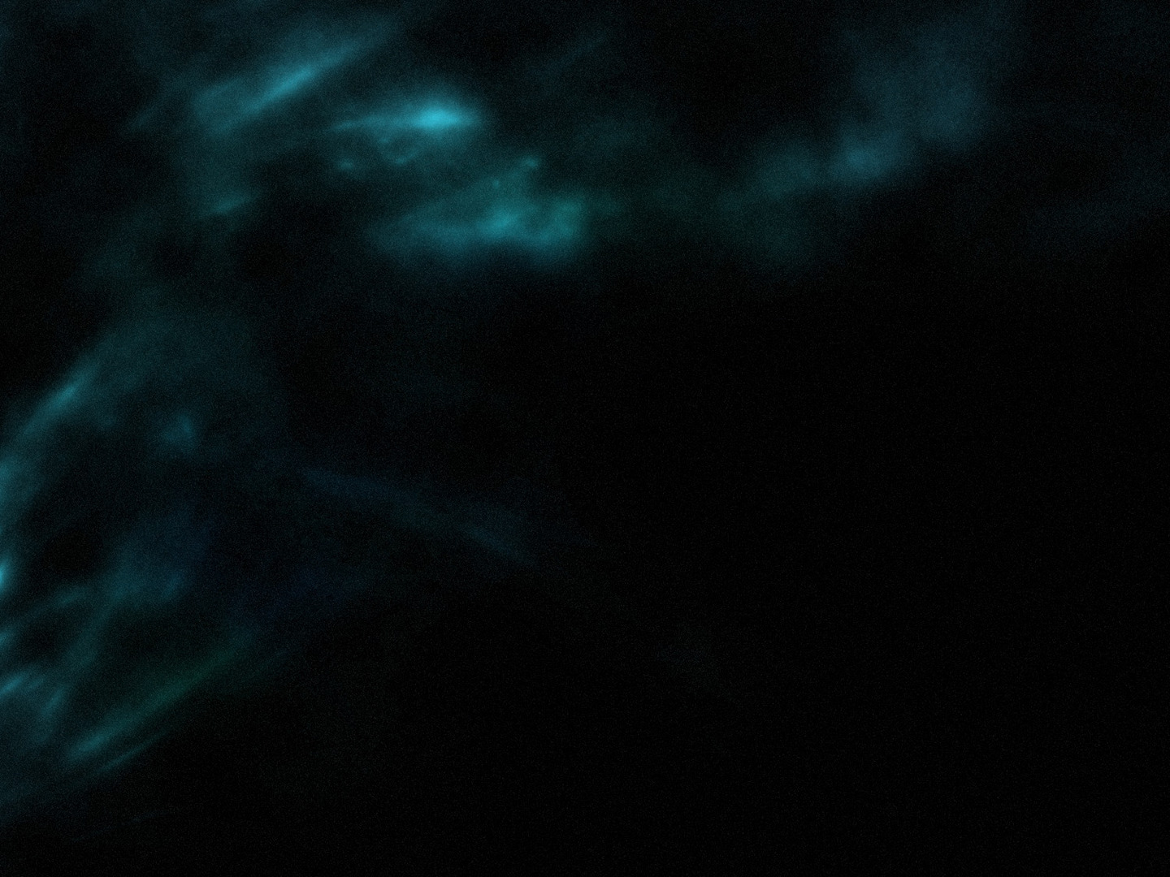
Romans 1-11
The basis for our salvation and the blessings associated with it.
Romans 12-16
The practical application of
chapters 1-11.

Slide 3
Sacrificial Lives (v. 1)
Mercies of God = all the blessings of chapters 1-11
Total devotion to Him (2 Cor. 5:14)
Living sacrifice
Physically (as compared to dead sacrifices under the Mosaic law)?
Spiritually (see Rom. 6:12-14)?
Holy Sacrifice
Without blemish (Lev. 1, 5-6; 1 Pet. 1:15-16)
Sacrificial living is completely reasonable in light of the mercies of God

Slide 4
Transformed Lives (v. 2)
Don’t live like the world (1 Jn. 2:15)
Consider Christians mentioned in Acts
Transform our thinking (Col. 3:2; Phil. 2:8; Pr. 23:7)
Fill our minds with the mind of God (see Eph. 5:18 and Col. 3:16)
Allows us to know the will of God (Ps. 119:11, 105)

Slide 5
Humble Lives (v. 3-6)
The mercies of God remind us that there is no room for pride (Js. 4:6; 1 Pet. 5:5)
Humility is to be seen within the body of Christ
Our gifts should complement, not compete with one another

