Slide 2
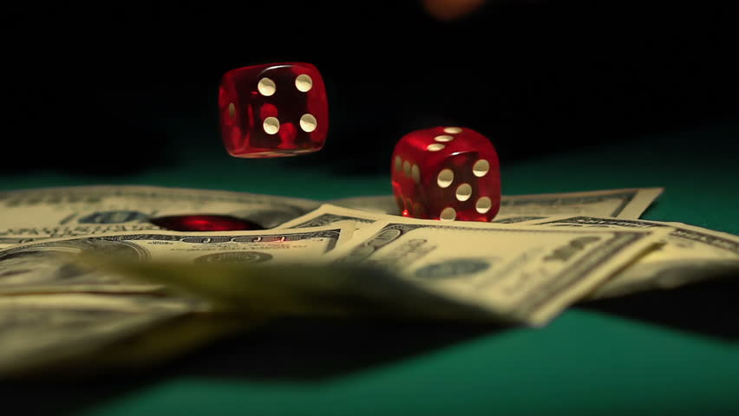
What is Gambling?
More than simply taking a risk.

Slide 3
What is Gambling?
Risking what’s yours on a chance event in an effort to profit from the loss of another.

Slide 4
“Gambling” is found nowhere in Scripture, but there are many principles that address it.

Slide 5
Gambling From a Biblical Perspective
Lack of Contentment
1 Tim. 6:6-12; Phil. 4:11-13

Slide 6
Gambling From a Biblical Perspective
Covetousness
Lk. 12:15; Eph. 5:2-5

Slide 7
Gambling From a Biblical Perspective
Poor Stewardship
Matt. 25:14-30; Pr. 3:9; Ps. 24:1

Slide 8
Powerball Jackpot: 1 in 292,201,338
Mega Millions Jackpot:
1 in 302,575, 350

Slide 9
Gambling From a Biblical Perspective
Addictive in Nature
1 Cor. 6:12; Titus 2:11-12; 1 Jn. 2:16

Slide 10
Gambling From a Biblical Perspective
Don’t for get about your influence!
1 Cor. 8:1-13

Slide 11
Gambling From a Biblical Perspective
A Lack of Love
Matt. 7:12; 22:29; 1 Cor. 10:24

