Slide 2
T – Total Hereditary Depravity
U – Unconditional Election
L – Limited Atonement
I – Irresistible Grace
P – Perservereance of the Saints

Slide 3
Total Hereditary Depravity
All mankind is born in sin and is unable to do any good on his own.
Compare to Eccl. 7:29; Ps. 106:38; Matt. 19:14; 1 Cor. 14:20

Slide 4
Unconditional Election
God’s arbitrary choosing of certain individuals to be saved, and others lost.
Compare to 1 Tim. 2:4; Titus 2:11; 2 Pet. 3:9; Rom. 2:11; 1 Cor. 9:19; 2 Cor. 5:10; 1 Pet. 1:17, 22

Slide 5
“The rest of mankind God was pleased, according to the unsearchable counsel of his own will…to pass by, and to ordain them to dishonor and wrath for their sin, to the praise of his glorious justice.
- The 1647 Westminster Confession of Faith, Chapter 3: Of God’s Eternal Decree

Slide 6
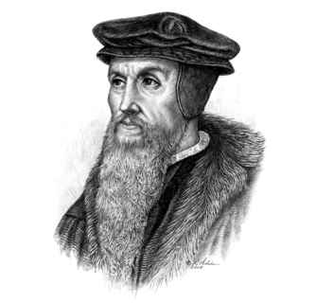
“By predestination we mean the eternal decree of God, by which He determined with Himself whatever He wished to happen with regard to every man. All are not created on equal terms, but some are preordained to eternal life, others to eternal damnation; and, accordingly, as each has been created for one or other of those ends, we say that he has been predestined to life or death…”
-John Calvin, Institutes of the Christian Religion, tran. Henry Beveridge (Grand Rapids: Christian Classics Ethereal Library, 2002), sec. 5, 1030-1031.

Slide 7
Acts 10:34-35
Truly I understand that God shows no partiality, but in every nation anyone who fears him and does what is right is acceptable to him.

Slide 8
Choosing God is not
works-based salvation
Acts 2:38; 10:34-35; Josh. 24:15-16; Jn. 7:17

Slide 9
Limited Atonement
Christ died only for those chosen for eternal life.
Compare to 2 Cor. 5:14; 1 Tim. 2:6; Heb. 2:9; 1 Jn. 2:2; Jn. 3:16

Slide 10
Irresistible Grace
The Holy Spirit draws God’s elect to Him, regardless of their desire.
Compare to 2 Thess. 2:14; 1 Pet. 1:23; Acts 7:51; 1 Thess. 5:19; Gal. 2:21

Slide 11
Perservereance of the Saints
Impossible for God’s elect to fall away (“once saved always saved”)
Compare to 1 Cor. 9:27; 10:12; Gal. 5:4; Heb. 3:12; 1 Tim. 4:1; 2 Pet. 2:20-21

Slide 12
“The Bible clearly teaches that God's love for His people is of such magnitude that even those who walk away from the faith (emp. mine) have not the slightest chance of slipping from His hand.”
- Charles Stanley, Eternal Security: Can You Be Sure?, 74

Slide 13
1 Corinthians 10:1-5
For I do not want you to be unaware, brothers, that our fathers were all under the cloud, and all passed through the sea, and all were baptized into Moses in the cloud and in the sea, and all ate the same spiritual food, and all drank the same spiritual drink. For they drank from the spiritual Rock that followed them, and the Rock was Christ. Nevertheless, with most of them God was not pleased, for they were overthrown in the wilderness.

Slide 14
God is love and He desires all to be saved.
1 Jn. 4:8; 1 Tim. 2:3-4; 2 Pet. 3:9; Ezek. 18:31-32; 33:11; Hos. 3:1; Jn. 3:16; Rom. 10:21

Slide 15
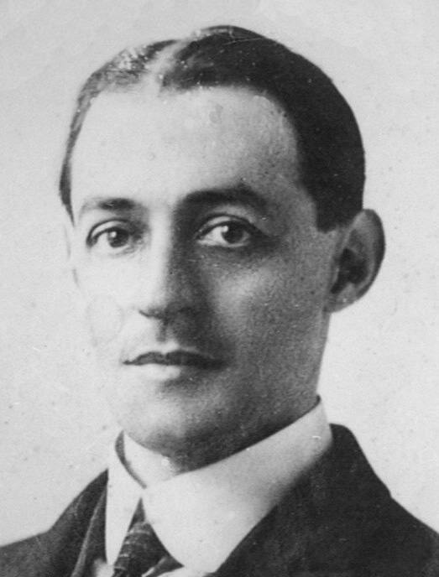
“One of the most popular beliefs of the day is that God loves everybody, and the very fact that it is so popular with all classes ought to be enough to arouse the suspicions… That God loves everybody, is, we may say, quite a modern belief… With the exception of John 3:16, not once in the four Gospels do we read of the Lord Jesus, the perfect Teacher, telling sinners that God loved them…”
- A.W. Pink, The Sovereignty of God

Slide 16
“When we say that God is Sovereign in the exercise of His love, we mean that He loves whom He chooses. God does not love everybody”
- A.W. Pink, The Sovereignty of God

Slide 17
2 Peter 3:9
The Lord is not slow to fulfill his promise as some count slowness, but is patient toward you, not wishing that any should perish, but that all should reach repentance.

